Slide 1
Building Tier 2/3 Creating a Seamless System of Support

Slide 2
Training Behavioral Expectations
EXPECTATION | TRAINING SITE
BE RESPONSIBLE | Make yourself comfortable & take care of your needs Address question/activity in group time before discussing “other” topics Ask questions
BE RESPECTFUL | Turn cell phones, beepers, and pagers “off” or to “vibrate” Contribute where possible Save talking with your neighbor/s until team time.
BE PREPARED | Follow up on tasks for next training day Take (and Pass) notes (use Action Plan throughout day)
Notes:
2
Verbal prompt: Limit/avoid sidebar conversations

Slide 3
Objectives
1. Create a Tier 2/3 System
Tier 2 and Tier 3 System Team
Team members' roles and responsibilities
2. Using Data for decision making and on-going progress monitoring
3. Design a process for effective communication and data sharing between Secondary and Tertiary Team including the use of Secondary data and other referral sources to identify students in need of Tertiary Level Interventions
4. Understand the Tracking Tool and the Systems Response Tool for assessing the building’s system for responding to youth needing tier 2/3 interventions.
Action Plan: Teams will design their Tier 2/3 System

Slide 4
A few notes before we begin…
A way, not THE way
Action Plan at the End of each Activity
Keeper of the information from today

Slide 5
Agenda
8:30-10:00 Secondary Systems introduction and key features
10:00-10:15 Break
10:15-11:00 Secondary Data and Building your Secondary System
11:00-11:30 Exploring Universal Screening
Critical Features of Secondary Interventions
11:30-12:15 Lunch
12:15-12:45 Tertiary Systems Introduction and Key Features
12:45-1:45 Tertiary Tools and Interventions
1:45-2:00 Break
2:00-3:00 Building your Secondary and Tertiary Systems
Notes:
5

Slide 6

Grounding Activity

Slide 7
٭
Positive
Behavior
Support
Social Competence &
Academic Achievement
OUTCOMES
Supporting
Decision
Making
Supporting
Staff Behavior
SYSTEMS
DATA
PRACTICES
Adapted from “What is a systems Approach in school-wide PBS?”OSEP Technical Assistance on Positive Behavioral Interventions and Supports. Accessed at http://www.Pbis.org/schoolwide.htm
Supporting
Student Behavior
Notes:
7
2 types of data: Individual Student outcome data and process data

Slide 8
School-Wide Systems for Student Success: A Response to Intervention (RtI) Model
Academic Systems
Behavioral Systems
Tier 3/Tertiary Interventions 1-5%
Individual students
Assessment-based
High intensity
1-5% Tier 3/Tertiary Interventions
Individual students
Assessment-based
Intense, durable procedures
Tier 2/Secondary Interventions 5-15%
Some students (at-risk)
High efficiency
Rapid response
Small group interventions
Some individualizing
5-15% Tier 2/Secondary Interventions
Some students (at-risk)
High efficiency
Rapid response
Small group interventions
Some individualizing
Tier 1/Universal Interventions 80-90%
All students
Preventive, proactive
80-90% Tier 1/Universal Interventions
All settings, all students
Preventive, proactive
Illinois PBIS Network, Revised May 15, 2008. Adapted from “What is school-wide PBS?” OSEP Technical Assistance Center on Positive Behavioral Interventions and Supports. Accessed at http://pbis.org/schoolwide.htm
Notes:
8
Important points:
Family engagement at all three tiers (ex. Universal: parent volunteers using school reinforcer; Secondary: pushing teams to think about more than just consent but helping parents/families understand and be engaged in the intervention; Tertiary: Families need to be active member on the team
School population (race, free/reduced lunch, urban/rural, large/small buildings) Regardless of student population the percentage breakdowns remain the same. Any behavior that is impacting more than 20% of the student body is a universal issue.
Universal team/all students, Secondary team/small groups/generic problem solving team/Tertiary team/formed for individual student
Discuss importance of mental health, mental wellness

Slide 9
SCHOOL-WIDE
POSITIVE BEHAVIOR
SUPPORT:
What is meant by “layering” interventions?
Tertiary Prevention:
Specialized
Individualized
Systems for Students with High-Risk Behavior
~5%
Secondary Prevention:
Specialized Group
Systems for Students with At-Risk Behavior
~15%
Primary Prevention:
School-/Classroom-
Wide Systems for
All Students,
Staff, & Settings
~80% of Students
Notes:
You can use the all, some, few description for this triangle and also talk about the layering of interventions that this represents.

Slide 10
Success for all Youth
INCLUDING those who are MOST Vulnerable
Culture Change
Seamless System of Support

Slide 11
Effective PBIS = Changing a Culture
- The physical space of the building
- The daily schedule
- The roles of personnel in the building
- hidden talents
- building capacity
- changing roles
Having a global vision
The blending of Initiatives and Interventions
Knowing what the rest of the team is doing
Putting it all on a “MAP” – visual representation

Slide 12
Creating a Seamless System
Belief:
Common understanding and recognition of importance of PBIS and other RTI systems and interventions within the building
Needs:
Show that PBIS is not just wanted but needed at your school; Identify the needs in your building
Passion:
Harnessing individuals that are passionate about the program and want to continue to help build capacity
Willingness to Overcome Roadblocks:
Difficulties will arise—have to keep going! Bring on people and programs that will go the distance

Slide 13

District Level
The Balcony View

Slide 14
District Leadership Team
Team is configured to address district leadership and coordination.
Team is established with representation from appropriate range of stakeholders (special education, general education, families, mental health, administration, etc.).
Team completes self-assessment at least annually.
Team completes a 3-5 year prevention-based action plan.
Team establishes quarterly meeting schedule & meeting process (agenda, minutes, dissemination).
Team has established individuals with adequate & designated time to manage day-to-day operations.
Team has established individuals who put policy & action planning into practice.

Slide 15
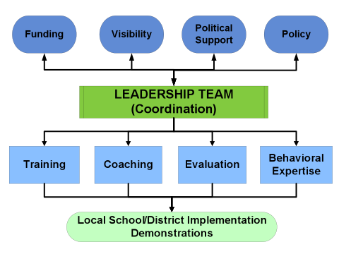
SWPBS Implementers’ Blueprint Elements
OSEP Center on PBIS

Slide 16
At your Table
What is already in place at the district level?
Make up of team
Data
Community Voice
Parent Voice
Student Voice

Slide 17
Positive Behavior Interventions & Supports: A Response to Intervention (RtI) Model
Tier 1/Universal
School-Wide Assessment
School-Wide Prevention Systems
ODRs, Attendance, Tardies, Grades, DIBELS, etc.
Tier 2/ Secondary
Tier 3/
Tertiary
Check-in/ Check-out (CICO)
Assessment
Intervention
Social/Academic Instructional Groups (SAIG)
Daily Progress Report (DPR) (Behavior and Academic Goals)
Group Intervention with Individualized Feature (e.g., Check and Connect -CnC and Mentoring)
Competing Behavior Pathway, Functional Assessment Interview, Scatter Plots, etc.
Brief Functional Behavior Assessment/
Behavior Intervention Planning (FBA/BIP)
Complex or Multiple-domain FBA/BIP
SIMEO Tools: HSC-T, RD-T, EI-T
Illinois PBIS Network, Revised October 2009
Adapted from T. Scott, 2004
Wraparound

Slide 18

ON THE SIDE
How do you distinguish between
Tier 2 and Tier 3?

Slide 19
Activity Blank Triangle What do you already have in place?

Slide 20
School-Wide Systems for Student Success: A Response to Intervention (RtI) Model
Academic Systems
Behavioral Systems
Tier 3/Tertiary Interventions 1-5%
_____________________
_____________________
_____________________
1-5% Tier 3/Tertiary Interventions
___________________________
___________________________
___________________________
Tier 2/Secondary Interventions 5-15%
___________________________
___________________________
___________________________
___________________________
___________________________
___________________________
5-15% Tier 2/Secondary Interventions
____________________________
____________________________
____________________________
____________________________
____________________________
____________________________
Tier 1/Universal Interventions 80-90%
________________________
________________________
________________________
________________________
________________________
________________________
80-90% Tier 1/Universal Interventions
____________________________
____________________________
____________________________
____________________________
____________________________
Illinois PBIS Network, Revised May 15, 2008. Adapted from “What is school-wide PBS?” OSEP Technical Assistance Center on Positive Behavioral Interventions and Supports. Accessed at http://pbis.org/school-wide.htm
Notes:
This is a startup activity...do to plan to finish
Add levels of support, not replace or supplement
Purpose of tier one-prevent new problem behaviors from occurring-tier two reduce the frequency of problem behaviors-tier three reduce the intensity of problem behaviors
Model measures ODRs, does not take into account internalizes

Slide 21

Let’s Talk NUMBERS
7-15%: Percent of total population expected to need and be supported by Tier 2 interventions
1-5%: Percent of total population expected to need and be supported by Tier 3 interventions
70%: Percent of youth (receiving intervention “X”) that should be responding to intervention

Slide 22
ACTIVITY What are we REALLY talking about?
1) What is your total building population?
2) What would 5% of your building population be? What would 15% be? Consider these two numbers for a range of students who should be receiving Secondary Interventions
3) What would 1% of your building population be? 5%? Consider these two numbers for a range of students who should be receiving Tertiary Interventions.
4) Using these calculations, what are the potential number of students your building could be serving at each Tier 2 and Tier 3 intervention?
5) What are some steps your building can take to prepare to serve these students?

Slide 23

NECESSARY CONVERSATIONS

Slide 24
3-Tiered System of Support
Necessary Conversations (Teams)
Universal Team
Secondary Systems Team
Problem Solving Team
Tertiary Systems Team
Uses Process data; determines overall intervention effectiveness
Uses Process data; determines overall intervention effectiveness
Plans SW & Class-wide supports
Standing team; uses FBA/BIP process for one youth at a time
Universal Support
CICO
Brief
FBA/BIP
SAIG
Complex
FBA/BIP
WRAP
Group w. individual
feature
Brief FBA/BIP
Sept. 1, 2009
Notes:
24
24

Slide 25
3-Tiered System of Support
Necessary Conversations (Teams)
Conversations Activity
Brief FBA/BIP
WRAP

Slide 26

Voices to REMEMBER

Slide 27
FAMILY VOICE
Who?
How many?
When?
Confidentiality?
Resistance
Benefits

Slide 28
Student Voice
Systems
Team Meetings
District Leadership Team
Tier 1 Universal
Tier 2 Secondary
Tier 3 Tertiary
Practices
Tier 1
“Behavioral Lessons”
Matrix Creation
Tier 2
Mentoring Programs
Data
Assisting with informed decision making on teams
Student Handbook
Culture Change
Visual Input
Posters, shirts, tickets, etc.
Audio Input
Announcements, songs, music in the hallway, etc.

Slide 29
Community Voice
Participate as member of systems team and/or problem solving teams.
Contribute to Social/Academic Instructional Groups development and/or facilitate S/AIG’s. (ex: DPR and classroom generalization techniques.)
Useful resource for community-based service linkage and referrals.
Skill-based clinicians can contribute to BIP techniques.
Provide trainings and individual teacher support. (ex: homelessness, trauma, communication techniques, classroom management, etc..)

Slide 30

Let’s focus on Tier 2 Systems

Slide 31
Conversations/Teaming
Secondary Systems Planning ‘conversation’
Monitors effectiveness of CICO, S/AIG, Mentoring, and Brief FBA/BIP supports
Review data to make decisions on improvements to the interventions
Individual students are NOT discussed
Problem Solving Team ‘conversation’
Develops plans for one student at a time
Every school has this type of meeting
Teachers and family are typically invited

Slide 32
Secondary Systems Team Roles
Team Leader: responsible for agenda & facilitation of meeting
Intervention Coordinators (CICO, S/AIG community agencies who may be providing or facilitating interventions, etc.): report out on aggregate student data from interventions they facilitate (ex. “50 youth in CICO, 40 are responding”)
Action Plan Recorder: a.k.a. note taker
Time Keeper
Family Representative
Community
Administrator
CICO Facilitator: adult who checks students in and out in the morning and afternoon
Notes:
32

Slide 33
Review Tier 2 Systems Team Agenda
See your folder for the Sample Tier 2 Systems Team Agenda
Compare the tracking tool and the secondary systems team agenda
Discuss at your table how you think the meeting should go?

Slide 34
Activity TIER 2
Return to your Building Conversations
Who is or who could have these conversations (systems conversation and problem solving)
Where do the 3 “voices to remember” currently fit and where could they fit at TIER 2.
When could they meet? How often? Where?

Slide 35

DATA
PROCESS
OUTCOME

Slide 36
Student Outcome Data
Identify Students
“In”
Progress Monitor
“On”
Transition
“Out”
1) Student outcome data is used to:
Notes:
36

Slide 37
Process Data
2) Intervention Integrity or Process Data is used:
to monitor
the effectiveness
of the intervention
To make decisions
regarding the continuum
of Interventions
Intervention Integrity data
Is monitored
by the Tier 2 Systems Team

Slide 38
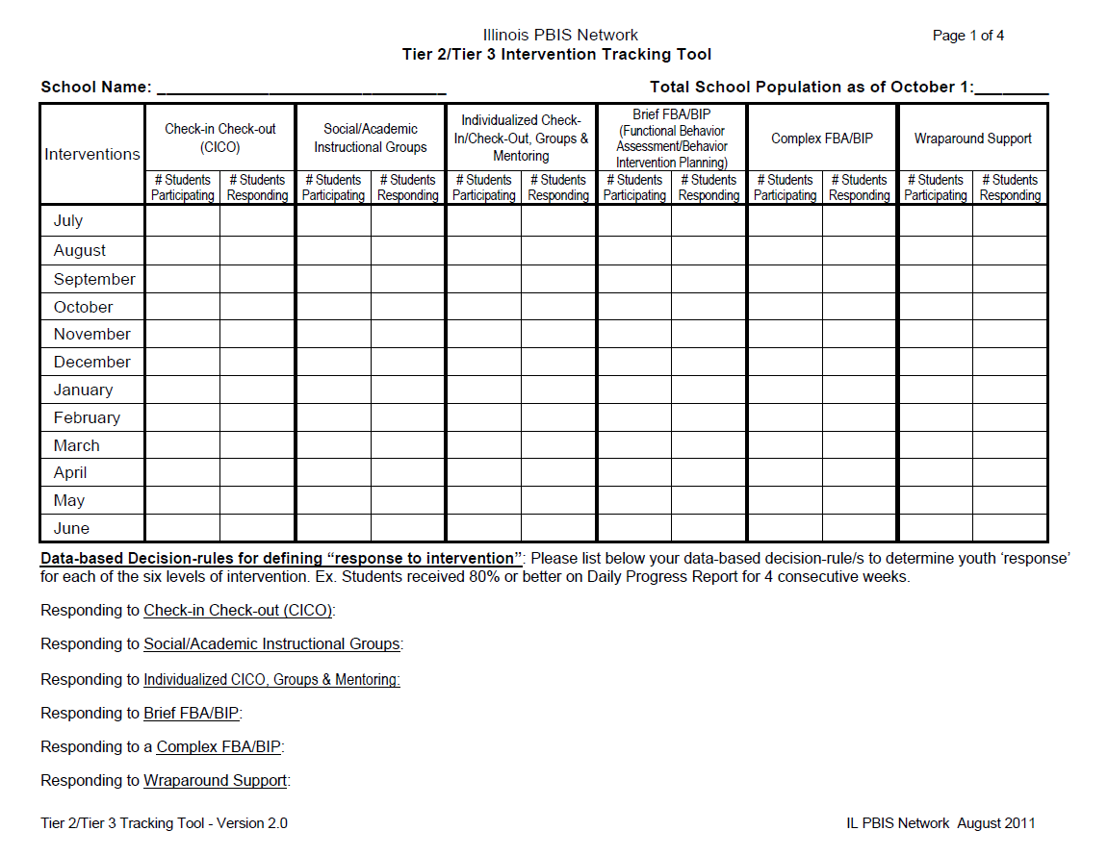
PROCESS DATA

Slide 39
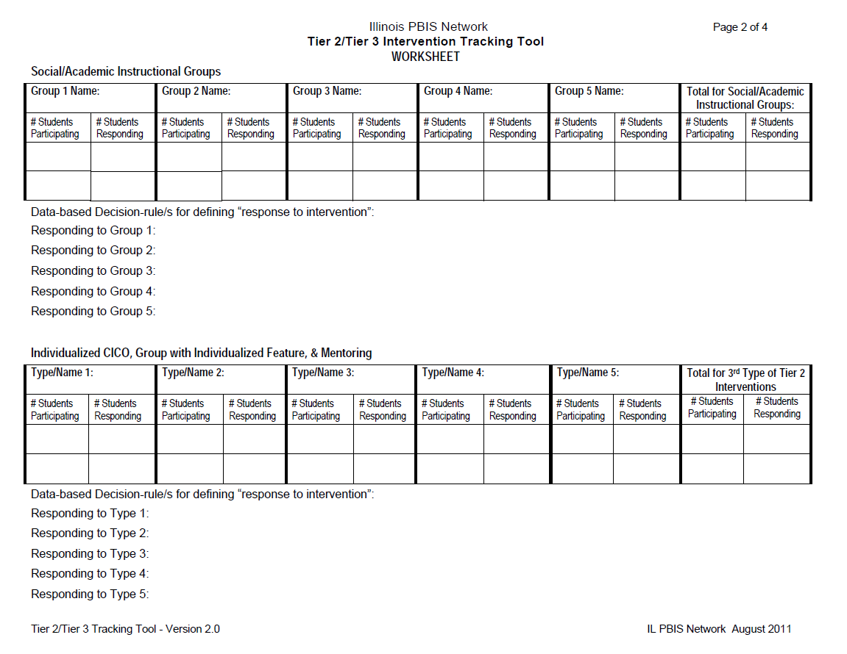

Slide 40
Data Used to Identify Students in Need of a Simple Secondary Intervention
Student outcome data:
Office Discipline Referrals
Suspensions
Attendance
Tardies
Credits
Universal Screeners (SSBD, BESS etc.)
Requests for Assistance made by teachers, family members and/or students
Notes:
40
We are beginning with description/examples of ways we will identify students who are in need of Secondary Support/s

Slide 41
Request for Assistance Tools RFA and RRFA
1. Discuss
2. Plan to modify if needed
Notes:
41

Slide 42
Universal Screening Implementation Summary

Slide 43
Purpose of Universal Screening for Behavior
Universal screening for behavior is integral to the Response to Intervention (RtI) model
Emphasis on prevention versus intervention
Use an evidence-based instrument to identify:
Risk factors for emotional/behavioral difficulties
Social-emotional strengths and needs
Casts a ‘wider net’ than just using office discipline data (Identify students who don’t typically receive referrals)- “internalizers”

Slide 44
Universal Screening & the Importance of the Preparation Process
District-level commitment
Secondary PBIS system in place
Provides seamless transition from screening to intervention
Logistics of preparation
Screening Coordinator
Overview for all staff
Schedule & organize ‘day of administration’

Slide 45
Implementation Process Summary:
Multiple Gating Procedure
(Adapted from Severson et al. 2007)
Gate 1
Teachers Rank Order then Select Top 3 Students on Each Dimension (Externalizing & Internalizing)
Pass Gate 1
Gate 2
Teachers Rate Top 3 Students in Each Dimension (Externalizing & Internalizing)
Using a Research-Validated Tool (e.g., SSBD, BASC-2/BESS, SDQ)
Pass Gate 2
Tier 2
Intervention
Notes:
Summary of four points covered in slide 5

Slide 46
Let’s focus on Tier 3 Systems

Slide 47
Conversations at Tier 3
Tertiary Systems Planning ‘conversation’
Monitors effectiveness of Complex FBA/BIP & Wraparound supports
Review data in aggregate to make decisions on improvements to the interventions themselves
Students are NOT discussed
Individual Student Teams
FBA/BIP Team per student
Wraparound Team per student

Slide 48
Tertiary Systems Team Roles
Team Leader: responsible for agenda & facilitation of meeting
Intervention Coordinators (FBA/BIP and wraparound): report out on aggregate student data from interventions they facilitate (ex. “5 youth are in FBA/BIP 4 are responding”)
Action Plan Recorder: a.k.a. note taker
Time Keeper:
Family Representative:
Community
Administrator
FBA/BIP and wraparound facilitators: Staff with clinical expertise to facilitate the process of tier 3 interventions
Notes:
48
Remind teams that at each level, Univ, Sec, Tert, there should be a division of duties among team members to avoid one person being the “expert” or carrying all of the PBIS responsibilities.
Family members: reminder we are not talking about individual students, this is a system meeting, no worries about confidentiality

Slide 49
Review Tier 3 Systems Team Agenda
See your folder for the Sample Tier 3 Systems Team Agenda
Compare the tracking tool and the tertiary systems team agenda
Discuss at your table how you think the meeting should go?

Slide 50
Student-Specific Teams
Wraparound Team:
Family of child and all relevant stakeholders invited by family. Wrap facilitators are trained to effectively engage families so that they will see that these teams are created by and for the family, and therefore will want to have a team and actively participate. School staff involved are informed that their presence is uniquely important for this youth and invited to participate.
Individual Youth FBA/BIP Team:
Like the wraparound team, this team is uniquely created for each individual child in need of comprehensive planning and the families are critical members of the team. All relevant individuals/staff are invited.

Slide 51
Activity TIER 3
Return to your Building Conversations
Who is or who could have this tier 3 systems conversation
Where do the 3 “voices to remember” currently fit and where could they fit at TIER 3.
When could they meet? How often? Where?

Slide 52
Activity TIER 3
Who could facilitate tier 3 interventions?
Wraparound
Complex FBA

Slide 53
DATA
PROCESS
OUTCOME

Slide 54
Student Outcome Data
Student outcome data is used :
a) To identify youth in need of support and to identify appropriate intervention
b) For on-going progress-monitoring of response to intervention
c) To transition youth out of interventions at the appropriate time
Notes:
54
Please emphasize/point out that this is exact wording from earlier slide..we’re using redundancy to build fluency and put focus now on individual student data (not TT)

Slide 55
Data Used to Identify Youth in Need of Tertiary Support
Universal Data by Student (ODR’s, # of absences, # of ISS or OSS, Credits)
Universal Screening Data – SSBD, etc.
Request by Family Member, Teacher or Student
Recommended: referral to Tertiary Systems Team from Secondary Problem Solving team after Brief FBA/BIP was not successful

Slide 56
Systems-Response Tool “Finding” Students in Need of Tertiary Supports
Records the “system’s response” to youth behavior/circumstance
Administrators and team members need to find the #s of youth that meet each criteria
Using the tool IS engaging in a ‘systems-reflection’
Prevents the hiding or mis-labeling of youth (ex. “We don’t have any kids that need Wraparound”)

Slide 59
Student Outcome Data Tools
Tools for Complex FBA/BIP:
Referral Disposition Tool (RD-T)
Educational Information Tool (EI-T)
Additional Tool for Wraparound:
Home, School, Community Tool (HSC-T)
Review copies of the tools

Slide 60
Data-Based Decision Rules: Tertiary Sample to Consider
Identification for Complex FBA/BIP:
Youth is identified by Secondary Problem Solving Team because not responding to Brief FBA/BIP
Progress-monitoring:
Outcome data (i.e. ODRs, attendance) is reviewed by FBA Facilitator weekly.
SIMEO data is collected & reviewed by each FBA/BIP team at least once a month.
Exiting/transitioning:
Outcome data (i.e. ODRs etc.) shows improvement (aka response to intervention)
FBA/BIP team agrees interventions can be faded and team is no longer needed

Slide 63
SRT Activity
What are your best guesses on some of the data in each category for your building?
What might be your strengths and needs?
Who is the “keeper” of this data?
How will you go about gathering this information?

Slide 64

Report Out Progress & Next Steps

Slide 65
Resources available at: www.pbisillinois.org

