Slide 1
Family and Community Engagement
Images in this module were obtained at google.com/images unless otherwise specified.
Notes:
Trainer Notes:
In this session, we will talk about ways to engage and involve families and others in the community. The main resource for the content in this presentation is the e-book Aligning and Integrating Family Engagement in Positive Behavioral Interventions and Supports (PBIS) - Concepts and Strategies for Families and Schools in Key Contexts (edited by Mark D. Weist, S. Andrew Garbacz, Kathleen Lynne Lane, and Don Kincaid and supported by the Technical Assistance Center for PBIS, funded by the Office of Special Education Programs).

Slide 2

Context
What is family engagement?
Benefits of family engagement
Family engagement in PBIS
Communicating with families
High school considerations
Community involvement
Notes:
Trainer Notes:
We will discuss the benefits of involving families and ways to communicate with, and engage, families and other community members.

Slide 3
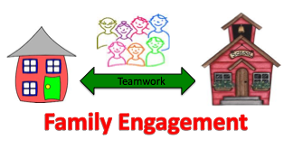
Why Engage Families?
Build positive relationships
Encourage new behaviors
Teach & reinforce skills
Increase optimism
Expected in Individuals with Disabilities Education Act
Congress reauthorized the IDEA in 2004 and most recently amended the IDEA through Public Law 114-95, the Every Student Succeeds Act, in December 2015
https://www.pbis.org/family/family-partnership
Notes:
Trainer Notes:
Through family engagement, schools and families work together towards better outcomes for students. Engagement is also required in IDEA. It’s important to involve families in the process of “how” school and family engagement can happen to ensure trust and open communication. Citation: https://www.pbis.org/family/family-partnership

Slide 4
Involvement vs. Engagement
Family involvement:
Families do what educators ask or expect families to do.
The school/educator is driving the outcome.
From From "Collaborating For Success" Parent Engagement Toolkit – www.Michigan.gov; pbis.org; Christenson & Sheridan, 2001; Sheridan, Knoche, Kupzyk, Edwards, & Marvin, 2011
Notes:
Trainer Notes:
The distinction between involvement and engagement is important. Involvement implies doing to, whereas engagement implies doing with. The term family engagement indicates a shared and continuous responsibility for student achievement and learning that occurs across multiple settings. Staff and leaders who serve youth are acknowledging that “experts” telling youth and families what they should be doing is not working. There is a paradigm shift emerging; research is showing that when equal partnerships are in place among children, youth, families, staff, and leaders that serve youth, positive educational, health, mental health, social and occupational outcomes for youth are promoted. Adapted from: https://www.michigan.gov/documents/mde/what_does_it_mean_to_be_engaged_or_involved_370138_7.pdf

Slide 5
Involvement vs. Engagement
Family engagement:
Families are partners.
Families bring their own knowledge "together" with schools.
Families share decision making and determination of goals and outcomes, such as…
  active, interactive, and dynamic processes and practices that family members use.
  engagement as equal partners with educators and other key stakeholders.
  supporting their children’s development.
From From "Collaborating For Success" Parent Engagement Toolkit – www.Michigan.gov; pbis.org; Christenson & Sheridan, 2001; Sheridan, Knoche, Kupzyk, Edwards, & Marvin, 2011
Notes:
Trainer Notes:
The distinction between involvement and engagement is important. Involvement implies doing to, whereas engagement implies doing with. The term family engagement indicates a shared and continuous responsibility for student achievement and learning that occurs across multiple settings. Staff and leaders who serve youth are acknowledging that “experts” telling youth and families what they should be doing is not working. There is a paradigm shift emerging; research is showing that when equal partnerships are in place among children, youth, families, staff, and leaders that serve youth, positive educational, health, mental health, social and occupational outcomes for youth are promoted. Adapted from: https://www.michigan.gov/documents/mde/what_does_it_mean_to_be_engaged_or_involved_370138_7.pdf

Slide 6
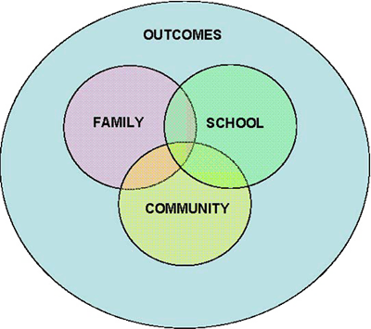
School, Family, & Community Partnership Efforts Should Help Families…
Know what children are doing at school
Promote high standards for student work
Gain skills to help children at home
Understand what good teaching looks like
Discuss how to improve student progress
Henderson, Mapp, et al. Beyond the Bake Sale: The Essential Guide to Family-School Partnerships. The New Press, 2007
Notes:
Trainer Notes:
School, family, and community partnerships should help families have a clear idea of what their children are learning and doing at school. They should help families feel more empowered to help their children be more successful. Book recommendation: Henderson, Mapp, et al. Beyond the Bake Sale: The Essential Guide to Family-School Partnerships. The New Press, 2007

Slide 7

Positive Effect On Student Behavior
More positive attitudes and behavior
With support from home and school:
  More self-confidence
  Feel school is more important
  Tend to do better in school
At-risk behaviors decrease
National PTA, 10/28/2005
Notes:
Trainer Notes:
(From the National PTA survey.) When families are involved, students exhibit more positive attitudes and behaviors. When students report feeling support from both home and school, they have more self-confidence, feel school is more important, and they tend to do better in school. Student at-risk behaviors, such as alcohol use, violence, and other anti-social behaviors decrease as family involvement increases.

Slide 8

Benefits Of Family Engagement To Teachers And Schools
Greater job satisfaction
Higher ratings of teaching skills
Higher ratings of school effectiveness
Improved classroom behavior
https://www.pbis.org/family/family-partnership
Notes:
Trainer Notes:
Teachers and schools benefit from family engagement through greater job satisfaction, higher ratings of teaching skills from families and principals, higher ratings of school effectiveness, and improved classroom behavior through increased knowledge of children’s family, cultural, and community contexts. Citation: https://www.pbis.org/family/family-partnership

Slide 9
Universal Components Of PBIS
School-wide
Common purpose & approach to discipline
Behavioral expectations
Teaching of expected behaviors
Encouraging of expected behaviors
Discouraging of inappropriate behavior
Data-based monitoring & evaluation
Notes:
Trainer Notes:
Review – we’re leading into applying PBIS logic to family engagement.

Slide 10
How To Apply PBIS To Family Engagement
Provide these for families:
A continuum of positive behavior supports for all families
Frequent, regular, positive contacts & acknowledgements
Formal, active participation & involvement as equal partners
Access to a system of integrated school & community resources
Notes:
Trainer Notes:
This is PBIS logic applied to family engagement. According to pbis.org: “The primary focus on engaging families at the universal level is to build ‘awareness’ of the school’s behavioral expectations, teaching strategies and supports. A secondary focus on engaging families at the universal level is to ‘involve’ families in the PBIS (Positive Behavioral Interventions and Supports) development and implementation process. While less of an emphasis, family ‘supports’ are also addressed at the universal level of implementation.” Teach families what students are being taught so they can share common expected behaviors and/or outcomes. Sending home a behavioral matrix of school-wide expected behaviors helps families understand what is being taught.

Slide 11
Developing Your Program
Evaluate current status
Formulate goals and strategies
Form action steps and responsibilities
Review performance
Evaluate your plan
Notes:
Trainer Notes:
(From Michigan Dept. of Ed Collaborating for Success Parent Engagement Toolkit.) Just like with PBIS, before starting something new, evaluate what you are already doing and see what can be used or adapted to fit within PBIS. From there, develop goals for family engagement, strategies for reaching those goals, and then specific action steps with responsibilities identified and assigned. It is important to include families throughout the development process. Again, with PBIS we always use data-based decision making. Monitor progress with your action steps and revise as needed. Then, do periodic evaluation to see if you are meeting or approaching your goals and consider revising or updating strategies and action steps.

Slide 12
District Family Engagement Plan Example
Involvement is:
  Intermittent attendance or participation
  One way, school-directed
  School-driven decision making
  Changes & evolves as child matures
Engagement is:
  Ongoing & continuous
  Reciprocal
  Strengths-based partnership between families & school
  Shared responsibility
  Changes & evolves as child matures
From Marion Community Unit School District 2, Marion, IL
Notes:
Trainer Notes:
Marion Community Unit School District 2 in Marion, IL went through the process of building capacity for family engagement in their district. Upon assessing their current status, they felt they needed to change their focus from family involvement to family engagement, so they started by defining family engagement. They also sent out a survey to assess needs of families.

Slide 13
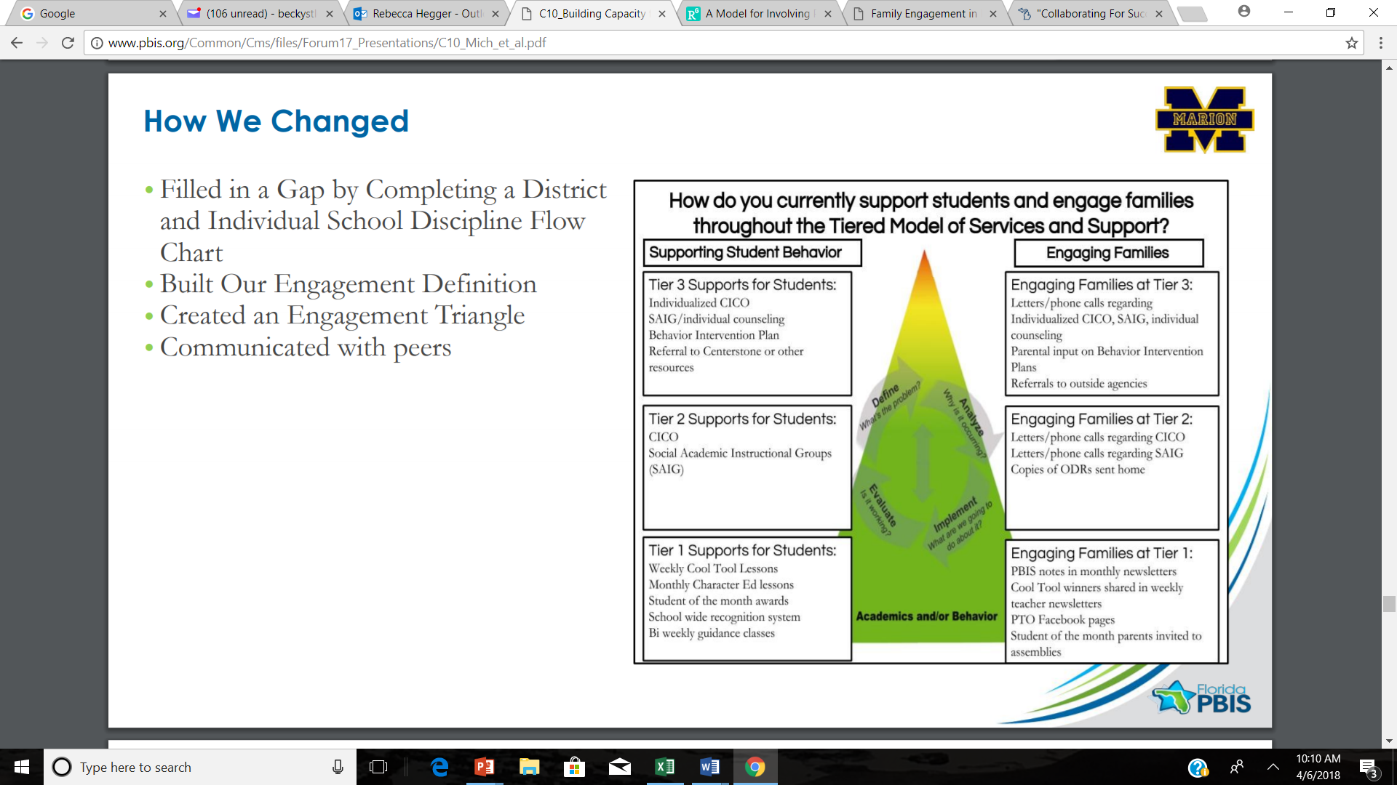
From Marion Community Unit
School District 2, Marion, IL
Notes:
Trainer Notes:
Marion CUSD2 then created this “triangle” during their process. It shows their plan/strategies for engaging families using the PBIS three tiered model.

Slide 14

Examples Of Actions & Strategies
Introduce behavioral expectations.
Show progress on school-wide outcomes.
Include family representatives on PBIS team.
Have a sign-up list of volunteer activities.
Notes:
Trainer Notes:
Here are some examples of steps schools can take to engage families. The school can schedule family events focused on introducing expectations, show progress on outcomes, and provide volunteer activities, such as writing form letters to request free samples from local businesses to reinforce students for positive behavior.

Slide 15

More Examples
Blend PBIS into the daily family routine.
Have trained family members wear “ask me about PBIS” buttons.
Incorporate PBIS into Individualized Education Program (IEP).
Provide information about community resources.
Notes:
Trainer Notes:
Assist family members in blending PBIS into daily routines. Train family members and ask them to wear “ask me about PBIS” buttons. Work together with families to incorporate PBIS into the IEP.

Slide 16
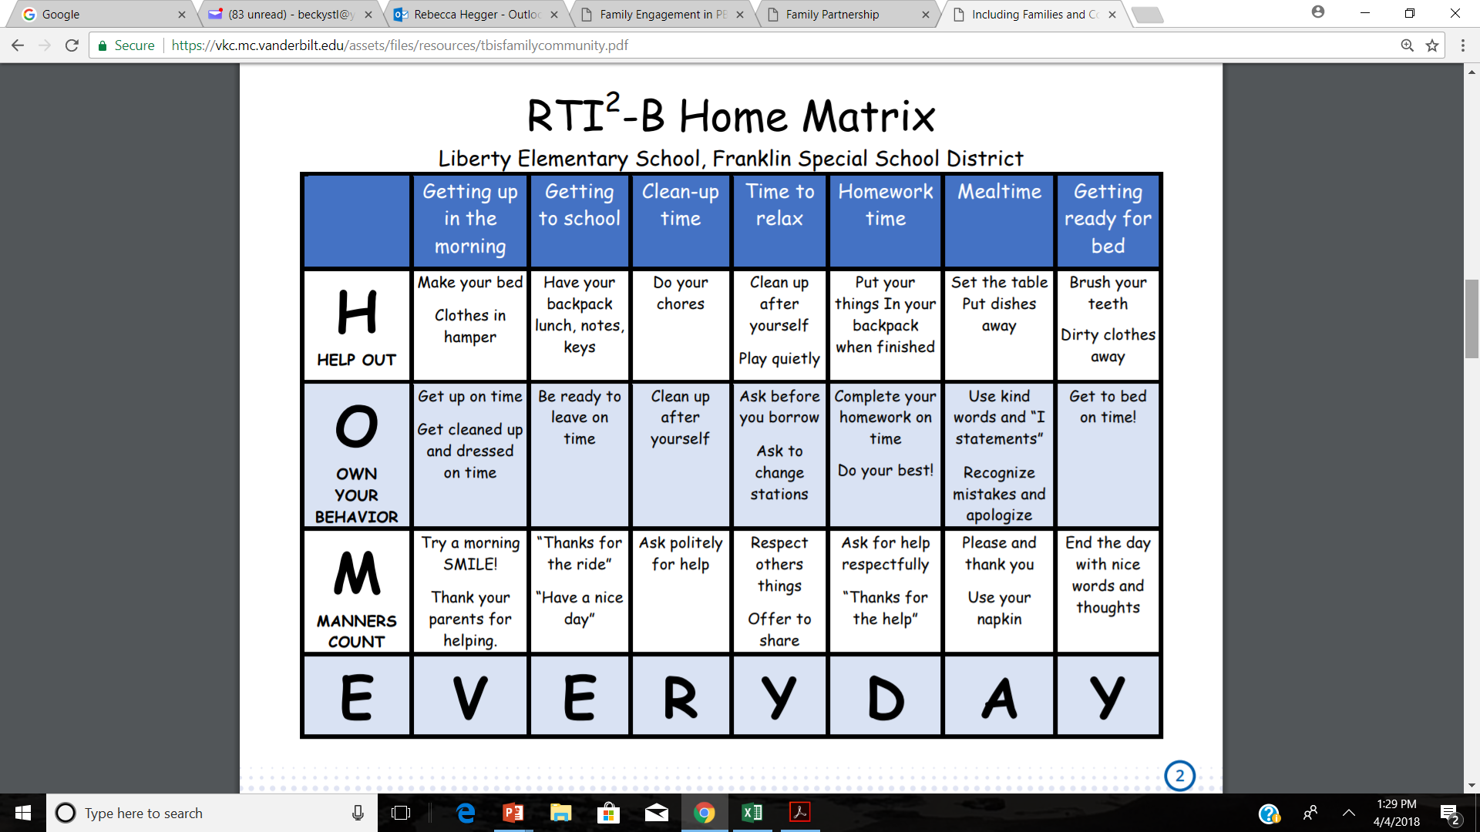
Example Of A Home Matrix
Notes:
Trainer Notes:
This is an example of a matrix that a Tennessee school developed for families to use at home with students. This is from the Tennessee Behavior Support Project’s July 2017 guide “Including Families and Communities in your School’s RTI2-B Framework”. It can be accessed at: https://vkc.mc.vanderbilt.edu/assets/files/resources/tbisfamilycommunity.pdf.

Slide 17
Communicating With Families
Make it more personal.
Be culturally and linguistically responsive.
Define technical terminology.
Empower family members.
Notes:
Trainer Notes:
Some families respond better to more personal outreach (e.g., phone calls, emails, even other families reaching out to them), as opposed to flyers sent home with students. Language barriers may be more extensive than you think. Some families are not very literate in their native language. Get to know families and their preferences, and don’t assume families know acronyms or understand terms that educational professionals use regularly. Families may not have had good past experiences with education or may not think they have anything to contribute. Invite them to offer input and help plan activities. This will also ensure that school activities more accurately reflect the community and its various cultures. Also, offer families educational opportunities on academic topics, child development, etc. and invite them to help in the classroom. It could be helpful to talk about cultural and linguistic responsivity.

Slide 18
Communication Tips
Follow up after parent-teacher conferences.
Send home student work for review and comment.
Send home useful notices, memos, and/or newsletters.
Respect family’s perspective on their child's abilities and progress.
Use social media (e.g., Facebook, messenger).
Text family.
Notes:
Trainer Notes:
Follow up the annual parent-teacher conference with regular communications with families. Know how to get information translated into the languages of your students' families. Consider student-led conferences with families, especially at the secondary level. Consider families who do not read well and arrange for phone calls in their native language. Every week or every month, send home folders of student work for family’s review and comment. Have a regular schedule to send home useful notices, memos, or newsletters. Respect family’s perspective on their child's abilities and progress. They know their own child in a different setting than you do. Expect to disagree once in a while and embrace the opportunity to see things from a new point of view.

Slide 19
Prepare Staff To Work With Families
Discuss hypothetical cases from family members’ points of view.
Have staff evaluate their assumptions and beliefs about families.
Develop staff communication skills.
Help staff understand research and rationale.
Provide staff time to process difficult situations.
Harvard Family Research Project, 10/06
Notes:
Trainer Notes:
Help those who work with families take different perspectives on situations by discussing hypothetical cases from different family members’ points of view. Ask staff to evaluate their own assumptions and beliefs about the families with whom they work. Develop staff communication skills. Aid staff in understanding research on families and the theoretical rationale for the program. Provide staff time to process with others difficult conversations or situations.

Slide 20
Remove Barriers
Have face-to-face visits.
Meet during nontraditional hours.
Visit families in the community.
Provide transportation, infant care, and meals at meetings.
Notes:
Trainer Notes:
Get to know families. Remove as many barriers as possible for family meetings. Recruit families through face-to-face visits. Hold meetings for families during nontraditional hours, including weekends and evenings. Visit families in community locations. Provide transportation, infant care, and meals at meetings.

Slide 21
Know The Community
Understand community beliefs, values, and attitudes.
Ensure staff are culturally sensitive.
Have current and former family volunteers help recruit.
Think of recruitment and retention as routine.
Notes:
Trainer Notes:
Get to know the community in which your school is located. Understand the culture of the community.

Slide 22
Some Ideas
Surveys:
  Behavioral needs
  Behavioral expectations
  What families know about PBIS
  How families can support PBIS
Develop information for families about PBIS.
Evaluate “family friendliness” of the school.
Notes:
Trainer Notes:
Make sure families know about and are involved with PBIS. Give information, but also collect information.

Slide 23

Display photos of families.
Display images of various cultures.
Have an “open-door” policy for visits.
Develop family information centers.
Have meetings with families in their homes and community settings.
Consider the family’s native language and culture when communicating.
Notes:
Trainer Notes:
Make families feel welcome and make things convenient for them.

Slide 24

Retention
Send regular notes home about PBIS.
Send home thank you notes for supporting PBIS.
Increase use of technology as a form of communication with families.
Hold a PBIS day that families plan and coordinate.
Recruit families to develop displays related to PBIS.
Notes:
Trainer Notes:
These are some ideas for retaining family support and involvement with PBIS. Send regular notes home about PBIS developed by families for families. Send home thank you notes for supporting PBIS in schools. (These can be sent to families and/or staff and teachers.) Hold a PBIS day at your school that is planned and coordinated by families. Recruit families to develop displays around the school related to PBIS (e.g. PBIS student of the week, month, etc.).

Slide 25


Reaching Out
Write a PBIS
piece for
school
newsletter.
Create a home PBIS contract with families.
Help plan a PBIS family night.
Use social media to promote PBIS events.
Notes:
Trainer Notes:
Here are some ideas for reaching out to families and communities about PBIS.

Slide 26

Informing Families About PBIS
Set up a PBIS table during parent-teacher conferences.
Create PBIS family resources.
Develop a PBIS family calendar.
Have skits at half-time of sporting events about PBIS.
Notes:
Trainer Notes:
These are some more ideas for including families in PBIS activities. Set up a PBIS table during parent-teacher conferences to give info on expectations, what you’re teaching, acknowledgements, events, etc. Create PBIS family resources. These could include things, such as a behavior management “Tip of the Month” or “Five Ways a Day” to reinforce good behavior in the home. Have PBIS celebrations and upcoming events posted in the office or near the entrance of the school. Develop a PBIS family calendar to keep families up to date about current events, goals, challenges, etc.

Slide 27
High School
Family engagement is always important, but typically declines in the high school years.
Challenges:
  Large sizes of schools
  Academic focus
  Structure characterized by different departments
  Developmental level of the students
Notes:
Trainer Notes:
Family engagement clearly promotes academic success and graduation, yet typically declines in the high school years. Family engagement efforts at the high school level will be more effective when there is a clear vision for and commitment to meaningful family engagement that is communicated by the district leadership team. Schools should provide a range of opportunities for families to participate, invite families to collaborate, and encourage families to contribute.

Slide 28
High School Considerations
To give family engagement a boost in high school, consider…
Including family members and students in PBIS teams
Creating multiple communication options
Giving clear guidance about who families are to contact
Removing barriers to promote family participation in events
Working with school counselors to engage families

Slide 29
Community Engagement
Give annual surveys to identify community interests, talents, and volunteers.
Invite community member representatives on the PBIS team.
Invite community members to school events and assemblies.
Train local community centers that provide before and after care on Tier I practices.
Train local church youth ministries on Tier I.
Notes:
Trainer Notes:
A great way to inform potential partnerships is to distribute annual surveys to community members to identify interests, talents, and volunteer availability. A community member could give local insight to the team and take PBIS and school information back into the community.

Slide 30
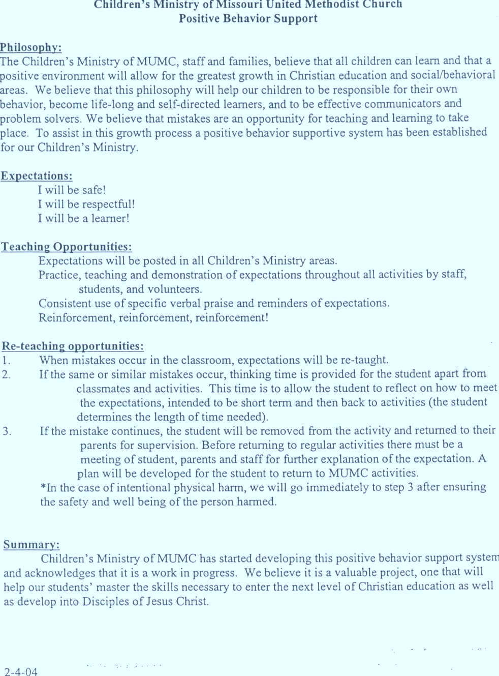
Example Of
Introducing PBIS In Youth Ministry

Slide 31
Partnerships
Ask/invite local businesses to:
Donate resources; help with fundraising
Help disseminate information on PBIS to a broader community
Volunteer or help recruit volunteers
Attend school activities

Slide 32
Show Appreciation
Family representatives recognize students, staff, and teachers.
Make sure everyone feels welcomed in the building.
Create banners for businesses that help with fundraising.
Host a raffle at a family night event.
Recognize involved family and community members in the school newsletter, on websites, or on social media.
From TN Behavior Supports Project
Notes:
Trainer Notes:
Be sure to show appreciation – acknowledgement and recognition – to families and community members that participate and donate time and resources. Examples: Family representative recognizes students, staff, and teachers for reinforcing behavioral expectations (at team meetings individuals can be identified who are exhibiting the behaviors that support PBIS in your school). Schools can show their appreciation by simply making sure that everyone feels welcome when walking into the building. Schools could create banners for businesses that help with fundraising, which is a great way to advertise the business and the school’s plan. They could also host a raffle at a family night or recognize involved family and community members in their school newsletter, on their websites, or on social media.

Slide 33
Guiding Questions
In what ways will you communicate with staff, families, students, and the community about PBIS?
In what ways would you like to see families involved and engaged?
What actions will you take to encourage families to become (more) involved?
How will you prepare staff to work with families?
How will you develop relationships/partnerships in the community?

Slide 34
Do It With Fidelity!
Tiered Fidelity Inventory (TFI)
Efficient, valid index of extent to which PBIS core features are in place
Section 1.11 Student/Family/Community Involvement
Notes:
Trainer Notes:
The TFI is an important tool in the PBIS implementation process. It can be used in the development stage and then used in an ongoing manner to ensure all core features are in place. The TFI highlights each critical component of PBIS. Section 1.11 covers student, family and community involvement.

Slide 35
1.11 Student/Family/Community Involvement
Subscale: Implementation
Feature | Data Sources | Scoring Criteria
 |  | 0 = Not implemented 1 = Partially implemented 2 = Fully implemented
1.11 Student/Family/ Community Involvement: Stakeholders (students, families, and community members) provide input on universal foundations (e.g., expectations, consequences, acknowledgements) at least every 12 months. | Surveys Voting results from family meeting Team meeting minutes | 0 = No documentation (or no opportunities) for stakeholder feedback on Tier I foundations. 1 = Documentation of input on Tier I foundations, but not within the past 12 months or input not from all types of stakeholders. 2 = Documentation exists that students, families, and community members have provided feedback on Tier I practices (expectations, consequences and acknowledgements) within the past 12 months.
Main Idea: Schools need active engagement of students, families and the community to be successful.

Slide 36
Summary
Engage families with the goal that they become equal partners in helping students develop (e.g., socially, emotionally, educationally).
Use PBIS logic for developing a family engagement plan.
Communicate with families in ways that encourage and enable involvement with students and the school.
Eliminate barriers as much as possible.
Develop community partnerships.

Slide 37
Acknowledgements And Resources
PBIS/OPEC Technical Assistance Center
  http://www.pbis.org/Common/Cms/files/pbisresources/Family%20Engagement%20in%20PBIS.pdf
US Department of Education
  https://y4y.ed.gov/tools/#family
Tennessee Behavior Supports Project
  https://vkc.mc.vanderbilt.edu/assets/files/resources/tbisfamilycommunity.pdf
Michigan Department of Education
  http://www.michigan.gov/documents/mde/4a._Final_Toolkit_without_bookmarks_370151_7.pdf

