Slide 1
Responding to Inappropriate Behavior
Images in this module were obtained at google.com/images unless otherwise specified.
Notes:
Trainer Notes:
In this module we will be discussing how to create a system for consistently responding to problem behavior.

Slide 2
Context
What isn’t working with your current way of managing problem behaviors?
Notes:
Trainer Notes:
In this module, we will talk about what type of responses to problem behaviors have not worked, as well as strategies that do work. We will go through the components and steps for building systems for school-wide, consistent responses to problem behaviors. (This would be a good time to stop and ask for audience participation, if you have a plan for using that discussion across this presentation.)

Slide 3
Ways That Don’t Work
Exclusion
Punishing problem behavior without a positive, proactive, educative approach
Punishment used alone interferes with teaching and learning.
Notes:
Trainer Notes:
Studies, like Costenbader & Markson (1998), Mayer & Sulzer-Azaroff (1990), and Skiba, Peterson & Williams (1997), have shown that neither punishment alone nor exclusion are effective in reducing problem behavior. These methods may even lead to an escalation in negative behavior, such as aggression, vandalism, truancy, and dropping out. For example, students may exhibit stress responses or learned helplessness. Alternatively, punishment may even be rewarding to some students (e.g., suspension).

Slide 4
What Does Work?
Building on a current discipline policy (consequences)
Developing a continuum of procedures for discouraging inappropriate behavior
Focusing on teaching desired behaviors and when to appropriately use them
(Lewis & Sugai, 1999)
Notes:
Trainer Notes:
Most schools already have a list or handbook of rules and “don’t do this” instructions. Through PBIS, they will be creating systems for teaching students the correct behavior, modeling the behavior, and encouraging the behavior. At the same time, schools need to have a clear, consistent bank of strategies and set of procedures for addressing problem behavior.

Slide 5
Building A System To Manage Inappropriate Behavior
Behaviors are defined and classified.
Procedures and strategies are established to manage misbehavior.
Behavior data are collected for effective decision making.
The focus is on PREVENTION.
Notes:
Trainer Notes:
In this module, we will talk about what type of responses to problem behaviors haven’t worked, as well as strategies that do work. We will go through the components and steps for building systems for school-wide, consistent responses to problem behaviors.

Slide 6
Prevention Is The Key
Guiding Questions:
Can we improve the physical environment or schedule?
Do we have clear behavioral expectations?
Have the expectations been thoroughly taught?
Are we consistently using strategies to encourage the desired behaviors?
Notes:
Trainer Notes:
When inappropriate behaviors occur, first assess the setting or events that led up to the behaviors. See if can you adjust or improve the environment to help prevent the behaviors in the future. Also assess whether or not your core components are being implemented fully. Ask some guiding questions, such as, “Have you taught the expectations sufficiently?” or “Have adults been encouraging the expected behaviors through specific praise and acknowledgements?” As the saying goes, the best defense is a great offense.

Slide 7
Prevention In The Classroom
Start with prevention, not punishment.
Active supervision (e.g., moving, scanning, prompting)
Pre-correction
Beginning of class period
Transitions
Moving to another setting
Notes:
Trainer Notes:
PBIS is about prevention and does not specify punishments. Those are left to the school and classrooms, but it is assumed the school and classrooms will develop a continuum of approaches to problem behaviors. Because the classroom is where students spend the majority of their time at school, it’s important to make sure teachers are equipped with strategies that will help prevent problem behaviors. Two very effective strategies are active supervision and pre-correction. Simply moving around and scanning the classroom will prevent a lot of minor disruptions or distractions. For some students, a simple tap on the shoulder or desk will prompt them to get back on task. Pre-correction is something you can do with your class before they transition to a new task or new setting. Remind students about the expectations, and what/when the proper procedures are. For instance, getting ready to go to lunch or when they are moving from group to individual work in the classroom.

Slide 8
An Effective Approach
Inappropriate behavior can become a teaching opportunity.
Point out the problem (specific feedback)
Re-teach
Provide guided and unguided practice
Provide follow-up feedback to indicate progress
Notes:
Trainer Notes:
When a student does use inappropriate behavior, think of this as a teaching opportunity. Don’t just point out the problem behavior and punish, but engage the student in re-teaching and practicing the correct behavior for the situation. Be sure and give them feedback to encourage them to keep following the expectations. This also sets up an opportunity to attend to and reinforce a given student when he/she does exhibit the appropriate behavior.

Slide 9
Create A Predictable Environment
Avoid reinforcing problem behavior.
Provide effective strategies for responding to problem behavior.
Differentiate office-managed and classroom-managed behaviors.
Notes:
Trainer Notes:
Students need to know what to do and what behavior is expected, and staff need to have clear procedures and strategies for addressing different types of infractions. For some students, what you think is a punishment may actually be a reward (e.g., students wanting to avoid a task may cause a disturbance that gets them sent out of the room). Provide staff with effective strategies for responding to problem behavior (not all staff have the same skill set or educational background). Be sure that all staff and faculty are clear about the procedures for addressing problem behavior. The school needs to agree on what behaviors will be managed by staff and what they will send to the office.

Slide 10
The Power Of Correcting Social Errors Through Teaching
Upholds and demonstrates the importance of expectations
Restores order to the learning environment
Interrupts or prevents practice of inappropriate behavior
Teachable moment: the learner is active, the learning is relevant
Student learns to be successful
Student learns valuable social skills
Increases probability of future correct behavior
Decreases future time out of learning/instruction
Builds relationships with students
Maintains a positive learning climate
Notes:
Trainer Notes:
Here are some benefits to turning a behavioral mistake into a teaching opportunity.

Slide 11
Building Your Response System
Determine how staff will efficiently and effectively respond to a range of inappropriate behavior.
Minor behaviors
Chronic minor behaviors
Serious or dangerous behaviors
Notes:
Trainer Notes:
There are different levels of misbehavior, so you will have to consider what type of response is required in different situations. The basic categories for misbehavior range from minor misbehaviors that are mostly disruptive or annoying to more serious ones that could cause damage or injury. You and your team, along with input from staff, will be differentiating these behaviors so that staff know which behaviors will be addressed by them and which behaviors will require an office referral.

Slide 12
Staff-managed (Minor) Behaviors
Use best practices (e.g., correction, re-teaching)
Avoid escalation
Anticipate students’ response
Consider office referral for persistent behavior
Notes:
Trainer Notes:
If you’re going to ask staff to consistently respond to specific behaviors, they will need strategies. Be sure to use best practices, such as correction and re-teaching, and know when to step away from the situation before it escalates beyond what can be appropriately managed. We want to build better relationships with students so that as you’re getting to know your students, you can better anticipate which ones are more likely to escalate. If behavior continues to persist, you may need to refer the student to the office. Your team will be making decisions as to when a persistent behavior should become an office-managed behavior.

Slide 13
Office-managed (Major) Behaviors
Behavior that…
Is a serious or chronic disruption
Concerns safety for the student or others
Is potentially illegal
Actions taken in the office may include…
More intensive teaching
Restitution activities
Strategies to help the student handle future situations
Phone calls home
Notes:
Trainer Notes:
There are definitely some behaviors that will require an immediate office referral. You will want to have procedures in place to make sure everyone knows how to maintain safety for everyone. With lesser offenses, it’s still important to apply strategies and consequences that include teaching. Again, punishment alone isn’t enough to improve behavior.

Slide 14
What Is Needed
To effectively manage problem behavior, you must…
define all behaviors (be specific – observable, measurable).
define what constitutes office-managed behavior.
document strategies to respond to minor behaviors.
document procedures for responding to any misbehavior.
develop related data gathering tools.
Notes:
Trainer Notes:
The first step in building your consequence system is to formally categorize the problem behaviors that you have identified at your school. It’s also essential to have specific definitions for each of your identified behaviors so that you will have an accurate account of behavior issues in your school. Work with your staff to come to a consensus on how different behaviors will be defined. For example, what differentiates disrespect from insubordination? What type of language would constitute a minor infraction and what would be a major infraction? Have a documented procedure showing what staff should do when an inappropriate behavior occurs. All these steps will help create more consistency throughout the school.

Slide 15
Example Of Behavior Definitions
Minor Problem | Behavior Definition
Inappropriate verbal language | Student engages in low intensity instance of inappropriate language (develop examples)
Major Problem | Behavior Definition
Abusive language/ inappropriate language/ profanity | Verbal messages that include swearing, name calling or use of words in an inappropriate way
Make sure all staff have the definitions and report accurately.
Notes:
Trainer Notes:
Here is an example of definitions for different levels of inappropriate language. In this example, this school has identified major behavior, or behavior that will be office-managed, as language that is abusive or profane. In this case, the school specifically identifies swearing and name calling as major infractions. Once the PBIS team has sorted and defined behaviors, distribute the information to all staff so that there will be consistency and accuracy in reporting infractions.

Slide 16
Example (T-chart)
Teacher managed behaviors (minor) | Office managed behaviors (major)
Tardy Inappropriate language (minor) Chewing gum; food/drinks Not having materials/supplies Missing homework Tattling Teasing/bullying Lying Cheating Minor dress code violation Minor disruption Defiance/disrespect/non-compliance | Chronic/severe bullying Stealing Vandalism Illegal substance Chronic non-compliance Possession of weapons Profanity directed at person Repeated disruptions Fighting/assault Threat Chronic class skipping Gang-related behaviors Sexual harassment False fire alarm/bomb threat
Notes:
Trainer Notes: Here is an example of a T-chart of behaviors. One column will show behaviors that teachers and staff will address themselves, and the other will show the behaviors that warrant an office referral.

Slide 17
Procedural Flow Charts
Documents the “standard procedure” for responding to any inappropriate behavior
All staff give input and come to a consensus
Distribute final document to all staff to keep for reference
Notes:
Trainer Notes: In order to have consistency in how everyone in the school responds to problem behavior, it’s important to have documented procedures that everyone can refer to.

Slide 18
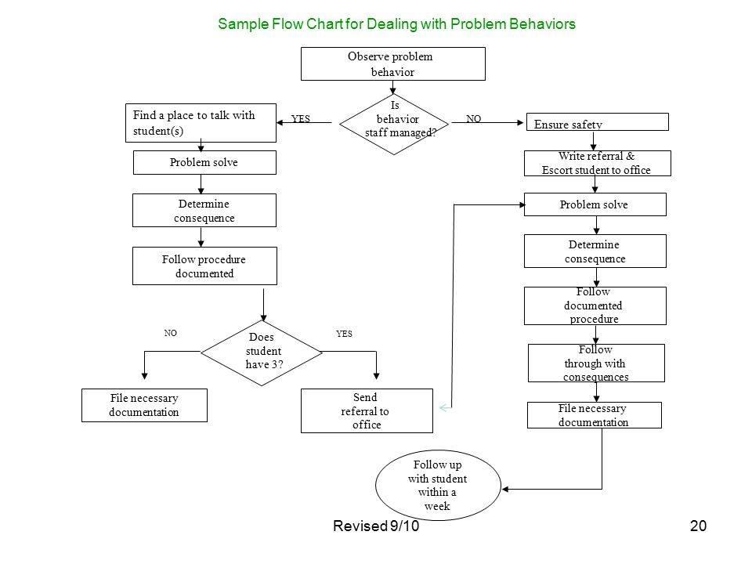

Slide 19
Purpose Of Office Discipline Referrals (ODRs)
Interrupt problem behavior and prevent escalation
Teach what is acceptable behavior
Keep behavior from being rewarded
Allow instruction to safely continue for others
Collect data
Notes:
Trainer Notes:
When a student uses behavior that has been identified as office-managed, keep in mind the purpose of the office referral and what it should accomplish. First and foremost, you’re interrupting a problem behavior and preventing it from escalating. If there are safety concerns, those need to be addressed first, but otherwise, the goal is to discourage the student from doing the behavior again. This requires making sure the student knows what the acceptable behavior would have been in that situation, keeping the punishment appropriate, and making sure your response doesn’t serve as a reward for the student.

Slide 20
“Must-have” Data For ODR Forms
Student name | Location of incident
Referring staff name | Others involved
Date of incident | Possible motivation
Time of incident | Administrative decision
Inappropriate behavior with designation of office-managed or staff-managed
Notes:
Trainer Notes:
Office discipline referrals are data that document an incident. In order to be able to make informed decisions and monitor progress, it’s important to have a complete picture of the who, what, when, where, and why of what happened. These data are an accurate representation of the incident and take the guess work out of the equation. The information provided can be used for parent conferences, documenting a nomination for Tier II or Tier III interventions, etc.

Slide 21
Guidelines For Office Referrals
Ensure referral is appropriate – use outlined procedures
Complete ODR fully – these are data points
Be prepared to talk to your administrator to determine consequences.
Make student’s return to class a smooth transition
Notes:
Trainer Notes:
Again, ODRs are data documenting an incident and are important for making decisions.

Slide 22
Example ODR Form
Notes:
Trainer Notes:
This example shows a convenient, concise way to organize the necessary information fields, making it easier for staff to complete.

Slide 23
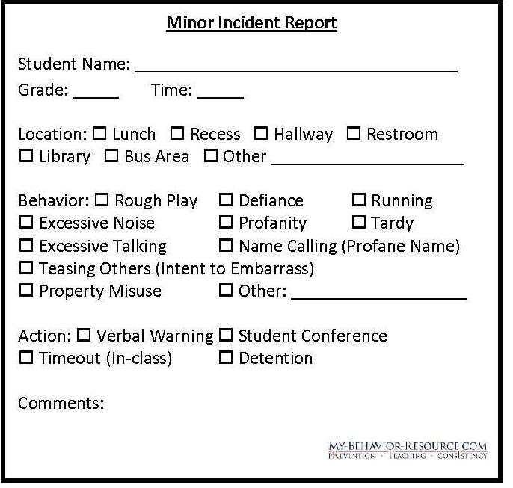
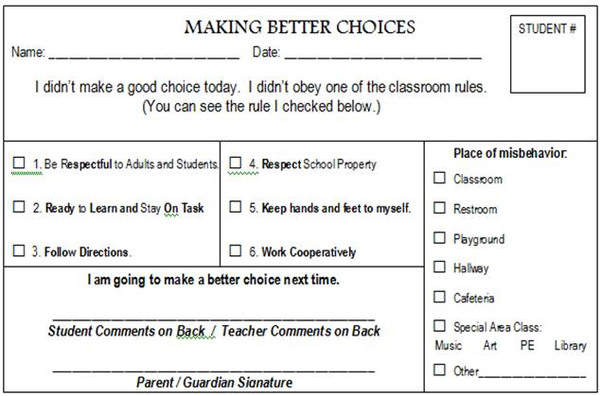
Minor Behavior Report Examples
Notes:
Trainer Notes:
Ideally, schools should collect minor incident reports. These could be used by classroom teachers to keep their own data and develop their own action plans. Also, collecting these data will help provide useful information down the road if the teacher wants to refer students for additional supports (Tier II or Tier III interventions).

Slide 24
Guiding Questions
Is there consensus among staff on the definitions of all problem behaviors?
What are the minor problem behaviors in your school?
What are the major problem behaviors in your school?
Do you have a T-chart to distinguish minor from major behaviors?
What will you do when there are repeated minor behaviors?
Notes:
Trainer Notes:
These are some guiding questions to keep in mind when building a system for responding to problem behaviors.

Slide 25
Some Strategies For Minor Behaviors
Re-teach expectations/rules
Change seating arrangements
Conference
Peer mediation
Student contracts
Provide choices
Remove tempting items from room
Teach replacement skills
Cool-off time
Re-direction
Restitution/apology
Prompt
Reward alternate positive behaviors
Reward peers for using appropriate behaviors
Notes:
Trainer Notes: It’s important that classroom teachers and other staff have some good strategies for responding to the behaviors identified as being classroom-managed. The overall goal is to provide re-teaching of the expected behavior, help the student learn an appropriate replacement behavior, and then reinforce them when they use the correct behavior. Not all teachers have been taught or had time to develop a lot of strategies, so this may be an area you want to address in your professional development opportunities. It’s recommended that staff only choose a couple to focus on at one time, and then give teachers time, support, and encouragement to become skilled in using these strategies.

Slide 26
Considerations For Correcting Misbehavior
Be consistent
Use least intrusive strategy
Be specific, but brief
Have a quiet, respectful interaction
Refocus class first, if you will require a bit of time
Notes:
Trainer Notes:
Students have a better chance at changing their behavior if you are consistent in your teaching and responses. You don’t want to draw any more attention to a misbehavior than you have to. Be sure to give specific descriptions of the behavior you observed and the behavior that is expected. Be brief and concise and disengage quickly. Make sure the interaction is quiet and respectful – again, you don’t want to draw more attention to the misbehavior and you don’t want to single out students. Also, if we want the student to be respectful, we have to model that behavior. If you think the interaction will take a bit of time, make sure the class has a task to focus on first and then give individual attention to the student.

Slide 27
Appropriate Consequences
Matched to the severity of the behavior
Matched to the perceived function of the behavior
Should not result in a power struggle
Notes:
Trainer Notes: Consequences work best when they fit the individual student’s motivation, the specific behavior, and the severity of the behavior. Consequences aren’t “one size fits all”. Make sure the consequences match the behavior. Fairness and consistency come into play through the expectations and standards that everyone is held to. Fairness means that everyone gets the appropriate support in order to be successful. See Missouri website for resources at http://pbismissouri.org/wp-content/uploads/2017/06/6.0-MO-SW-PBS-Tier-1-Workbook-Ch-6-Discouraging.pdf?x30198.

Slide 28
Effective Consequences
Result in greater learning
Often involve learning tasks or opportunities
Practice replacement behavior/skill
Student demonstrates desired skill
Make amends to others affected
Invite student to take responsibility & also be part of solution
Require effort and leave little incentive for repeat of misbehavior
Notes:
Trainer Notes:
Again, your interactions with students who have used inappropriate behavior need to include a teaching component. This will increase the likelihood that the student’s behavior will change positively. Give the students learning tasks and opportunities to practice using the desired behavior. Encourage the student to take responsibility for the inappropriate behavior and also be involved in determining the solution. Consequences need to take some effort. You want the student to have no incentive to repeat the unwanted behavior.

Slide 29
Do It With Fidelity!
Tiered Fidelity Inventory (TFI)
Efficient, valid index of extent to which PBIS core features are in place
Section 1.5 Problem Behavior Definitions
Section 1.6 Discipline Policies
Notes:
Trainer Notes:
The TFI is an important tool in the PBIS implementation process. It can be used in the development stage, and then used in an ongoing manner to ensure all core features are in place. The TFI highlights each critical component of PBIS. Section 1.5 covers problem behavior definitions and 1.6 covers discipline policies.

Slide 30
1.5 Problem Behavior Definitions
Subscale: Implementation
Feature | Data Sources | Scoring Criteria
 |  | 0 = Not implemented 1 = Partially implemented 2 = Fully implemented
1.5 Problem Behavior Definitions: School has clear definitions for behaviors that interfere with academic and social success and a clear policy/procedure (e.g., flowchart) for addressing office-managed versus staff-managed problems. | Staff handbook Student handbook School policy Discipline flowchart | 0 = No clear definitions exist, and procedures to manage problems are not clearly documented. 1 = Definitions and procedures exist but are not clear and/or not organized by staff- versus office-managed problems. 2 = Definitions and procedures for managing problems are clearly defined, documented, trained, and shared with families.
Main Idea: Operational definitions of problem behavior and consistent processes for responding to problem behavior improve the “predictability” of social expectations in the school. Focus on reducing reward for problem behavior.

Slide 31
1.6 Discipline Policies
Subscale: Implementation
Feature | Data Sources | Scoring Criteria
 |  | 0 = Not implemented 1 = Partially implemented 2 = Fully implemented
1.6 Discipline Policies: School policies and procedures describe and emphasize proactive, instructive, and/or restorative approaches to student behavior that are implemented consistently. | Discipline policy Student handbook Code of conduct Informal administrator interview | 0 = Documents contain only reactive and punitive consequences. 1 = Documentation includes and emphasizes proactive approaches. 2 = Documentation includes and emphasizes proactive approaches AND administrator reports consistent use.
Main Idea: Preventative and positive approaches to discipline are the most effective.

Slide 32
Summary
Develop a continuum of procedures for responding to problem behavior.
Be clear about behavior definitions and procedures.
Make teaching a part of the response – be proactive and prevent further escalation.
Make sure responses are appropriate and consistent throughout the school.

Slide 33
Resources
Missouri PBIS: http://pbismissouri.org/wp-content/uploads/2017/06/6.0-MO-SW-PBS-Tier-1-Workbook-Ch-6-Discouraging.pdf?x30198

