Slide 1
Check-in, Check-out (CICO) Tier II Intervention
Images in this module were obtained at google.com/images unless otherwise specified.

Slide 2
Purpose of This Module To guide schools through the process of developing a Check-in, Check-out intervention

Slide 3
Objectives
Learn the purpose of Check-in, Check-out (CICO)
Learn about personnel roles and responsibilities for CICO
Learn the components of the CICO implementation process

Slide 4
The Tiered Fidelity Inventory (TFI) Tier II Planning Tool
TEAM 2.1 Team Composition 2.2 Team Operating Procedures 2.3 Screening 2.4 Request for Assistance INTERVENTIONS 2.5 Options for Tier II Interventions 2.6 Tier II Critical Features 2.7 Practice Matched to Student Need 2.8 Access to Tier I Supports 2.9 Professional Development | EVALUATION 2.10 Level of Use 2.11 Student Performance Data 2.12 Fidelity Data 2.13 Annual Evaluation
Notes:
Trainer Notes:
The PBIS Tiered Fidelity Inventory (TFI) tool is hyperlinked in the title of this slide.
The TFI Action Planning Tool is also hyperlinked in the title of this slide.

Slide 5
Purpose of Check-in, Check-out (CICO)

Slide 6
Overview of CICO
For students whose problem behaviors…
Are unresponsive to Tier I practices and systems
Do not require individualized interventions
Are observed across multiple settings or contexts*
Efficient and cost-effective
*Crone, Hawken, & Horner, 2010
Notes:
Trainer Notes:
CICO is considered a group intervention because all students receive the same supports and routines.

Slide 7
CICO is Appropriate for Students…
With recurring minor behaviors
With two to five office referrals
With behaviors occurring across multiple locations
Seeking adult attention
Examples of behaviors addressed:
Talking out
Minor disruptions
Lack of work completion
Notes:
Trainer Notes:
Check for understanding that CICO is a low level intervention and not intended to be the only intervention tried for more serious or chronic behaviors. (Mid-Atlantic PBIS and OSEP Technical Assistance Center)

Slide 8
CICO is Not Appropriate for Students…
With serious or violent behaviors/infractions
With extreme chronic behavior (8-10+ referrals)
Requiring more individualized support, such as…
Functional Behavior Assessment (FBA)
Behavior Intervention Plan (BIP)
Wraparound Plan
Notes:
Trainer Notes:
Functional behavior assessment is an approach to figuring out why a student acts a certain way. It uses different methods to understand what’s behind behavior challenges.
Wraparound supports involve working with students and the adults invested in their success to identify how a student’s natural support systems, strengths, and needs can work together to improve their outcomes. The Wraparound plan typically includes both formal, research-based services and informal supports provided by friends, family, and other people drawn from the student's social networks (https://www.pbis.org//pbis/tier-3).

Slide 9
Personnel Needed for CICO
Notes:
Trainer Notes:
This section discusses additional roles needed to support the CICO intervention.

Slide 10
What Resources are Needed?
CICO Coordinator
Facilitator A
Facilitator B
Student 1
Student 2
Student 3
Student 4
Adapted from MO-SW-PBS
Notes:
Trainer Notes:
The CICO Coordinator will be a member of the Tier II team; however, the facilitators working with students do not need to be on the team.
Depending on the number of students enrolled in CICO, there will need to be enough facilitators to check students in and out each day.
Also, someone will need to be the coordinator for CICO.

Slide 11
Personnel: CICO Coordinator
Qualifications:
Fluent with CICO procedures
Regarded positively by students
Effective in communication with students, staff, and families
Consistent with follow-through and activity completion
Effective in data decision making
Responsibilities:
Generating data graphs for team meetings
Completing tasks as assigned
Notes:
Trainer Notes:
Qualifications:
Fluent with CICO procedures
Regarded positively by students
Will communicate well with students, staff, and families
Consistent with follow-through and activity completion
Effective in data decision making
Responsibilities:
Generates student data graphs and brings them to team meetings
Completes tasks as assigned during meetings

Slide 12
Personnel: Facilitators
Qualifications:
Has time in the morning and afternoon to meet with students
Has positive relationships with students in the school
Responsibilities:
Morning check-ins
Afternoon check-outs
Recording of DPR points
Maintaining of records of parent reports and DPRs
Notes:
Trainer Notes:
Facilitator(s): For groups of students, it is recommended to have no more than 15-20 students at elementary level and no more than 30 for secondary level.
Qualifications:
Staff chosen for CICO facilitators has a relationship with target students and need to have the flexibility to meet with students each morning and each afternoon.
Responsibilities:
Speak to one target student at a time (but facilitator can be responsible for more than one student)
Morning check-ins (get the student started positively each day and give pre-corrects)
Afternoon check-outs (reinforce the things they did well and give positive corrective feedback for tomorrow)
Recording DPR points each day for each student (ideally using a tool that can graph progress)
Maintaining records of parent reports and DPRs

Slide 13
Coordinator and Facilitator Provide Introductions and Communication
Provide orientation for targeted students entering CICO
Introduce parents and new teachers to CICO
Communicate with teachers and families
Notes:
Trainer Notes:
Coordinators and facilitators share the following duties:
Provide orientation for target students entering CICO
Introduce Daily Progress Report (DPR) form (data collection form)
Explain when and where to check in and out daily
Explain when and how to receive teacher feedback
Introduce parents and new teachers to CICO
Communicate with teachers and families regarding the progress and needs of individual students

Slide 14
Weekly and Quarterly Responsibilities

Slide 15
Weekly Responsibilities
CICO coordinator:
Examines data
Prioritizes students to be discussed in the Tier II team meeting
Graphs data
Provides update to Tier II team on students’ progress
Presents names and data for potential new students to Tier II team
Notes:
Trainer Notes:
The CICO coordinator…
examines student data and prioritizes which students will be discussed during Tier II team meeting, and creates data graphs for the team.
provides an update on the number of students participating in the program and the number of students showing positive response; also, reports students that are ready for transition to self-management phase, as well as students that are not making progress.
presents names and data for any new students who are being considered for the program.

Slide 16
Weekly (or Bi-weekly) Responsibilities
CICO Coordinator attends Tier II Meetings to help team:
Make decisions about students.
Discuss student awards or recognition.
Consider recognition for staff members.
Notes:
Trainer Notes:
CICO Coordinator attends Tier II Meetings to help team:
makes decisions about students in the program (e.g., fade, continue, modify or intensify).
may choose to discuss awards or recognition for students who are improving or consistently meeting behavioral goals.
considers recognition for staff members who consistently implement the intervention.

Slide 17
Quarterly Responsibilities
Coordinator:
Give feedback to families and staff.
Maintain staff interest in the program.
Recognize accomplishments of participating students and staff.
Identify areas for improvement.
Adapted from pbis.org
Notes:
Trainer Notes:
There is an example of a quarterly report on next slide.
The CICO coordinator gives feedback to families and staff about CICO implementation (NOT data for individual students).
Note: The Tier II team administrative representative will need to support the Coordinator in some of these responsibilities.

Slide 18
Example – Quarterly Report
During a scheduled staff meeting, the CICO coordinator might have ten minutes to report the following:
The number of students currently participating in the program
The rate of positive student response
Data on how well interventions are being implemented

Slide 19
The Components of the CICO Implementation Process

Slide 20
CICO Process
Student is identified and parent permission is obtained.
A data collection form called a Daily Progress Report (DPR) is given to student.
Daily and/or weekly goal established with the student.
Student receives prompts and feedback.
Student data are recorded daily (DPR).
Data are used to monitor progress and make decisions.
Notes:
Trainer Notes:
First, the student is identified as needing additional behavioral support.
A daily progress report (DPR) is given to the student.
Daily and or weekly goal established with the student.
The DPR defines behavioral expectations and documents daily progress in meeting expectations.
The student begins receiving a regular cycle of prompts and feedback from teachers and family for meeting behavioral expectations.
Student data are generated daily (through DPR) and are used to monitor progress and make decisions about the intervention’s effect.

Slide 21
What is a Daily Progress Report (DPR)?
A DPR is a data collection tool
Includes student’s weekly or daily goal
Used to record feedback on student behavior throughout each school day
Contains behavioral expectations
Contains rating scale for feedback on following expectations
Signed by parents nightly or weekly
Notes:
Trainer notes:
Typically, a student’s goal for CICO is to receive at least 80% of the possible points each day. However, students and facilitators should discuss the goal daily and may want to set a personal daily goal.
Some students may need to start with a lower goal, based on baseline data collection, e.g., 70%.
We will discuss the DPR more in depth later in this module.

Slide 22
Student Recommended for CICO
Components of the CICO Implementation Process
Daily and/or weekly goal established
CICO Implemented
CICO coordinator
Summarizes Data
For Decision Making
Morning Check-in/
DPR Pick-up
Regular Teacher
Feedback
Bi-weekly CICO Meeting
to Assess Student
Progress
Parent
Feedback
Afternoon
Check-out
Continue
Program
Revise
Program
Exit
Program
Notes:
Trainer Notes:
This is a visual representation of the CICO cycle.
As we discussed in the last slide, once the student is identified as meeting the criteria for CICO, the student receives a daily progress report (DPR) and the cycle of checking in and receiving feedback begins. The following slides will give a more explicit look at each of the five components of CICO.

Slide 23
Five Daily Components of CICO
Check-in with facilitator
Regular teacher feedback throughout the day
Check-out with facilitator
Data collection and progress monitoring
Parent/family participation
Notes:
Trainer Notes:
5 Daily Components of CICO:
The student checks in with a facilitator
The student receives feedback throughout the day from teacher(s),
The student checks out with the facilitator.
The student will take the DPR form home for the parent to sign and the process starts again the next day.
Parent/family participation
Every two weeks the student’s data are summarized and the team assesses the student’s progress. The team will then decide about continuing the intervention, making changes to the intervention, or fading the student from the intervention.

Slide 24
Component 1: Check-in

Slide 25
Component 1: Check-in
Each student “checks in” with a facilitator
Each student receives a Daily Progress Report (DPR) form for the day
Facilitator encourages each student to meet daily goals (pre-corrects)
(There is a video example in a few slides.)
Notes:
Trainer Notes:
At check-in in the morning, the facilitator gives the student their DPR for the day and then sets them up to have a good day by reminding them of the expectations and encouraging them to meet their goals.
Every student will have a goal, which is typically to earn at least 80% of the possible points each day.

Slide 26
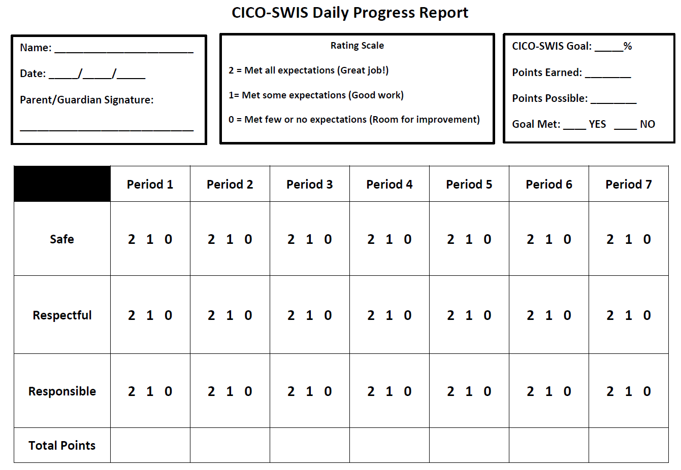
Defined number times for feedback (ten or less)
Built upon three to five
school-wide expectations
Generalizable across student schedules
Three point rating scale
Notes:
Trainer Notes:
This example comes from Mid-Atlantic PBIS and OSEP Technical Assistance Center. We will have more examples in later slides.
This slide shows a sample DPR with important considerations.
Notice that the points are earned based on how well the students follow each of the school-wide expectations.
When developing the DPR, teams can decide on the rating scale numbers, but a student is rated on whether or not they completely followed the expectations. In this example 0 means they did not, 1 means they partially followed them, and 2 means they completely followed the expectations.
It is very general so that all students in CICO can use the same card.

Slide 27
DPR Content
Student’s name and date
Matrix of behavioral expectations by period/class/setting
Rating scale that is easy for teachers to use
Student’s goal for the day (optional)
Student’s total points and percentage for day
Teacher notes on successes of student
Parent signature

Slide 28
Example
Student name and date
Behavioral expectations
Time periods
Rating scale
Student’s goal for the day
Student’s total points
Teacher notes on successes
Parent signature
Notes:
28
Trainer Notes:
Be sure to point out all of the content that is on this form.
It is a very small form that can be easily printed multiple times on one sheet of paper, but still includes all of the information that is needed.
28

Slide 29
For Younger Students
Goals
Am to Mid-morning
Mid-morning to Lunch
Lunch
PM
Be Safe
☺ • ☹
☺ • ☹
☺ • ☹
☺ • ☹
☺ • ☹
☺ • ☹
Be Kind
☺ • ☹
☺ • ☹
☺ • ☹
☺ • ☹
☺ • ☹
☺ • ☹
Be Responsible
☺ • ☹
☺ • ☹
☺ • ☹
☺ • ☹
☺ • ☹
☺ • ☹
Total Points
Teacher Initials
Daily Goal _____/______ Daily Score _____/_____
Notes:
29
Trainer Notes:
Elementary example
For very young students, symbols can be used instead of numbers. But there still needs to be a goal. In this example, the smiley face would be worth 2 points, the dot 1 point, and the sad face zero points. The facilitator would do all the calculations.
Considerations for older students: there are currently some electronic methods being developed and used for older students (middle and high school), e.g., apps on phones or ipads.

Slide 30
Notes:
Trainer Notes:
The research study here uses ipads for MS and HS kids. they self-rate and then teacher rates and they compare.
In the Facilitator Guide we will show examples of electronic data collection.

Slide 31
DPR Checklist
All expectations are included on the DPR.
At least four rating periods are included throughout the day.
A rating scale (with explanation) is provided for each rating period (teacher will just circle the rating).
Have spaces for the teacher’s positive comments.
Include spaces for student’s total points and percentage.
Include parent signature line.
Include space for specific target behaviors to be added under expectations, if necessary.
Notes:
Trainer Notes:
This checklist will help teams develop their DPR.
This is included in the facilitator guide as a handout.

Slide 32
Component 2: Regular Teacher Feedback

Slide 33
Component 2: Regular Teacher Feedback
Give positive, specific praise for appropriate behavior.
Give corrective feedback when needed.
Rate student’s demonstration of expectations.
Notes:
Trainer Notes:
At the end of each class period or during natural transitions, the classroom teacher gives the student positive, specific praise for using the appropriate, expected behavior.
If needed, the teacher can also give corrective feedback (also positive and specific).
Training on how to give positive specific praise and corrective feedback may be needed for teachers.
The goal is to help the student improve their behavior.
The teacher will then give the student a rating for how well they demonstrated each of the expectations, using the point system on the DPR.
The student and facilitator work together to determine the daily point goal, using the point system on the DPR.

Slide 34
This video is an example of how a school might teach staff how to give students proper feedback in the classroom for CICO.
Notes:
Trainer Notes:
This video was created to show teachers how to correctly give CICO feedback to students in their classrooms.
Link to video: https://www.youtube.com/watch?v=V5X9RpvC6u4

Slide 35
Example: Assess teacher feedback used with Tier II interventions.
Notes:
Trainer Notes:
This slide is animated.
Here is an example of an assessment teachers can use to determine if they are providing the appropriate support to the students in CICO.
This is provided in the facilitator guide as a handout.

Slide 36
Component 3: Check-out

Slide 37
Component 3: Check-out
Each student returns to the facilitator.
Points are totaled.
Facilitators provide verbal praise.
Optionally, give a Tier I acknowledgement.
Provide re-teaching and encouragement when needed.
Notes:
Trainer Notes:
At the end of each school day, the students go back to their CICO facilitator, where their points are totaled and recorded for the day.
The facilitator then gives the student additional verbal praise and possibly a Tier I acknowledgement if goals have been met. (This is something you can decide as a team.)
If the student hasn’t met their goal for the day, the facilitator will go over the expectations with the student again and encourage them to do better the next day.

Slide 38
Reinforcements at Check-out
Emphasize social aspects.
Personal connection with an adult
Increase adult attention, positive peer attention, or offer extra activities.
Reinforce for checking in, checking out, returning parent signature, and meeting daily and weekly point goals.
Students who participate in the CICO intervention will still participate in the school-wide system of encouraging appropriate behavior.
Important!!!!!
Notes:
Trainer Notes:
Students that have not made progress with Tier I interventions need additional reinforcement.
Be sure to emphasize the social aspects of the intervention.
The primary CICO reinforcer is the personal connection with an adult!
You can increase adult attention, increase positive peer attention, or provide easily accessible activities such as additional computer or gym time.
Reinforce for checking in, checking out, and meeting daily and weekly point goals.

Slide 39
Component 4: Data Collection and Progress Monitoring

Slide 40
Component 4: Data Collection and Progress Monitoring
Log percentage of points earned daily
Graph and review data
Monitor progress and make decisions
Notes:
Trainer Notes:
Once the student and facilitator have finished checking out, the facilitator will enter the student data into a spreadsheet.
Every student will have a goal, which is typically to earn at least 80% of the possible points each day.
These data will then be graphed about every two weeks so that the team can review the student’s progress and make decisions about the intervention.
In the upcoming section “Daily Progress Reports (DPRs)” there will be a lot of examples of data collection forms.

Slide 41
Using Data from the DPR
Calculate percentage of daily points earned.
Graph results on an ongoing basis.
Review data at least every two weeks.
After about six weeks of data, use data decision rules to determine next steps.
Notes:
Trainer Notes:
Ideally, daily points should be recorded and graphed daily, with a trend line showing progress.
The next slide gives examples of ways to record and analyze the data.
It’s important to review each student’s data often (at least every two weeks) to determine whether any changes need to be made.
This intervention is meant to be short term, but be sure to give the student at least a month to six weeks before making any changes.

Slide 42
Some Data Collection Options
CICO-SWIS
Link: Demonstration of this tool on pbisapps.org website
Missouri’s Advanced Tiers Data Collection Spreadsheet
Link: Instructions and different versions available for free on Missouri SW-PBS website

Slide 43
Reviewing Data
Data may show…
Positive response
Questionable response (e.g., positive trend, but very slow moving)
Negative response
Notes:
Trainer Notes:
As noted in an earlier slide, the student needs to be in the intervention long enough to learn and improve behavior (the team will need a data decision rule for this; e.g., the student will remain in the intervention for at least six weeks to collect sufficient response data).
After the determined minimum amount of time, consider the student’s response and use data decision rules to determine what the next steps will be. The next three slides will go into more detail about each of the scenarios on this slide.

Slide 44
Some Possible Next Steps, Based on Data
Positive Response
Move to self-management
Fade the intervention
Schedule graduation
Notes:
Trainer Notes:
Before beginning to fade or graduate a student from an intervention, it’s important that the student learns how to self-manage the behavior they have been learning and practicing. They will continue their normal CICO routine, but they will be self-rating throughout the day. Their teachers will continue to rate also, and they will discuss their ratings and the student’s ratings with the student. Both sets of data are collected and this will continue until the student and teacher ratings are matching up most of the time. The team will need to have a data decision rule for this, e.g., when the teacher and student ratings are at least 80% matching for two weeks, then the student can move on to fading the intervention and graduating.
Fading the interventions might involve…
having the student check in fewer times with teachers during the day.
having the student continue self-rating and getting feedback from the teachers on their ratings (though less often and fade the frequency).
using data decision rules to determine when the student is ready to graduate (e.g., if the student gets 80% or more of points 80% or more of the time with less frequent or no teacher feedback, then they are ready to graduate).
Have a graduation ceremony to celebrate the student’s success and reinforce how well the student has progressed. At this point, the CICO daily routine is discontinued, with occasional monitoring of student’s data and continued feedback from parents and teachers, though not formally. At this point, the team might want to have some options, such as letting the student continue to check in with the facilitator from time to time, or get feedback from teachers.

Slide 45
Some Possible Next Steps, Based on Data
Questionable Response
Check for fidelity of implementation
Intensify the intervention
Add individualized features
Review function of behavior
Notes:
Trainer Notes:
When a student is not having a positive response, the first step should always be to check that the intervention is being implemented the way it was intended. Some questions to ask:
Is the student checking in and out regularly and getting regular feedback from teachers?
Are teachers giving appropriate, positive, corrective feedback?
Intensifying the intervention might include adding additional check in times during the day or having the facilitator spend a little extra time with the student in the morning.
If the response is slow, but going in the right direction (e.g., the trend is positive, but it’s taking more than six weeks for the student to get 80% or more of points on a regular basis), take a deeper look at data to see if there are specific areas where the student isn’t having as much success and target those more closely. (See the next slide for an example of a DPR with individualized features.)
Another step would be to review the function of behavior. If the function is not actually to “gain adult attention,” another intervention might be more appropriate.

Slide 46
Example of a Daily Progress Report with Individualized Features
Notes:
Trainer notes:
Here is an example of a Daily Progress Report with individualized features. This will be available as a handout in the facilitator guide.
On this DPR, the student is focusing on specific expectations. Most students in CICO will be rated on how well they follow all of the expectations, but if a student is progressing slowly with CICO and it is determined that they are having more difficulty with specific behaviors, they can be more individualized. Everything else stays the same.
The student will be assessed during each period of the day on how well they followed the expectations.
The more they followed the expectations, the more points they get.

Slide 47
Some Possible Next Steps, Based on Data
Negative Response
Check for fidelity of implementation
Review function of behavior
Consider another Tier II intervention
Notes:
Trainer Notes:
Again, the first step is always to check that the intervention was implemented correctly and everyone involved is doing what they’re supposed to do.
If the response is not positive in a reasonable amount of time (the team will need to have data decision rules for this; e.g., no positive trend and not meeting 80% of daily points within four weeks), it is also important to review the function of behavior and whether the intervention was appropriate.
If the response continues to be negative and it is determined that CICO is not appropriate for the student’s function of behavior, it may be time to consider another intervention.

Slide 48
Component 5: Family Participation

Slide 49
Component 5: Family Participation
Students are reminded to take their DPR home.
Parents sign and return the DPR.
Facilitators provide re-teaching and encouragement if the DPR is not signed.
Notes:
Trainer Notes:
The facilitator promotes school-to-home communication and family participation with the CICO intervention.
Students are reminded each day to take their DPR home.
Parents are asked to sign and return the DPR the following day.
If the DPR is not signed and returned, re-teaching and encouragement are provided but no punitive responses occur.
Possibly provide reinforcer when it is brought back signed
Considerations for older students: middle school and high school students may need parent signature less often, e.g., weekly.

Slide 50
Video example of morning and afternoon in CICO
Notes:
Trainer Notes:
Link to video: https://youtu.be/MyPUY38blZQ

Slide 51
Guide for Implementing CICO
Guide for implementing CICO provided on the next slide
This Guide can also be downloaded from http://cce.astate.edu/pbis/wp-content/uploads/2019/11/5.-check-in-check-out-guide.docx
Notes:
Trainer

Slide 52
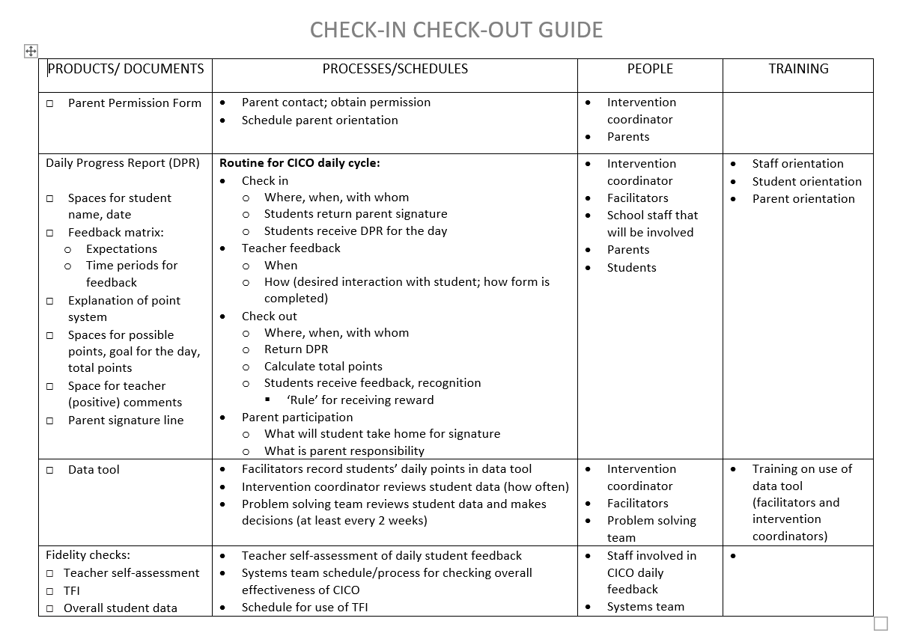
Notes:
Trainer Notes:
This guide will be in the Facilitator Guide.

Slide 53
Do it With Fidelity!
Tiered Fidelity Inventory (TFI)
Section 2.6: Tier II Critical Features
Section 2.8: Access to Tier I Supports
Section 2.9: Professional Development
Notes:
Trainer Notes:
In order for Tier II to have the desired effect, it must be done with fidelity. Use the TFI as a fidelity check.
The next 3 slides will provide a main idea and outline the criteria for reaching fidelity for each of these items.

Slide 54
2.6 Tier II Critical Features
Feature | Possible Data Sources | Scoring Criteria
Tier II Critical Features: Tier II interventions provide (a) additional instruction/time for student skill development, (b) additional structure/ predictability, and/or (c) increased opportunity for feedback (e.g., Daily Progress Report). | Universal lesson plans Tier II lesson plans Daily/Weekly Progress Report School schedule School Tier II handbook | 0 = Tier II interventions do not promote additional instruction/time, improved structure, or increased feedback. 1 = All Tier II interventions provide some but not all three core Tier II features. 2 = All Tier II interventions include all three core Tier II features.
Main Idea: Tier II supports should focus on improving the skills and context needed for student success.

Slide 55
2.8 Access to Tier I Supports
Feature | Possible Data Sources | Scoring Criteria
Access to Tier I Supports: Tier II supports are explicitly linked to Tier I supports, and students receiving Tier II supports have access to and are included in Tier I supports. | Universal lesson plans & teaching schedule Tier II lesson plans Acknowledgement system Student of the month documentation Family communication | 0 = There is no evidence that students receiving Tier II interventions have access to Tier I supports. 1 = Tier II supports are not explicitly linked to Tier I supports, and/or students receiving Tier II interventions have some but not full access to Tier I supports. 2 = Tier II supports are explicitly linked to Tier I supports, and students receiving Tier II interventions have full access to and receive all Tier I supports.
Main Idea: Tier II supports are more effective when layered within Tier I.

Slide 56
2.9 Professional Development
Feature | Possible Data Sources | Scoring Criteria
Professional Development: A written process is followed for teaching all relevant staff the process for and how to implement each Tier II intervention that is in place. | Professional development calendar Staff handbook Lesson plans for teacher trainings School policy | 0 = No process for teaching staff is in place. 1 = Professional development and orientation process is informal. 2 = Written process is used to teach and coach all relevant staff in all aspects of intervention delivery, including request for assistance process, using progress report as an instructional prompt, delivering feedback, and monitoring student progress.
Main Idea: Effective Tier II supports require participation of many adults in the school.

Slide 57
Summary
CICO requires implementing daily, weekly, and quarterly components.
Choose CICO facilitators who have positive relationships with students in the school.
The CICO coordinator and facilitator(s) have individual and shared responsibilities.
Develop a daily progress report and a process for how it will be received and used throughout the day.
Develop a progress monitoring process with regular data collection and data review, and the use of data decision rules for responses to the intervention.

Slide 58
Resources
What is Tier 2 Support (pbis.org)
Missouri Schoolwide Positive Behavior Support Tier II Team Workbook
CCE Tier II Resources
Book and DVD: Responding to Problem Behaviors in Schools: The Behavior Education Program
Behavioral Intervention Tools Chart

Slide 59
We appreciate the following for sharing information:
Missouri School-Wide Positive Behavior Support
PBIS OSEP Technical Assistance Center

