Slide 1


Coaching in PBIS
Module 11
Anne Merten
Rebecca Hegger
amerten@astate.edu
rhegger@astate.edu
Notes:
Images in this module were obtained at google.com/images unless otherwise specified.

Slide 2
Context
Why have a coach?
Coaching skills
Guiding questions
Responsibilities & qualifications
Phases of coaching

Slide 3
Why Have a Coach?

Slide 4
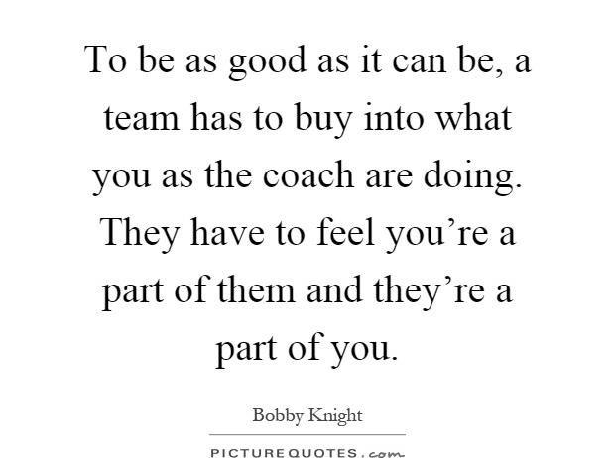
http://www.picturequotes.com/dmca

Slide 5
Why Invest In Coaching?
Ensures fidelity of implementation
Ensures fidelity of interventions
Ensures systems are in place
Provides staff with an onsite resource
Notes:
Trainer Notes:
It’s important to invest in coaching so that teams have guidance and encouragement to ensure fidelity of implementation and interventions using evidence based practices, and to ensure systems are in place to support and sustain implementation. Coaches also serve as an onsite resource for staff members.

Slide 6

Coaching
Coaching is done…
  By a person with credibility & experience
  After initial training
  On-site, in real time
  Repeatedly, as needed
Notes:
Trainer Notes:
Coaching is about guiding someone in developing skills. This is why a coach not only needs experience with these skills, but needs to be viewed as credible. Coaching is only done after the team has had training, and is done in real time, such as during team meetings. As the team begins to develop skills, the level of coaching is adjusted to meet the needs of the team.

Slide 7
Training Outcomes Related to Training Components
 | Training Outcomes
Training Components | Knowledge of Content | Skill Implementation | Classroom Application
Presentation/ Lecture | 10% | 5% | 0%
Plus Demonstration | 30% | 20% | 0%
Plus Practice | 60% | 60% | 5%
Plus Coaching/ Admin Support Data Feedback | 95% | 95% | 95%
Joyce & Showers, 2002
Notes:
Trainer Notes:
Research regarding training outcomes related to training components found that trainees were more successful in all areas, especially in applying skills in the classroom, if they had coaching, administration support, and data feedback. Teams will be more successful with coaching. However, PBIS team members should also view themselves as “coaches” who are available to assist teachers, staff, family members, students, etc. with implementing PBIS and providing the necessary feedback to enhance acquisition and application across the school setting.

Slide 8
Guiding Principles For Effective Coaching
Build local capacity
Maximize current competence
Focus on valued outcomes
Emphasize accountability
Pre-correct for success
Build credibility through…
  Consistency
  Competence with behavioral principles/practices
  Relationships
  Time investment
Notes:
Trainer Notes:
Build local capacity so that you become unnecessary, but remain available. Maximize current competence; don’t fix it if it’s not broken! Make the smallest change that will have the biggest impact. Focus on valued outcomes; tie all efforts to the benefits for children. Emphasize accountability- measure and report! (A good way to absorb this is to think of another context – sports coaching. Think, for instance, how a baseball hitting coach might approach his/her job, using the principles above. Now, think how this is applied to a PBIS team member learning data-based problem solving.)

Slide 9
Outcomes Of Coaching
Fluency with trained skills
Adaptation of skills locally
Rapid redirection from misapplications
Increased fidelity of overall implementation
Improved sustainability
Notes:
Trainer Notes:
As coaching proceeds, teams gain skills and become fluent in them. The fluency leads to the team’s ability to use and adapt the skills to solve local problems. Coaches can point out misapplications immediately and redirect to appropriate applications, helping teams gain knowledge and skills more quickly. Active, ongoing coaching results in teams being more efficient, more effective, and more likely to continue implementing PBIS.

Slide 10

What Is A Coach?
Supporter
Partner
Resource
Liaison
Facilitator
Notes:
Trainer Notes:
A coach serves many roles, but, in general, a coach is there to guide others in developing the skills they need to do the best job possible! A coach doesn’t do all the work, but instead teaches the team, then guides them as they gain fluency with the skills the coach has taught them.

Slide 11
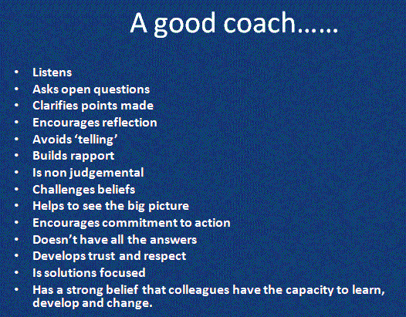
The Coaching Toolkit by Shaun Allison, 2009.
Notes:
Trainer Notes:
This image is from the book The Coaching Toolkit by Shaun Allison, 2009.

Slide 12
Coaching Skills

Slide 13

Effective Communication Skills
Active listening
Summarizing
Questioning
Empathizing
Gaining consensus
Actively engaging stakeholders
Notes:
Trainer Notes:
These are skills that will be very important to the developing PBIS coach.

Slide 14
Commit To Listening
Make eye contact
Acknowledge
Pause before you speak and ask,
“Will my comment open up or close down this conversation?”
Notes:
Trainer Notes:
Commit to listening by making sure that your body language mirrors your partner’s, making eye contact, showing appreciation (by making sounds that show you’re listening), and summarizing or paraphrasing back what you hear. Be sure to ask questions.

Slide 15
Use Words That Are Specific And Positive
Use and rather than but…
“Emily I appreciate the way you analyzed our data into precise problem statements before our meeting and your analysis of our data kept our meeting focused.”
Notes:
Trainer Notes:
Use the constructive word “and” rather than “but”. This builds on, rather than blocks out, what has just been said. It advances discussions rather than anchoring them in argument. Avoid words that carry negative emotional implications, such as careless, dishonest, lazy and unprofessional because they can be very divisive when directed at others – even when they are used indirectly.

Slide 16

Example:
Constructive Feedback
Valerie R. Burton, M.Ed.
English/Language Arts Teacher at Jefferson Parish Public Schools
Notes:
Trainer Notes:
PBIS represents a change in philosophy. Instead of telling someone what they did wrong, tell them what they can do to be better.

Slide 17
Content Knowledge Skills
Philosophy behind…
  Systems change
  RTI and multi-tiered systems of support
  PBIS
  Principles of behavior
Notes:
Trainer Notes:
Coaches need to know about the philosophy behind systems change and multi-tiered systems of support.

Slide 18
Problem Solving Skills
(DESE recommends using Judy Elliot’s four-step approach shown below)
Notes:
Trainer Notes:
Coaches need to be able to guide teams through the problem-solving process at monthly meetings. This starts with guiding the data analyst in identifying a precise problem in the school’s discipline data, then moves to the team process of developing a plan to respond to the problem, and following up with evaluation to progress monitor the plan.

Slide 19
Guiding Questions

Slide 20
Communication Skills
Do I…
  have necessary communication skills?
  actively participate?
  follow through on commitments?
Am I…
  collaborative and cooperative?
  able to adapt to situations?
Notes:
Trainer Notes:
Coaches are just starting down the road to gaining skills and competencies. This slide and the next few are questions that can help guide coaches throughout their training so that they are mindful of the skills that they need to be effective coaches. Questions: Do I have the skills to effectively and constructively communicate with others? Do I actively participate in team meetings and other activities? Do I consistently and accurately follow through on commitments? Am I a collaborative and cooperative team member? Am I able to adapt to ever-changing situations?

Slide 21
Communication Skills
Do I have the skills to…
  facilitate meetings?
  collaborate with diverse groups?
  effectively distribute data?
  engage in problem solving?
  conduct trainings?
Notes:
Trainer Notes:
Questions: Do I have the skills to facilitate meetings? Do I have the skills to efficiently and effectively collaborate with diverse groups? Do I have the skills to effectively distribute data to all key stakeholders? Do I have the skills to engage in collaborative problem solving? Do I have the skills to conduct trainings for school staff and families?

Slide 22
Content Knowledge
Do I understand…
  how to lead to systems change?
  the critical elements of Tier 1?
  basic principles of behavior and how to apply them?
  classroom strategies?
Am I familiar with discipline policies and procedures?
Notes:
Trainer Notes:
Questions: Do I understand the need for a shared vision, collaborative communication, structured planning, and problem-solving to lead to systems change? Do I understand the critical elements of Tier 1 PBIS? Do I understand the basic principles of behavior and am I able to apply them within the Tier 1 core curriculum? Am I familiar with the discipline policies and procedures at my school? Do I understand classroom behavior management strategies?

Slide 23
Data-Based Problem Solving
Do I understand the problem-solving process?
Can I facilitate the problem-solving process?
Do I have the skills to…
  analyze behavior data?
  select evidence-based interventions?
  evaluate implementation fidelity?
  evaluate student outcomes?
Notes:
Trainer Notes:
Again, these are critical questions to keep in mind as coaches continue through training. Problem solving is especially critical for the PBIS team. It is their primary function. Questions: Do I understand the problem-solving process? Am I able to fluently facilitate the structured problem-solving process at Tier 1? Do I have the skills to analyze Tier 1 behavior data for effective decision making? Do I have the skills and knowledge to select evidence-based interventions based on problem analysis? Do I have the skills and knowledge to evaluate implementation fidelity and student outcomes?

Slide 24
Training & Professional Development
Am I able to attend…
  all trainings with the PBIS team?
  monthly PBIS team meetings?
  coaching meetings in my district?
  coaching professional development trainings?
Notes:
Trainer Notes:
These questions are about the coach’s commitment to continuing education and skill-building. Questions: Am I able to attend all trainings with the PBIS team? Am I able to attend monthly school-based PBIS team meetings? Am I able to attend the coaching meetings in my district? Am I able to attend professional development trainings specifically designed to enhance my coaching skills?

Slide 25
Responsibilities and Qualifications

Slide 26
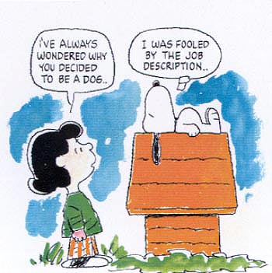
Roles And Responsibilities
Facilitation
Monitoring
Coaching
Charles Schultz
Notes:
Trainer Notes:
These are the general categories of roles and responsibilities that building coaches have. More detail will be given on the following slides.

Slide 27
Facilitation & Monitoring
Create a positive, supportive environment
Create & ensure structure in school & team system
Facilitate meetings (optional)
Monitor action plans, outcomes
Network with other district PBIS coaches
Serve as liaison between school team and district leadership
Notes:
Trainer Notes:
The biggest role the coach plays is making sure PBIS is being implemented with fidelity, but it’s also important to ensure a positive experience for the team. The coach doesn’t HAVE to be the facilitator, this is just an option. The coach can help build this skill with others and let someone else become facilitator. Another important job is connecting with the district and other coaches to represent your school team, report outcomes and needs, etc.

Slide 28
Coaching
Ensure fidelity of implementation
Pass on skills (sustainability)
Assist team in gaining expertise in…
  Data analysis
  Defining measurable outcomes
  Setting goals to achieve outcomes
  Developing strategies & activities to reach goals
  Progress monitoring
Notes:
Trainer Notes:
The coach will help build skills in others and prompt them along the way, and guide the team through problem solving and evaluation activities. The coach should also ensure fidelity of implementation, pass on skills to create sustainability, and assist the team in action planning through gaining expertise in: data analysis, defining measurable outcomes, setting goals to achieve outcomes, developing strategies and activities to reach goals, and progress monitoring.

Slide 29
Qualifications
Understands PBIS essentials in depth
Skilled at problem solving & school improvement process
Has credible/positive relationships with staff
Works collaboratively and in groups
Can attend team/district/network meetings & advanced training
Notes:
Trainer Notes:
The coach needs to be ahead of the team in understanding the essential features of PBIS and be skilled at problem solving and the school improvement process. Also, it’s important that the coach has credibility and positive relationships with other staff, is able to work collaboratively, can attend meetings with the building team and district/network, and can attend any advanced training that may be necessary.

Slide 30
Phases of Coaching

Slide 31
Phases Of Coaching – Phase 1
Teaching/transfer of new skill set
Define roles & tasks; supervise closely
Decisions made by coach/facilitator; one-way communication
Team will need direction & supervision
Adapted from Situational Leadership, Blanchard and Hersey
Notes:
Trainer Notes:
Phase one is the teaching/transfer of a new skill set. The coach is highly involved in this phase. The coach defines the roles and tasks of the team and supervises them closely. Decisions are made by the coach/facilitator and announced, so communication is largely one way. The team will lack fluency, but are enthusiastic and committed. They need direction and supervision to get them started.

Slide 32
Phase 2
Coaching:
High task focus, high relationship focus
Defines roles & tasks, but seeks input
More two-way communication
Team will need direction & supervision; support & praise; involvement in decisions
Notes:
Trainer Notes:
In phase two the coach is still highly involved, but begins to ask for input from the team. The coach still defines roles and tasks, but seeks ideas and suggestions from the team. Communication is much more two way. The team will have some competence, but may lack commitment. They need direction and supervision because they are still relatively inexperienced. They also need support and praise to build their self-efficacy and involvement in decision making to restore their commitment.

Slide 33
Phase 3
Participating/supporting:
Low task focus, high relationship focus
Coach passes day-to-day decisions to team
Decision-making control is more with team
Team will not need much direction; bolster their confidence and motivation
Notes:
Trainer Notes:
In phase three the coach is less involved with decisions, but still provides a lot of support and encouragement. The coach passes day-to-day decisions, such as task allocation and processes, to the team. The leader facilitates and takes part in decisions, but control is with the team. Team members now have competence, but may still lack confidence or motivation. They do not need much direction because of their skills, but support is necessary to bolster their confidence and motivation.

Slide 34
Phase 4
Delegating:
Low task focus, low relationship focus
Coach still involved, but control is with team
Team decides how coach is involved
Team will be able, willing to work with little supervision, support
Notes:
Trainer Notes:
The coach is still involved in decisions and problem solving, but control is with the team. The team decides when and how the coach will be involved. Team members will have both competence and commitment - they are able and willing to work on a project by themselves with little supervision or support.

Slide 35
Year-at-a-Glance Tool
Keep the year organized
Tasks categorized: data, systems, practices, communication
See example on next slide.
Notes:
Trainer Notes:
In order to stay focused and organized throughout the year, this tool, Year at a Glance, will help the coach plan tasks that need to take place to support the implementation of PBIS: data, systems, practices and communication.

Slide 36
Month | INFORMATION (DATA) | PLANNING (SYSTEMS) | IMPLEMENTATION (PRACTICES) | COMMUNICATION WITH STAFF, PARENTS and Community
August- before students return | Review prior year’s data | Establish monthly Team meetings Establish schedule for reporting to & celebrating with staff Plan for kick-offs | Conduct staff kick-off Conduct parent kick-off | Staff kick-off Develop communication to explain PBIS to parents Offer Parents opportunities to help
August - 1st week of school | Review results of TFI | Familiarize yourself with the Tiered Fidelity Inventory (TFI) Take pictures for stakeholder communication | Conduct student kick-off Administer kick-off evaluation survey Conduct school-wide celebration | Send out good news stories to media
Notes:
Trainer’s Notes:
Here is an example of tasks that might be scheduled in each category. This would be completed for each month of the year. By scheduling tasks for the entire year, the coach will be able to prompt the team regularly.

Slide 37
Sustainability
Be honest about issues.
Concentrate on precise problems.
Have clear, coherent discipline procedures.
Help the team be more efficient and effective.
Integrate coaching into key job descriptions.
Recommit to PBIS every year!
Notes:
Trainer Notes:
Things the coach can do to help sustain PBIS: be honest about issues and concerns in your building, concentrate on precise problems for the biggest impact with the smallest effort, have clear and coherent discipline procedures (known by all staff), help your team become more efficient and effective, integrate coaching functions into job descriptions of key personnel (e.g. school psychologist, school counselor, behavioral specialist, etc.), and recommit to PBIS every year!

Slide 38
Do It With Fidelity!
Tiered Fidelity Inventory (TFI)
Efficient, valid index of extent to which PBIS core features are in place
Section 1.1 Team Composition
Notes:
Trainer Notes:
The TFI is an important tool in the PBIS implementation process. It can be used in the development stage and then used in an ongoing manner to ensure all core features are in place. The TFI highlights each critical component of PBIS. Section 1.1 outlines the team composition. Note on the next slide that this includes coaching expertise. Coaches need to be familiar with the TFI and able to use this tool, which includes a walkthrough tool, and be able to guide the team in getting more fluent in using it regularly.

Slide 39
1.1 Team Composition
Feature | Data Sources | Scoring Criteria
 |  | 0 = Not implemented 1 = Partially implemented 2 = Fully implemented
1.1 Team Composition: Team Composition: Tier I team includes a Tier I systems coordinator, a school administrator, a family member, and individuals able to provide (a) applied behavioral expertise, (b) coaching expertise, (c) knowledge of student academic and behavior patterns, (d) knowledge about the operations of the school across grade levels and programs, and for high schools, (e) student representation. | School organizational chart Tier I team meeting minutes | 0 = Tier I team does not exist or does not include coordinator, school administrator, or individuals with applied behavioral expertise 1 = Tier I team exists, but does not include all identified roles or attendance of these members is below 80% 2 = Tier I team exists with coordinator, administrator, and all identified roles represented, AND attendance of all roles is at or above 80%
Main Idea: Teams need people with multiple skills and perspectives to implement PBIS well.

Slide 40
Summary
Coaches need to…
build their skills and fluency.
guide their team in building skills and fluency.
phase themselves out, but stay available.
stay organized! Create a schedule for the year.

Slide 41
Resources
Resources for Coaches & Trainers at OSEP Technical Assistance Center
https://www.pbis.org/topics/coaching
Arkansas PBIS Networking Sessions http://pbis.astate.edu/pbis/pbis-coaches/coaches-networking/

