Slide 1
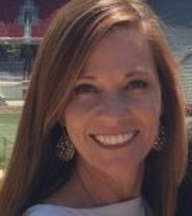

Staff Ownership
Module 12
Anne Merten
Rebecca Hegger
amerten@astate.edu
rhegger@astate.edu
Notes:
Images in this module were obtained at google.com/images unless otherwise specified.

Slide 2
Context
Importance of high staff ownership
Staff involvement
Cost/benefits of implementing PBIS
Showing appreciation
Indicators of ownership

Slide 3
Importance of Staff Ownership

Slide 4
“The best-planned reforms cannot achieve success without teachers committed to altering their practices and learning new approaches.”
Examining Comprehensive School Reform, Daniel K. Aladjem, Kathryn M. Borman, 2006.
Notes:
Trainer Notes:
Staff taking ownership of an initiative – committing to changing their practices and approaches – is crucial to the success of the initiative.

Slide 5

Reasons For Poor Staff Ownership
“Temporary fix”
No administrative ownership
Overwhelmed by tiers
Misunderstand implementation
Notes:
Trainer Notes:
Here are some of the reasons you might be having trouble getting everyone on board with PBIS: expectation that PBIS is a temporary fix, lack of administrator buy-in, administration is overwhelmed by tiers of implementation, and/or teachers misunderstand implementation.

Slide 6
It’s Only Human
Asking people to change can create:
Fear
Anger
Feeling of being judged
Sense of loss
Sense of threat
Uncertainty
Notes:
Trainer Notes
This might be a good discussion: (1) What kind of feedback are implementers hearing from staff? (2) Are there other reasons why staff are resisting change?

Slide 7
Critical Elements For Ownership
Process for obtaining ownership
Perceptions of problems vs. strategies to address them
Amount of professional development (PD) & support
Adapted from Kathryn Borman et. al., 2004.
Notes:
Trainer Notes:
Kathryn Borman and her co-authors (2004) report that current literature suggests three critical elements to promote teacher buy-in and commitment: 1) the process by which teacher support for reform is obtained, 2) alignment of teachers’ perceptions of the school’s main problems and the strategies proposed to address them, and 3) the amount of professional development and technical support provided by the developer.

Slide 8
Do The Prep Work
Do you have a good reason “why” change is needed?
Is there a sense of urgency?
Is there a unified vision?
Notes:
Trainer Notes:
As the PBIS team, it’s important to know why you want to do this and why staff should want to buy in to it. Why is it needed in your school? Along with your sense of urgency, it’s important to know how the staff feel about the current school climate and what kind of climate they envision. It's also important that district PBIS leadership teams know “why” change is needed. If schools are within a district that is implementing PBIS, there should be a district rationale for why change is needed. This rationale should be communicated to building leadership teams who in turn garner staff support and buy-in.

Slide 9
Creating A Compelling “Why”
What “why” will make your school care about implementing PBIS?
What makes your school’s “why” unique?
Notes:
Trainer Notes:
(From Michigan Dept of Ed training materials.) Part of making the “why” important to your school staff is to make it real for your staff within the context of your school. If your school has a 98% graduation rate, using national data on high school dropout is not likely to create any kind of sense of urgency for your staff. Context is going to matter with the why. Your work as the school leadership team is to get your staff and school community to care about the work of positive school climate. One of the easiest ways to do this is to identify a data point that the staff and school community are not comfortable with and are willing to commit to work on to change. Not that other data points do not matter, but if we overwhelm our staff and school community with multiple data points it may not have the impact we want regarding buy-in.

Slide 10

YOUR “Why”
Sense of urgency
  National statistics
  Local data
What will motivate staff?
Notes:
Trainer Notes:
(Adapted from Michigan Dept of Ed, day 1 of PBIS training.) There are a lot of data around discipline and school climate available on a national scale. How does your school compare? Under what circumstances would you be motivated to make a systemic change? How bad would a situation have to be? For example, 24% (national statistic) of students who drop out are unable to identify an adult in the school by whom they feel supported (Neild & Balfanz, 2006). What percent of students graduate from your school? Do you have climate survey data that suggest that students don’t have an adult they connect with at your school?

Slide 11
Critical Data Points
Input from staff, students, & parents
Current & historical data
A critical data point can show sense of urgency
Notes:
Trainer Notes:
Before you can go to staff with a sense of urgency, it’s important to understand what staff, students, and parents think about the school climate. Consider a survey to all stakeholders; analyze results to see if there are data that stand out. Also look at current discipline, attendance, graduation, academic, and any other data, as well as historical data to see if there are stand outs and trends. Use these data to create your sense of urgency and to show your staff that a change is well-founded.

Slide 12
Staff Involvement

Slide 13
PBIS Is A Collaboration
Ensure staff ownership
Explain how staff will benefit
Teach & reward behavior you want to see from staff
Keep staff informed & updated
Notes:
Trainer Notes:
PBIS is a collaborative effort. It is an ongoing process that will require consistent practices, responses, and procedures from staff. They need to feel that their efforts will benefit them and their students. Just as staff will be doing with students, you will have to teach and reinforce staff for delivering supports to students. Because PBIS is a continual process, it’s important to keep staff updated and informed so that they will know what the current issues are, what progress has been made, and how well you are meeting your goals.

Slide 14
Involve Staff In The Process
Get staff input throughout the implementation process.
  Overarching goals & mission
  Expectations
  Responding to student behavior
  Discipline procedures
  Evaluation
Notes:
Trainer Notes:
Implementing Tier I of PBIS requires creating systems and practices to support students. It’s important to involve staff in the process from the beginning. The team will be responsible for developing and implementing plans, and will make the final decisions. However, staff also need to be invested in the process, as they will be the ones delivering the supports to students. Staff need to be convinced that their efforts will be worthwhile.

Slide 15

A Good Indicator
Do staff want a change?
Do a high percentage agree?
Notes:
Trainer Notes:
It is recommended that 80% of staff agree that change is needed, agree to a change in philosophy, and agree to implement PBIS. The higher the percentage of staff that buy in to this change, the more likely PBIS will be successful. You want consistency throughout the school, and if only half of the building is willing to participate, it will be much harder to have success. People will be divided and students will be confused.

Slide 16
Ideas For Involving Staff
Climate survey
Get input for…
  Expectations
  Acknowledgements
  Behavior definitions
  Developing consistent procedures
Have staff develop lesson plans
Notes:
Trainer Notes:
Consider giving a climate survey to understand what staff perspective is on your school’s strengths and weaknesses, what behavior they see and want to see, what they think is being done consistently, how safe they feel, etc. This survey will help you narrow down the choices for school-wide expectations. Let staff vote on the top three to five behaviors they feel need to be taught and reinforced. Ask staff for input in defining expectations and developing a way of teaching the expectations. What types of acknowledgements do staff think are best? Ask staff for input on how all reported behaviors are defined and differentiated, and for procedures for responding to these behaviors. Staff will be the ones carrying out these practices, so they need to be invested in the process.

Slide 17
Staff Surveys
Staff can give truthful opinions while remaining anonymous.
Get staff perceptions on types and locations of problems occurring throughout the school.
Notes:
Trainer Notes:
The advantages of surveying staff are that you can get honest feedback and you can get a picture of what staff are seeing throughout the school. Compare perceptions to school data and you can get a lot of useful information.

Slide 18
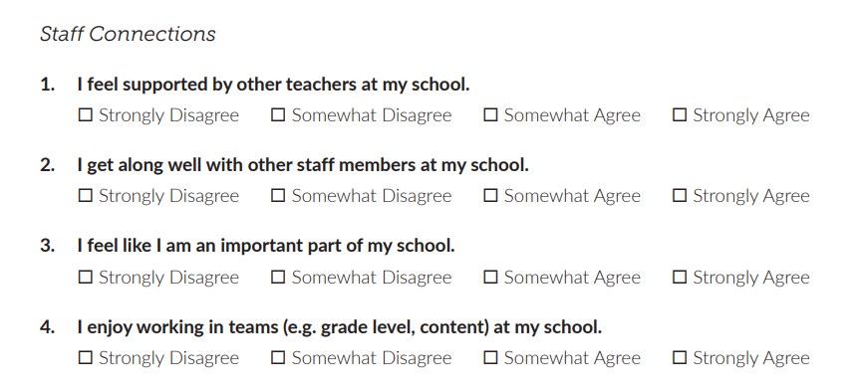
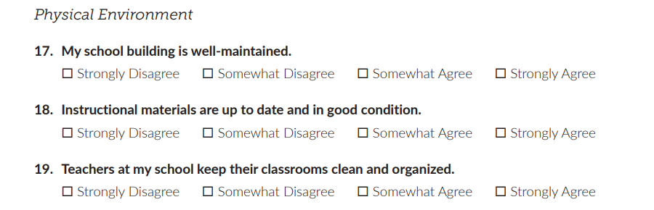
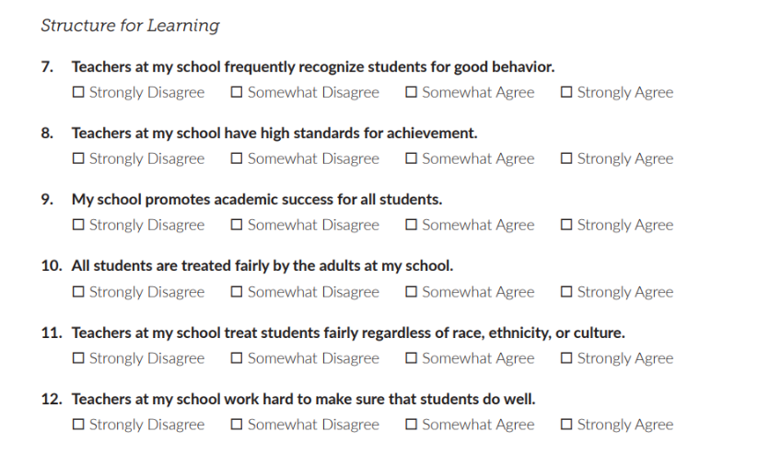
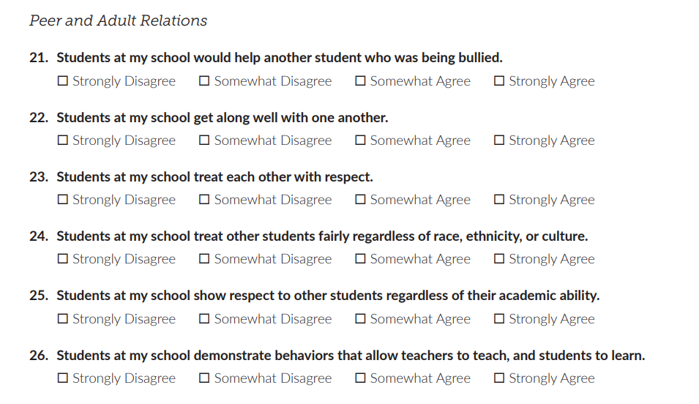
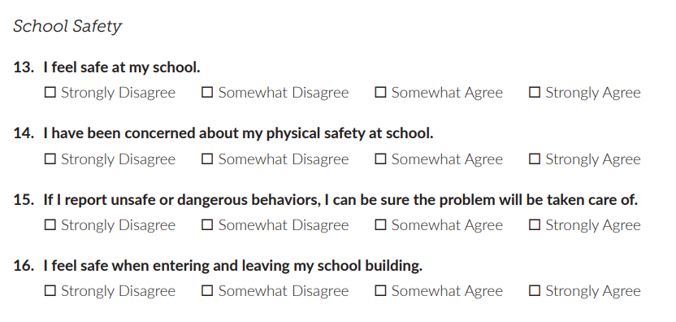
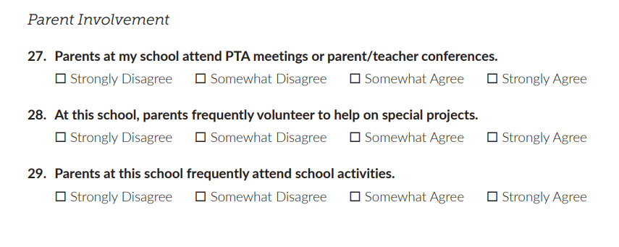
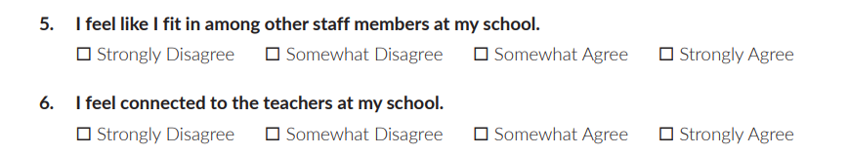
Notes:
Trainer Notes:
Here is an example of a staff survey on school climate and how teachers feel about working in the school. It can be found here (PBIS apps): https://www.pbisapps.org/resource/school-climate-survey-suite-manual.

Slide 19
Cost/Benefit of PBIS

Slide 20
What Does Behavior Cost?
How much time do…
  teachers spend responding to misbehavior?
    Minor problem behaviors
    Major problem behaviors
  administrators spend on misbehavior?
  students lose from instruction because of misbehavior?
Notes:
Trainer Notes:
Staff and administrators know that they spend a part of their school day responding to misbehavior, but do they really understand how much instruction and administrative time is lost over the course of a week? A month? A school year?

Slide 21
Maryland’s Worksheet
Overview of time lost for entire school year
Compare year to year to see time regained through PBIS
Graphic representation
Notes:
Trainer Notes:
The Maryland PBIS Initiative created the worksheet on the next slide to help schools understand how much time it “costs” teachers and administrators to respond to misbehavior and how much instruction time students miss. By implementing PBIS and continuing to be proactive and preventive, staff will spend less time on misbehavior and more time teaching. PBIS teams can give staff and administrators a graphic representation of what they have gained from year to year. This may not be apparent from day to day, but to see the big picture as presented by this worksheet, staff can see how their efforts have paid off.

Slide 22
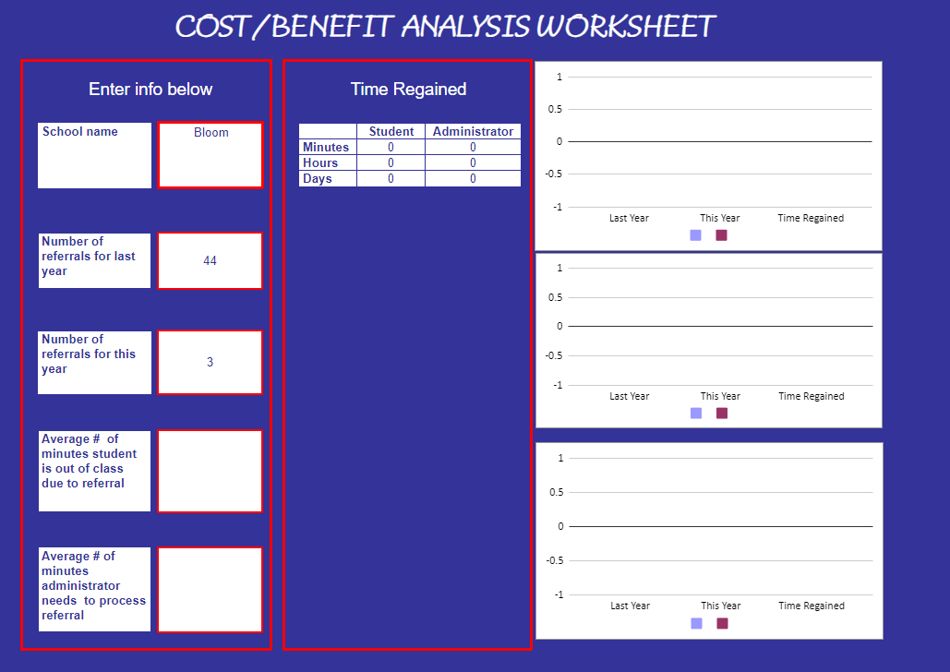
https://docs.google.com/spreadsheets/d/1wefGSMB_3NxPWA1IyrlxTvdNMyZWJNmN/edit#gid=910299469
Notes:
Trainer Notes:
Teams can find the worksheet on the Maryland website at https://www.pbismaryland.org/coaches-corner/coaching-resources (under the “Evaluation” section, it is titled “Cost Benefit Calculator”). The direct link is on the slide to download and show the team how it works. For example, a suggested average number of minutes for students to be out of class is 30 and for administrators to process is 20. This might be a good place to ask for thoughts from trainees. How much time do their students and administrators spend on average? How many referrals did they have last year? What would they like to see instead?

Slide 23
Showing Appreciation

Slide 24

Staff Appreciation
How will you encourage staff in implementing PBIS?
What will motivate them?
How will you know if it’s working?
Notes:
Trainer Notes:
If you expect staff to carry out PBIS practices, it’s important to acknowledge their efforts. As with everything PBIS, look at what things motivate staff and make an effort to see if your acknowledgements really do make staff feel appreciated. Be sure to ask for input and get feedback.

Slide 25
Guiding Questions
How will you acknowledge staff?
What problems do you expect?
How will you ensure they are given out properly and consistently?
Notes:
Trainer Notes:
It’s important to acknowledge staff for their efforts in implementing PBIS. They need positive reinforcement, too! Here are a few guiding questions to help develop a staff recognition plan.

Slide 26
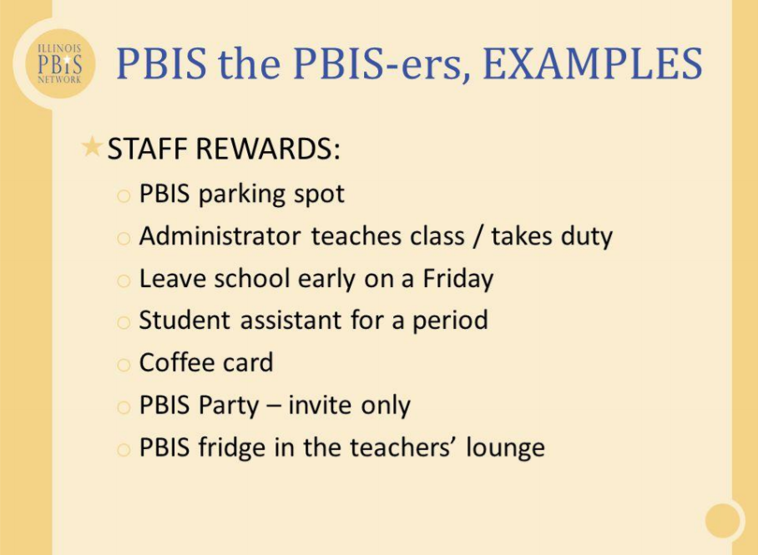

Slide 27
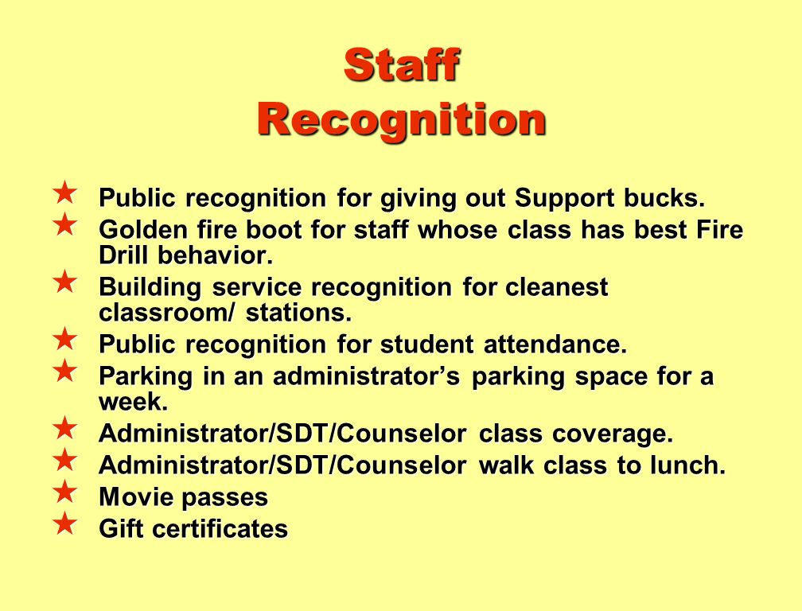

Slide 28
Indicators of Buy-in

Slide 29

Indicators Of Buy-In
Approximately 80% of the staff are able to…
State definition of school-wide PBIS
State the school-wide behavioral expectations
Notes:
Trainer Notes:
So, how will you know if you have good buy in? The items on this slide and the next are considered to be good indicators of staff buy-in. Staff will need training and support to achieve them. PBIS assessments and walk-throughs can help in determining these indicators.

Slide 30
Indicators Of Buy-In
80% of the staff…
Actively supervise in non-classroom settings
Agree to support SWPBIS action plans
Have more positive daily interactions with students than negative
Have opportunities to be recognized for their SWPBIS efforts
Notes:
Trainer Notes:
Again, for these items to happen, staff will need training and support. Administration can play a big role in determining/assessing if many of these items are being done (e.g., principal walk-throughs to look for active supervision, allowing staff reciprocal assessments to check for positive to negative interaction ratios, etc.). PBIS assessments (free assessments) can help schools assess many of these items (www.pbisapps.org).

Slide 31
Do It With Fidelity!
Tiered Fidelity Inventory (TFI)
Efficient, valid index of extent to which PBIS core features are in place
Section 1.7 Professional Development
Section 1.10 Faculty Involvement
Notes:
Trainer Notes:
The TFI is an important tool in the PBIS implementation process. It can be used in the development stage and then used in an ongoing manner to ensure all core features are in place. The TFI highlights each critical component of PBIS. Section 1.7 covers professional development and 1.10 covers faculty involvement. See next two slides.

Slide 32
1.7 Professional Development
Subscale: Implementation
Feature | Data Sources | Scoring Criteria
 |  | 0 = Not implemented 1 = Partially implemented 2 = Fully implemented
1.7 Professional Development: A written process is used for orienting all faculty/staff on four core Tier I SWPBIS practices: (a) teaching school-wide expectations, (b) acknowledging appropriate behavior, (c) correcting errors, and (d) requesting assistance. | Professional development calendar Staff handbook | 0 = No process for teaching staff is in place. 1 = Process is informal/unwritten, not part of professional development calendar, and/or does not include all staff or all four core Tier I practices. 2 = Formal process for teaching all staff all aspects of Tier I system, including all four core Tier I practices.
Main Idea: The key to PBIS implementation is staff consistency. All staff need to be informed and aware of goals, process, measures.

Slide 33
1.10 Faculty Involvement
Subscale: Implementation
Feature | Data Sources | Scoring Criteria
 |  | 0 = Not implemented 1 = Partially implemented 2 = Fully implemented
1.10 Faculty Involvement: Faculty are shown school-wide data regularly and provide input on universal foundations (e.g., expectations, acknowledgements, definitions, consequences) at least every 12 months. | PBIS Self-Assessment Survey Informal surveys Staff meeting minutes Team meeting minutes | 0 = Faculty are not shown data at least yearly and do not provide input. 1 = Faculty have been shown data more than yearly OR have provided feedback on Tier I foundations within the past 12 months but not both. 2 = Faculty are shown data at least four times per year AND have provided feedback on Tier I practices within the past 12 months.
Main Idea: Schools need active engagement of faculty to be successful with PBIS implementation and sustain the work over time.

Slide 34
Summary
Get staff input throughout all stages of implementation.
Provide professional development.
Ensure staff understand PBIS and why you are implementing it.
Provide data to staff to show progress.
Show staff appreciation for their efforts.

Slide 35
Resources
Sustaining PBIS
http://www.pbismissouri.org/sustaining/
Effective Professional Learning
http://pbismissouri.org/wp-content/uploads/2017/06/9.0-MO-SW-PBS-Tier-1-Workbook-Ch-9-PL-1.pdf?x30198

