Slide 1


PBIS Assessment & Evaluation
Module 14
Anne Merten
Rebecca Hegger
amerten@astate.edu
rhegger@astate.edu
Notes:
Images in this module were obtained at google.com/images unless otherwise specified.

Slide 2
Context
Why do assessment/evaluation?
Data sources
Evaluation tools
Planning
Sharing outcomes
Notes:
Trainer Notes:
In this training, we will discuss the need for, and uses of, evaluation and assessment and learn about some tools to use for assessment and evaluation. Also, we will talk about the importance of planning evaluation and sharing results.

Slide 3
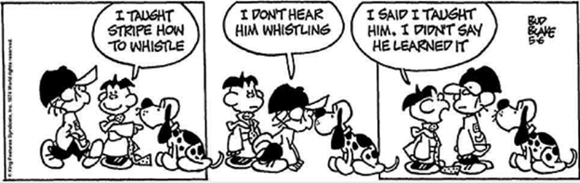
Notes:
Trainer Notes:
This comic strip shows what can happen if you don’t use assessment. We can teach something, but that doesn’t mean the student learned! By using assessment and evaluation, you can use the information gained to make decisions about current actions and strategies and make a plan for going forward.

Slide 4
Why Evaluate PBIS Implementation?
Ensure accuracy and consistency in implementation.
Identify strengths and weaknesses in implementation.
Notes:
Trainer Notes:
How will you know if you are implementing PBIS systems and practices consistently and accurately? Evaluate the “glows” and “grows” (see your strengths and your areas in need of more work).

Slide 5
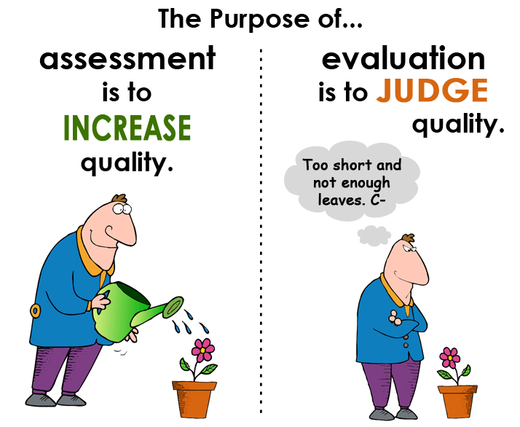
Notes:
Trainer Notes:
Assessment and evaluation are often used interchangeably, but generally, assessments are used formatively and evaluations are used in a summative way. So, you could say that an evaluation is a summative assessment. The tools we will look at later in this presentation can be used in both ways.

Slide 6
Evaluating PBIS
Fidelity of implementation of core elements
Outcomes – behavior, academics, school climate, etc.
Notes:
Trainer Notes:
When we evaluate PBIS, we are asking two overarching questions: 1) how well are we implementing the core elements of PBIS, and 2) are we getting the outcomes that we wanted to get? We then use this information to develop action plans to address areas of need and to find ways to make systems and practices more efficient. Evaluation can also help schools prepare for implementing Tiers II and III.

Slide 7
Some Data Sources
School-wide academic data
School-wide discipline data
Attendance data
Special education data
PBIS assessments
Climate surveys
Needs surveys
Incentive surveys
Involvement surveys
Notes:
Trainer Notes:
Data sources serve different purposes in evaluation. School-wide academic and discipline data show big picture, important outcomes. This may include office referrals, suspensions, standardized testing, grades, etc. You can also look at groups within the school, such as students with disabilities, male students, Hispanic students, ESL learners, etc. to show disproportionality data (for example, what percent of students receiving special education are receiving discipline referrals, suspensions, and expulsions)? PBIS assessments help teams implement the core elements of PBIS and continuously improve the effectiveness and efficiency of implementation of those elements. For example, the PBIS Self-Assessment Survey can show staff perspective on how well PBIS is being implemented in the school. Other surveys can be given to look at specific topics, such as those listed above.

Slide 8

PBIS Assessments
Tiered Fidelity Index (TFI)
Self-Assessment Survey (SAS)
Team Implementation Checklist (TIC)
Benchmarks of Quality (BoQ)
School Safety Survey (SSS)
www.pbisapps.org
Notes:
Trainer Notes:
PBIS assessments are specifically for assessing how well PBIS is being implemented from different perspectives. The TFI can be used as a formative assessment as well as an annual evaluation. It is designed to assess all three tiers. The SAS is recommended as a yearly assessment of how well staff feel PBIS is being implemented. This helps to inform the team on various areas of need, such as communication and professional development. The TIC is a good tool for teams to use often when first implementing PBIS. It will help them identify Tier I components that need to be addressed. The BoQ is a tool for teams to assess implementation of Tier I and what impact it is having. The SSS assesses safety from the perspective of various staff and students. All of these tools and others are online and free at www.pbisapps.org.

Slide 9
The Tiered Fidelity Inventory (TFI)
Single, efficient, valid, reliable survey
Measures application of core features of PBIS (three tiers)
Completed by small team (administrator, coach, others)
Includes a walkthrough tool
Notes:
Trainer Notes:
We will go into a little more depth with the TFI, as it can be used by the team for most of their assessment and evaluation needs. Teams can still use the TIC or BoQ, but the TFI can also be used for their purposes. The TFI can evaluate all three tiers of PBIS. This provides a single, efficient, valid, and reliable survey to guide PBIS implementation. It measures the extent to which school personnel apply core features of PBIS. It is completed by a small team that includes administrator, coach, and others, with input from team. The walkthrough tool is for assessing visual displays and student and staff understanding of PBIS.

Slide 10
Uses Of The TFI
Determine what is in place & what is needed
Guide implementation efforts
Assess progress
Build action plan
Self-assess annually to sustain implementation of PBIS
Notes:
Trainer Notes:
Use formative assessment to determine current PBIS practices in place and needed prior to launching implementation. Use progress monitoring to self-assess PBIS practices to guide implementation efforts and assess progress. Build an action plan to focus implementation efforts. Use an annual self-assessment to self-assess annually to facilitate sustained implementation of PBIS.

Slide 11
When To Administer The TFI?
During initial implementation administer every three or four meetings.
Once 70% is met three times in a row, administer annually.
Notes:
Trainer Notes:
During initial implementation, complete the TFI every three or four meetings until you reach 70% fidelity three times in a row. Once that is met, you can complete the TFI annually.

Slide 12
TFI Categories
Section for each tier
Sub-divided into: teams, implementation, evaluation
Individual items in each area above
Walkthrough tool
Notes:
Trainer Notes:
The TFI can assess implementation for all three tiers. Each tier has items in three categories – teams, implementation, and evaluation. There is also a walkthrough tool to get an understanding of how PBIS is visually represented around the school and to get feedback from staff and students on their understanding of PBIS.

Slide 13
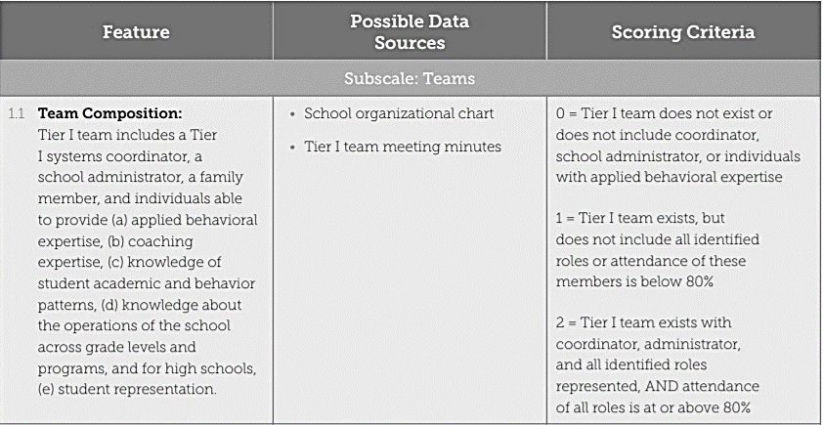
Example Of Items & Scoring Criteria
Notes:
Trainer Notes:
These are items from the “Teams” category of the Tier I section of the TFI. The item is described, and the criteria show how to score this item based on what is in place. The middle column shows possible sources for collecting data that will verify the score.

Slide 14
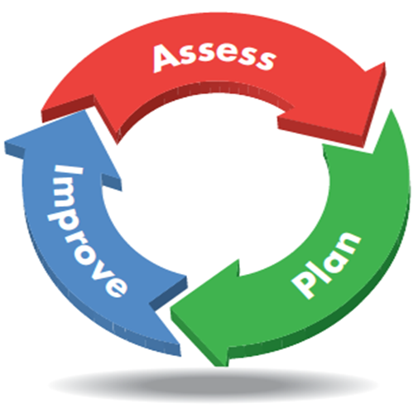
Action Planning With The TFI
Identify area(s) of need.
Identify individual items to address.
Develop actions and timeline; assign personnel.
Notes:
Trainer Notes:
Once you have evaluation/assessment data, use those data to develop plans for improvement. Identify an area or two that scored lower than desired on the assessment. Identify individual items that you want to address in those areas. Develop action steps to address the items, along with a timeline and individuals responsible for each step.

Slide 15
Subscale | Item | Current Score | Action(s) | Person(s) Responsible | Timeline
Teams | 1.1 Team Composition
 | 1.2 Team Operating Procedures
Implementation | 1.3 Behavioral Expectations
 | 1.4 Teaching Expectations
 | 1.5 Problem Behavior Definitions
 | 1.6 Discipline Policies
 | 1.7 Professional Development
 | 1.8 Classroom Procedures
 | 1.9 Feedback and Acknowledgment
 | 1.10 Faculty Involvement
 | 1.11 Student/Family/Community Involvement
Evaluation | 1.12 Discipline Data
 | 1.13 Data-based Decision Making
 | 1.14 Fidelity Data
 | 1.15 Annual Evaluation
Notes:
Trainer Notes:
This is the TFI action planning worksheet for Tier I of the TFI.

Slide 16
Action Plan (Based on what source?) | What needs to be done | Who will do what | When completed
1. Train all staff to work collaboratively and respectfully with families. (Family Survey questions 9, 10, 13) | Create a monthly newsletter to keep parents informed of PBIS/RTI data/events. Include volunteer portion for parents to be involved. | Tier I team will create a sub-team dedicated to communicating with staff and parents. | September 2017
2. Assess parents’ opinions of how well schools communicate with them. (Family Survey) | Continue using Survey Monkey Parent Survey in 1st and 3rd quarters. | Tier I sub-committee will review results of surveys. | Fall and spring 2017/2018
3. Share school-wide expectations, t-chart, school matrix, strategies for acknowledging, and the acknowledgement system. (Family Survey questions 4 & 15) | Expand current brochure given out at beginning of the year to include more info on PBIS/RTI and the benefits of implementing them. | Tier I sub-committee will make changes to brochure and to displays that will be posted at open house. | Summer 2017 – ready to use at open house night.
Notes:
Trainer Notes:
Here is an example of an action plan around a parent engagement survey. This spreadsheet is a generic example that can be used to action plan using results from any type of assessment.

Slide 17
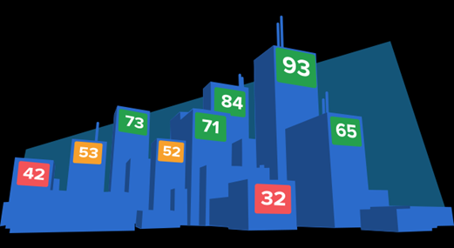
Self-Assessment Survey (SAS)
Staff perception/priorities
School-wide, classroom, non-classroom and individual student systems
Identifies staff priorities
Annual
Notes:
Trainer Notes:
The SAS is a staff perception of school-wide discipline systems. It assesses school-wide, classroom, non-classroom, and individual student systems and identifies the staff priorities for action planning (what areas do staff feel are not fully in place – prioritized). This is an annual assessment. It is recommended that it is completed by at least 80% of staff.

Slide 18

Team Implementation Checklist (TIC)
Team completes
Tier I implementation
Done every three or four months
Notes:
Trainer Notes:
The TIC is a team progress monitoring tool that the team completes collectively, allowing them to identify what is or isn’t in place in Tier I implementation. It is conducted every three or four months while first implementing Tier I; other assessments can be used on an annual basis after this.

Slide 19
Benchmarks Of Quality (BoQ)
Team members & coach give input
Identifies Tier I strengths & needs
Completed once per year
Notes:
Trainer Notes:
The BoQ assesses Tier I implementation. Team members and the coach give input to identify strengths and areas of need. It is completed once per year (typically in the spring).

Slide 20
School Safety Survey (SSS)
Determines risk and protective factors
Determines training and support needs
Tracked over time
Notes:
Trainer Notes:
The SSS determines risk and protective factors for the school and what training and support may be needed in the areas of safety and security to make staff and students feel safe at school. It is tracked over time to see changes.

Slide 21
Other Assessments
Surveys to determine direction and actions needed (e.g., climate surveys & parent engagement surveys)
Surveys to determine how well students, parents, and the community understand PBIS
Notes:
Trainer Notes:
Results from the surveys on the previous slides can help direct the team to other surveys that support the development of action steps. For example, if question 13 on the SAS (school has formal strategies for informing families about expected student behaviors at school) was identified as “not in place” and “high priority”, you may consider conducting a parent survey to get their perspective and then develop an action plan for this item.

Slide 22
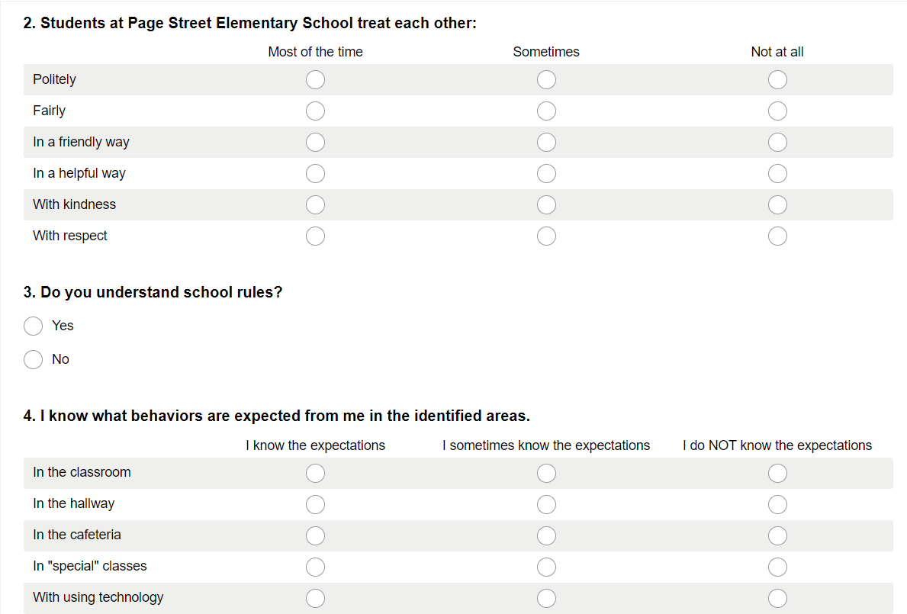
Example
Notes:
Trainer Notes:
This is an example of part of a survey for students to understand how they perceive the climate and how much they know about the rules and expectations in their school.

Slide 23
Plan For Evaluation (Example)
Measure/Tool | Year One |  |  | Year Two |  |  | Year Three
 | Fall | Winter | Spring | Fall | Winter | Spring | Fall | Winter | Spring
TFI | Sept |  | April/May |  |  | April/May |  |  | April/May
SAS | Oct |  |  | Oct |  |  | Oct
TIC |  | Jan
Parent Survey | Aug |  |  | Aug |  |  | Aug
Climate Survey for students | Sept |  | April |  |  | April |  |  | April
Teacher survey |  | Feb |  |  | Feb |  |  | Feb
SSS |  |  |  |  | Dec
Notes:
Trainer Notes:
Some districts may have a schedule for some of the evaluations, especially the TFI, but building teams should have a schedule in place at the beginning of the year. Decide what tools you want to use and when you will administer them. Typically, you should assess staff using the SAS once a year and complete the TFI once a year after the first year of implementation. Other assessments or surveys can be added as needed. The example above shows plans to collect some baseline data and then compare data year to year. This can always be amended, but it’s good to have a plan in place.

Slide 24

Share Your Results
Share with staff & district coach
Annual update to school board
Newsletters
Info on website
Local media
Notes:
Trainer Notes:
Show staff the progress on action plans to let them see that their efforts are paying off. The school board is also more likely to be supportive and positive about PBIS when they see what you have accomplished over the year. This is where the district coach can play a role; they can present a snapshot of the district to show where you are making improvements and where you want to keep improving. The school board will see that you are dedicated to improvement and will likely continue to make sure you have the resources and money that you need. Having informed parents is a great thing! If they are on board with PBIS they will be more likely to encourage their kids and remind their kids of the expectations. Media are often looking for stories that highlight local schools, so reach out to them! Report to the community what you’ve accomplished and what you have planned.

Slide 25
Let’s Practice!
Tiered Fidelity Inventory (TFI)
Section 1.14 Fidelity Data
Section 1.15 Annual Evaluation
Notes:
Trainer Notes:
The items of the TFI that assess how well a team is doing in the area of evaluation are 1.14 (Fidelity Data) and 1.15 (Annual Evaluation). The following slides can guide the team in their implementation of the evaluation portion of PBIS.

Slide 26
1.14 Fidelity Data
Subscale: Evaluation
Feature | Data Sources | Scoring Criteria
 |  | 0 = Not implemented 1 = Partially implemented 2 = Fully implemented
1.14 Fidelity Data: Tier I team reviews and uses SWPBIS fidelity (e.g., SET, BoQ, TIC, SAS, Tiered Fidelity Inventory) data at least annually. | School policy Staff handbook School newsletters School website | 0 = No Tier I SWPBIS fidelity data collected. 1 = Tier I fidelity collected informally and/or less often than annually. 2 = Tier I fidelity data collected and used for decision making annually.
Main Idea: Measuring fidelity is essential for maintaining high-criterion use of PBIS. Any Tier I fidelity measure is acceptable. Completing this inventory meets the criterion for a “2” score.

Slide 27
1.15 Annual Evaluation
Subscale: Evaluation
Feature | Data Sources | Scoring Criteria
 |  | 0 = Not implemented 1 = Partially implemented 2 = Fully implemented
1.15 Annual Evaluation: Tier I team documents fidelity and effectiveness (including on academic outcomes) of Tier I practices at least annually (including year-by-year comparisons) that are shared with stakeholders (staff, families, community, district) in a usable format. | Staff, student, and family surveys Tier I handbook Fidelity tools School policy Student outcomes District reports School newsletters | 0 = No evaluation takes place, or evaluation occurs without data. 1 = Evaluation conducted, but not annually, or outcomes are not used to shape the Tier I process and/or not shared with stakeholders. 2 = Evaluation conducted at least annually, and outcomes (including academics) shared with stakeholders, with clear alterations in process based on evaluation.
Main Idea: Implementation of the core components of PBIS is more likely if the Tier I team both self-assesses implementation status at least annually AND reports their status to relevant stakeholders (i.e., school community, school board, etc.)

Slide 28
Summary
Conduct regular assessments and surveys.
  Monitor fidelity of implementation.
  Assess satisfaction and buy-in.
Do evaluations regularly (at least annually).
  See the big picture.
  Report to stakeholders.

Slide 29
Resources
PBIS Apps - Assessment Overview https://www.pbisapps.org/products/pbis-assessment
PBIS Evaluation Blueprint
https://www.pbis.org/resource/pbis-evaluation-blueprint

