Slide 1
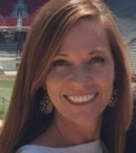

Kicking Off PBIS
Module 16
Anne Merten
Rebecca Hegger
amerten@astate.edu
rhegger@astate.edu
Notes:
Images in this module were obtained at google.com/images unless otherwise specified.
Trainer Notes:
In this module we will discuss the collection and use of data for problem solving and decision making, as well as progress monitoring.

Slide 2
Context
Purpose & critical features of kick-off
Kick-off planning
School examples

Slide 3
Purpose Of This Training
Show what goes into planning for kicking off PBIS.
Give trainees guidance and examples for creating action plans for their kick-offs.

Slide 4
Materials
Readiness checklists
Staff kick-off plan example
Parent kick-off example
Student kick-off examples
Countdown to kick-off action planning
Links to resources

Slide 5
Purpose of Kick-off

Slide 6

Of Kick-off
Provide “big picture” of PBIS
Teach expectations: all settings/all students
Explain acknowledgement system
Define correction system
Display visual reminders around school
Notes:
Trainer Notes:
A kick-off is an assembly or event providing students with the “big picture” of PBIS. Key features of the kick-off are: (1) behavior expectation lessons taught in the location to all students, (2) an overview of the acknowledgement system, (3) defining the correction system so that consequences are predictable, and (4) visuals posted around school to reinforce what has been taught.

Slide 7
Staff Kick-off
Celebrate commitment to student success.
Highlight big ideas of PBIS.
Provide research on PBIS.
Show how PBIS helps staff build social culture.
Notes:
Trainer Notes:
The purpose of kicking off PBIS to staff is not just to give staff information on how they will carry out their part of it, but to reaffirm the school community’s commitment to this change in philosophy. Celebrate your commitment to student success in academics, behavior, social skills, etc. Reinforce the big ideas and research behind PBIS. Then, show how staff will carry out this new commitment through: (1) teaching expectations, (2) reinforcing appropriate behavior and responding consistently to inappropriate behavior, (3) using data to make decisions, and (4) having additional support for students who need it.

Slide 8
Student Kick-off
Discuss the goal of creating a positive school climate.
Explain how to do this.
Teach expectations to students.
Notes:
Trainer Notes:
For the student kick-off, the focus is on creating a more positive community. Convey your commitment to improving by encouraging more positive interactions between students and between staff and students. Explain how this will start with clarifying what is expected, what adults will do, how they will teach behavior, and how you will celebrate or acknowledge successes and be more consistent in responding to problem behavior (which will include re-teaching).

Slide 9
Parent Kick-off
Discuss your goals for positive school climate.
Explain how PBIS helps achieve these goals.
Provide opportunities for involvement.
Notes:
Trainer Notes:
For parents, it’s important to convey the goals behind implementing PBIS. Let parents know that you will be working towards these goals by: teaching expectations, modeling, reinforcing, responding consistently to problem behaviors, etc. This is also a great time to encourage parents to become involved in PBIS. Give them an opportunity to volunteer.

Slide 10

Other Considerations
New students
Substitute teachers and new staff
Notes:
Trainer Notes:
Determine a method for explaining PBIS to new students as they register throughout the year. Also, consider substitutes and any new teachers that may start throughout the year. Have a packet that will make it easy for them to learn about PBIS and be able to teach expectations and give acknowledgements.

Slide 11
Kick-off Planning

Slide 12

Kick-off Planning
  What info do you want to convey? To whom?
    Staff
    Students
    Parents
    Bus drivers
    Who else?
Notes:
Trainer Notes:
The first consideration when planning a kick-off is WHO you want to address. What message do you want to convey to different groups within the school community?

Slide 13
Kick-off Planning
What needs to be done before the kick-off?
    Materials
    Scheduling
    Assigning staff
    Plan for follow up
    How will you advertise PBIS?
Notes:
Trainer Notes:
Next, gather materials that you will need: packets for staff, visuals for hanging around the school, newsletters, etc. Set a schedule for each of the events and determine which staff will do what, and always plan to follow up (e.g., do a survey, ask for feedback, etc.).

Slide 14
Example: Objectives For Staff Kick-off
For a staff kick-off, you might want to convey:
Background on PBIS
Info on school climate research
Share survey data
How you will implement PBIS in the school
How data are used
Notes:
Trainer Notes:
As we talked about earlier, staff kick-offs need to focus on why you are implementing PBIS and how you will do it. Give some background on PBIS and climate research and then follow up with any surveys you may have conducted with staff to understand their concerns about your school’s climate and how they want to address behavior. Don’t forget to show the importance of using data to make decisions about PBIS and how you will share data with them regularly.

Slide 15

Example: Planning Staff Kick-off
Analyze & summarize climate survey data
Create packets and include:
  Expectations
  Lesson plans
  Acknowledgements
  Procedures for responding to behavior
Schedule time
Develop system for communication
Notes:
Trainer Notes:
Create packets for staff that include expectations, lesson plans for teaching expectations, acknowledgements, procedures for responding to problem behaviors, etc. Schedule time for a meeting with staff. Develop a system for communication to get regular input and feedback from staff.

Slide 16
Example: Staff Survey
Sample questions:
Do you believe that behavior issues interfere with learning at our school?
Do you believe our school needs to be more consistent in dealing with behavior?
How important is it to have schoolwide expectations?
What are two things you liked about today?
What did you not like about today?
Notes:
Trainer Notes:
Here are some sample questions that can be given to staff to determine their takeaway from the kick-off. Do they understand what you wanted to convey? What do you need to do to follow up? What barriers do you foresee?

Slide 17
Example: Objectives For Student Kick-off
For a student kick-off, you might want to convey:
Your “vision” of positive school climate
The schoolwide expectations
How expectations will be taught
Acknowledgements process; celebrations
How staff will respond to misbehavior
Notes:
Trainer Notes:
You may want to convey to students your “vision” of positive school climate that you want to create, info about the school-wide expectations (how they will be defined throughout the school, as well as in classrooms), how expectations will be taught, the acknowledgements process, celebrations, and how staff will respond to/correct problem behaviors.

Slide 18

Example: Planning Student Kick-off
Create & display posters
Produce acknowledgements
Schedule for teaching expectations
Plan to teach classroom expectations
Plan for kick-off event
Short survey for feedback
Notes:
Trainer Notes:
These are examples of things that need to be planned before student kick-off.

Slide 19
Example: Student Survey
Sample questions:
What are the three school-wide PBIS expectations?
How well do you understand what is expected of students?
How important is it to have school-wide expectations?
What are two things you liked about today?
What did you not like about today?
Notes:
Trainer Notes:
Here are some sample questions that can be given to students to determine their takeaway from the kick-off. Do they understand what you wanted to convey? What do you need to do to follow up? What barriers do you foresee?

Slide 20
Example: Objectives For Parent Kick-off
For a parent kick-off, you might want to convey:
  Goal(s) for implementing PBIS
  The expectations & how they will be taught
  The acknowledgment process/system
  Information on how staff will respond to problem behaviors
  Ideas on how parents can use PBIS at home
  Information on ways parents can volunteer for PBIS activities
Notes:
Trainer Notes:
For parents, you might want to convey your goals in implementing PBIS and how you will implement it. You want parents to understand what students are experiencing so that parents can reinforce and encourage students, too. It’s also important that parents know the process when students don’t follow the expectations. Let them know that you are committed to using a proactive, preventive process with the goal of correcting student behavior and keeping it from escalating. You might want to give parents ideas for using similar practices in their home and how they can participate in PBIS at the school.

Slide 21
Example: Planning Parent Kick-off
Prepare materials to advertise PBIS.
Plan kick-off event/presentation.
Share info about PBIS on website.
Develop a presentation for PTA meeting.
Develop a monthly flyer for updates.
Create a sign-up sheet for volunteer opportunities.
Notes:
Trainer Notes:
Here are some items that you should consider having ready before the parent kick-off. Consider several different avenues for disseminating information to parents. Also consider the families’ cultural and language differences. Kick-off is a good opportunity to introduce PBIS and give parents opportunities to participate.

Slide 22
Kick-off Readiness Checklist
Notes:
Trainer Notes:
Here is a checklist to help schools prepare for kicking off PBIS to the school.

Slide 23


Countdown To Kick-off Action Planner
Notes:
Trainer Notes:
The countdown to kick-off planner on the next three slides helps teams prepare for kicking off PBIS by categorizing the critical elements that need to be in place beforehand. The next few slides will provide a template for developing action plans and a closer look at each category.

Slide 24
10 | Structures in Place | PBIS Team is established & has regular meetings scheduled Communication plan and feedback loops are developed between PBIS Team & staff
9 | Introduction to PBIS | PBIS Team creates plan to present Introduction to PBIS to staff Introduction to PBIS is presented to staff
8 | Staff Buy-In & Current Resources | Compelling ‘why’ is developed Staff commitment to PBIS is established (at least 80% of staff agree to this work) School Climate Survey is completed Resource mapping is completed
Notes:
Trainer Notes:
These three areas are the first big steps in committing to implementing PBIS. Before full implementation can begin, schools need to have wide agreement that this is something they want to commit to.

Slide 25
7 | Identify & Define School-wide Behavioral Expectations | PBIS Team creates plan to deepen staff learning around having 3-5 school-wide behavioral expectations PBIS Team & staff create 3-5 school-wide behavioral expectations PBIS Team creates plan to deepen staff learning around defining school-wide expectations in all settings PBIS Team develops behavior matrix/takes back to staff to approve
6 | Prepare to Teach & Monitor Behavioral Expectations | PBIS Team creates plan to deepen staff learning around teaching expectations PBIS Team & staff create lesson plans for teaching expectations in each setting PBIS Team & staff create a plan for teaching the lessons
5 | Positive & Corrective Feedback | PBIS Team creates plan to deepen staff learning around acknowledgements PBIS Team & staff develop a school-wide acknowledgement system PBIS Team creates plan to deepen staff learning around correcting behavior PBIS Team & staff develop a consistent response system for behavioral correction
Notes:
Trainer Notes:
These three areas are the critical components of PBIS. These will be the systems and practices that occur regularly to create a more consistent, positive climate. These need to be planned for and ready to roll out when you kick off PBIS.

Slide 26
4 | Data Systems | PBIS Team will complete the Tiered Fidelity Inventory (TFI) PBIS Team & staff develop Office Discipline Referral form (ODR) PBIS Team train staff on using Student GPS for behavior collection
3 | Finalize Development of All Components | 3-5 Behavioral Expectations Behavior matrix Lesson plans for all settings Plan for teaching the lessons | Plan for monitoring behavior Acknowledgement system Consistent behavioral response plan
2 | Plan PBIS Kick-Off Assembly | Date chosen Who will do what
1 | Order, create, gather all PBIS materials | Create posters, visual displays, etc. Acknowledgement system items Include PBIS information in staff & student handbooks, parent newsletters
Notes:
Trainer Notes:
Data is another area that needs to be ready to roll before kick-off. Teams should have a way to collect and analyze data. It’s also important to look at historical discipline data and get a baseline for the TFI. This final stretch before kick-off is a time to finalize all your components and start planning your kick-offs. Also, make sure all materials are ready to go and visuals are displayed around the school, in handbooks, on the website, etc.

Slide 27
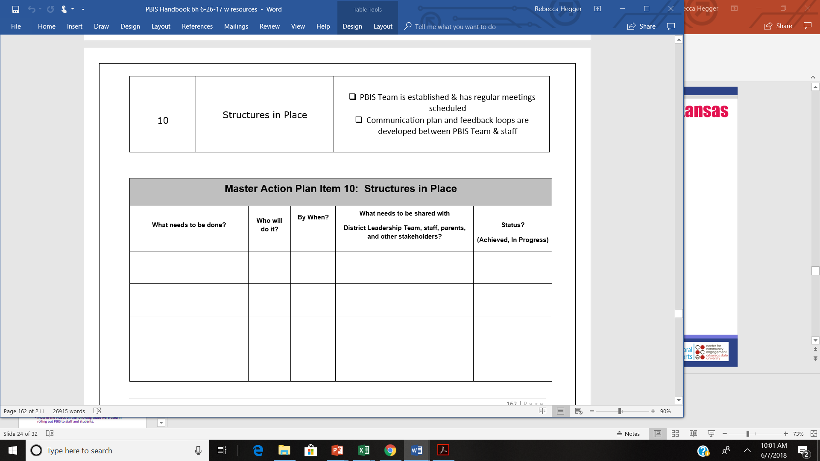
Notes:
Trainer Notes:
For each of the 10 categories in the countdown, use the above template to action plan.

Slide 28
School Examples

Slide 29
Video Examples
Most of the videos on the following slides were used in rolling out PBIS to staff and students.
The schools that created these videos were in various stages of implementation (not all were kicking off for the very first time).
Notes:
Trainer Notes:
The following videos show just one piece of the overall kick-off process, with in-person training and discussion accompanying the videos. Some videos will show actual kick-off events to give you some ideas!

Slide 30
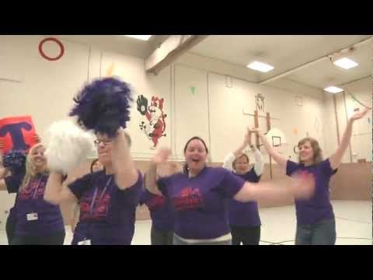
Kick-off Example
https://www.youtube.com/watch?v=3sc1JNF8X0s

Slide 31

Staff Intro
https://www.youtube.com/watch?v=nCXKvt04ii8

Slide 32
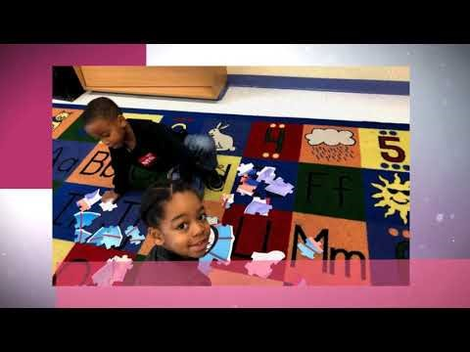
Student Rollout
https://www.youtube.com/watch?v=xiYE1RvQ_3g

Slide 33
Summary
Determine the groups you want to include in PBIS kick-off(s).
Determine what you want to convey to each group.
Develop and gather materials needed for kick-off.
Plan the event – time, place, schedule, and staff needed.
Follow up with each group.

Slide 34
Resources
https://pbis.astate.edu/kicking-off-pbis/
Readiness checklist
Kick-off examples
Kick-off videos

