Slide 1
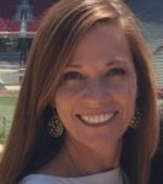

Philosophy and Overview of PBIS
Module 1
Anne Merten
Rebecca Hegger
amerten@astate.edu
rhegger@astate.edu
Notes:
Images in this module were obtained at google.com/images unless otherwise specified.

Slide 2
Context
Philosophy of PBIS
Steps to implement PBIS
Before you begin training

Slide 3
Philosophy of PBIS

Slide 4
Challenges For Schools
Student mobility
Perceived incivility
Inappropriate behavior
Student failure & dropouts
Changes at home & in family
Ever-increasing accountability
Notes:
Trainer Notes:
Some schools have more challenges than others, but all schools are under pressure being assessed and held accountable for student outcomes while dealing with increasing challenges like the ones above.

Slide 5
What Some Teachers Say
“Students don’t really have any consequences. They do whatever they want. Teachers feel helpless. Teachers are made to feel small and disrespectful.”
“Children need IMMEDIATE consequences…They get more out of control every day.”
[We need to] “… revert back to real discipline and send them home!!”
Notes:
Trainer Notes:
The comments on this slide were taken from a 2018 survey of staff members in an Arkansas school.

Slide 6
What Should A School Do?
Should it increase in-school and out-of-school suspensions?
  Is the goal to get rid of children, even temporarily?
  What does that do to their learning?
  What does that do for their behavior?
Should it increase expulsion?
  How many can you expel?
  How does that foster their achievement?
Notes:
Trainer Notes:
A common assumption is that students who receive a suspension will be less likely to engage in problem behavior in the future. See Do Out-of-School Suspensions Prevent Future Exclusionary Discipline? by Michelle M. Massar, Kent McIntosh and Bert M. Eliason; https://www.pbis.org/resource/do-out-of-school-suspensions-prevent-future-exclusionary-discipline

Slide 7
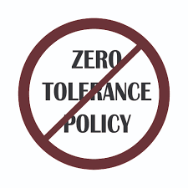
What Hasn’t Worked?
Zero tolerance policies & exclusion…
  often lead to worse behavior.
  result in loss of learning time.
  don’t help the student.
  reward student with vacation.
How many things have schools tried?
Notes:
Trainer Notes:
Beginning in the 1990’s, zero tolerance was adopted by schools all over the country, but this led to students being suspended or expelled for behavior that didn’t require this extreme consequence. Now, compare that to a student doing something wrong academically. Do we exclude the student?

Slide 8
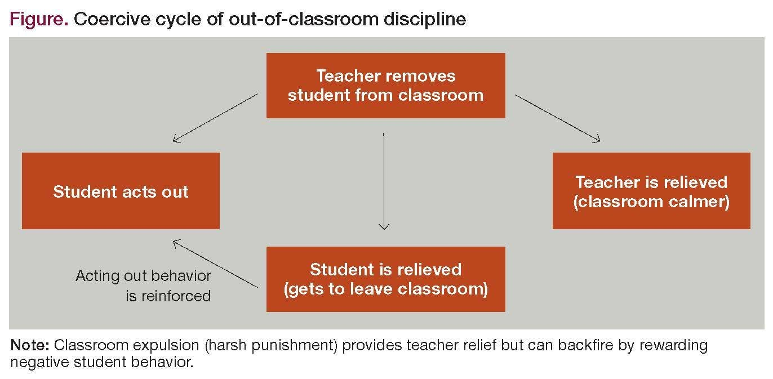
Coercive Cycles Are A Problem
https://www.psychiatrictimes.com/view/coercive-cycle-school-prison-pipeline
Notes:
Trainer Notes:
Researchers found that being disciplined was only a deterrent for about 20% of 3rd through 8th grade students, and for about 25% of students being disciplined led to increased disruptive behavior. https://www.psychiatrictimes.com/view/coercive-cycle-school-prison-pipeline

Slide 9
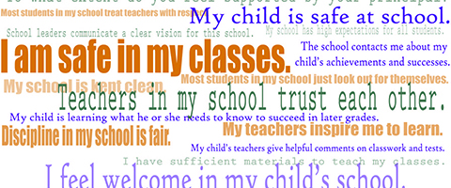
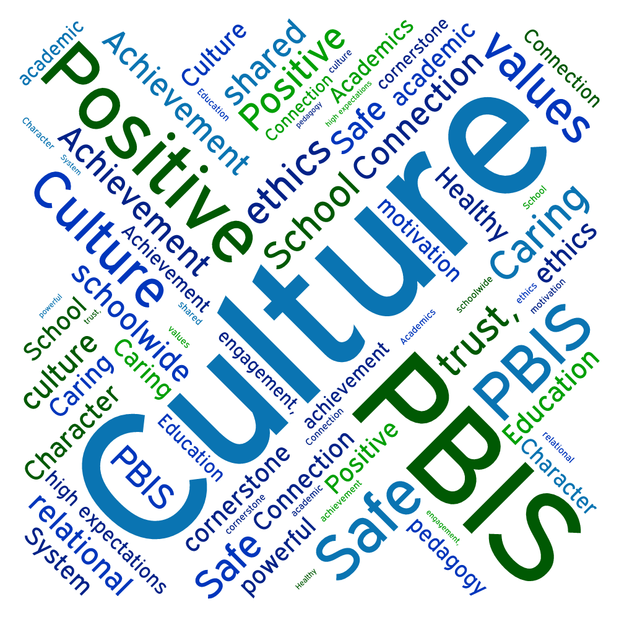
So Now What? You Should Change The School Culture!

Slide 10
Basic School Climate Model
Safety
Rules and Norms
Teaching & Learning
Support for Learning
Institutional Environment
Physical Surroundings
Interpersonal Relationships
Respect for Diversity
Social and Civil Learning
School Connectedness/Engagement
Social Support - Students
Social Support - Adults
Physical Safety
Social and Emotional Security

Slide 11
Changing Climate And Culture Require A Different Philosophy
How about preventing problems before they happen?
How about a proactive and positive approach to discipline?
Remember what discipline is about…
Notes:
Trainer Notes:
PBIS starts with a change in the way adults approach discipline. Instead of just giving students a handbook of rules and a list of things “not to do” and waiting for them to make mistakes, PBIS is about having expectations for behavior, teaching and modeling that behavior, and encouraging that behavior.

Slide 12
What Is Discipline?
Dis•ci•pline: From Latin disciplina (“instruction”) and discipulus (“pupil”), from discere (“to learn”)*
It is a branch of knowledge or learning.**
It is training that develops self-control, character, or orderliness and efficiency.**
* https://www.yourdictionary.com/discipline
** Webster's New World College Dictionary, Fifth Edition
Notes:
Trainer Notes:
The word discipline is often used as a synonym for punishment, instead of the original idea that it is learning and education. PBIS adheres more truly to this definition through teaching, modeling, and encouraging appropriate behavior, and encouraging students to continue to do it. This process should lead to students developing and using the behavior without needing the extrinsic “rewards” that were used when first learning the behavior.

Slide 13
Think About This…
“If a child doesn’t know how to read, we teach.”
“If a child doesn’t know how to swim, we teach.”
“If a child doesn’t know how to multiply, we teach.”
“If a child doesn’t know how to drive, we teach.”
“If a child doesn’t know how to behave, we…
…teach? …punish?”
“Why can’t we finish the last sentence as automatically as we do the others?”
John Herner (Counterpoint 1998, p. 2)
Notes:
Trainer Notes:
This is a quote from John Herner, former President of NASDSE 1998. We can’t just expect students to know what behavior to use if we don’t teach them first.

Slide 14
The PBIS Philosophy
Adults must stop…
  trying to get tougher; it will just anger and alienate children and leads to frustration.
  being reactive; it just keeps you angry because it doesn’t work.
  assuming children all know “how to behave”.
Adults must start…
  acknowledging children when they do well (just like grades in academics).
  preventing problems by planning and being proactive.
  teaching children what you want them to do.

Slide 15
Really? Will That Work?
Don’t you like being acknowledged when you do “good”?
  What is it when you say “thank you”?
  Why do hotels, airlines, credit cards, etc. give “reward points”?
Students want respect just like you do, and they respond to it.
“Consequences” are not ignored, but teaching comes first.

Slide 16
The PBIS Approach
What is the approach?
Using a multi-tiered system of support model
Developing consistency in defining, teaching, modeling, and encouraging expected appropriate behavior
Developing consistency in responding to problem behavior
Using data to guide implementation and progress
Notes:
Trainer Notes:
PBIS is a proactive, preventive approach that supports all students, with increasing levels of prevention. Everyone receives “general education” in expected behavior, along with acknowledgments for following the expected behavior. Some students need more teaching, and a few students may need intensive support. Developing consistency in prevention and also response to misbehavior is a big part of PBIS. Data are used to make decisions about all aspects of PBIS (e.g., what, when, and how to teach and acknowledge; progress monitoring school-wide as well as in classrooms).

Slide 17
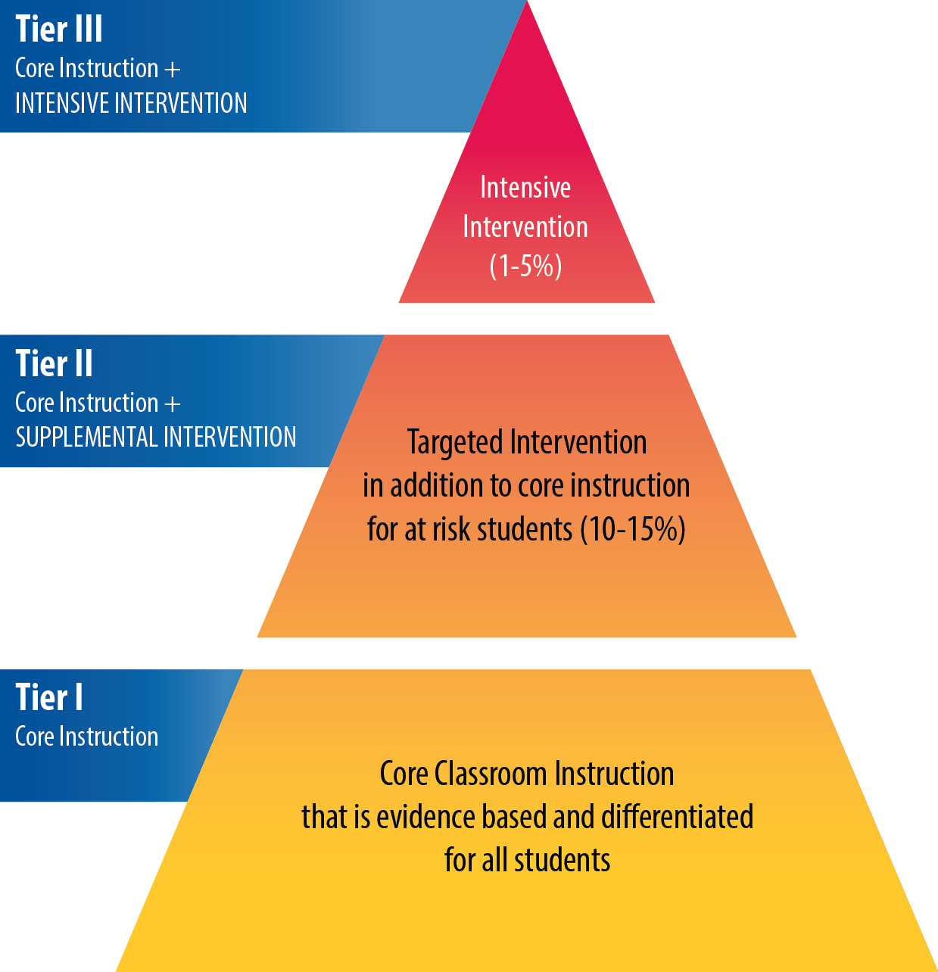
A Continuum Of Practices:
3 Levels Of Prevention
Tier III: Individualized supports
for a few students.
Tier II: Targeted supports for
small groups of students.
Tier 1: Core instruction for
all students.
Notes:
Trainer Notes:
This is a pyramid graphic that describes the three tiers of intervention for PBIS (same for RTI, in general). This pyramid has become an iconic symbol in PBIS implementation. We call these levels of prevention because the goal is to prevent students from making more mistakes or escalating in behavior. Note how the tiers overlap – they are not separate. Students receiving Tier II or Tier III interventions are still receiving Tier I support.

Slide 18
Tiers Of Interventions
PBIS is for all students (even those needing Tier 3 services).
Everyone receives instruction in behavior.
Some students may need more (Tiers 2 and 3), but they still get Tier 1 instruction and support.
Notes:
Trainer Notes:
The PBIS Framework provides three levels of interventions, which is ideal for giving students the best opportunity to succeed. Not all students that are making mistakes need individual or intensive interventions. PBIS provides a continuum of interventions matched to the needs of the students.

Slide 19
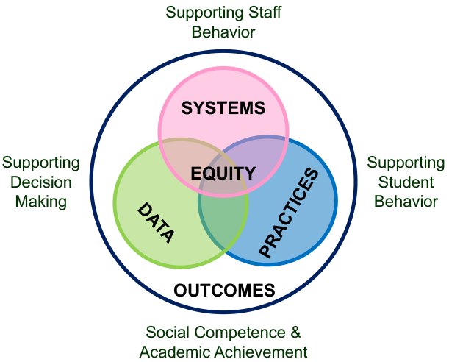
PBIS Model
https://www.pbis.org/pbis/what-is-pbis
Notes:
Trainer Notes:
This illustration shows how everything works together in the PBIS process. The combination of systems, practices, and data-based decision making works towards the desired outcomes of social and academic success for students. Systems (e.g., PBIS team) support the staff so that they can efficiently and effectively provide supports for students, and decisions about these systems and practices are guided by collecting and analyzing school data to make sure things are working and that practices support students.

Slide 20
Tier I Components
Developing behavioral expectations
Teaching expected behaviors
Acknowledging appropriate behavior
Consistent responses to inappropriate behavior
Data-based decision making
Assessment
Classroom PBIS
Notes:
Trainer Notes:
These are the components that will need to be developed to implement PBIS with fidelity. In order to prepare, to create your team and prepare for training, consider these components and think about personnel that have skills in these areas.

Slide 21
Steps to Implement PBIS

Slide 22
Outcomes
Step 1 is to decide on what outcomes you want to see.
What are your priority areas?
  If behavior isn’t one, don’t continue.
What are your behavior goals?
  Use your school and district data to see what is needed.
    Example: 25% reduction in out of school suspensions.
Notes:
Trainer Notes:
PBIS is about planning — you must decide what you want to see as outcomes before you start because you will be addressing behaviors related to those outcomes first.

Slide 23
Systems
Step 2 in PBIS is to establish a team.
The team is the basis for a PBIS system to facilitate implementation.
  Team needs to represent school (e.g., teachers, staff)
  Team needs a coach (positive, active coordinator)
The school also needs a data system to collect and collate behavioral information.
  Team needs a data person
  Team needs to present data to stakeholders

Slide 24
Practices
Step 3 is to identify expectations for student behavior.
  Expectations must be positively stated (e.g., respect), not a listing of violations.
  Expectations must encompass what the data say need changed in your school(s).
  Expectations need to be defined by specific behaviors.
  Expectations need to be defined for specific areas of school (e.g., cafeteria, hallway).
  Lesson plans need to be developed to teach the expectations in context.

Slide 25
Practices
Step 4 is to make PBIS part of the culture.
  An acknowledgement process for students needs to be developed.
  Responses to inappropriate behavior need to be examined and made consistent.
  An acknowledgement process for TEACHERS needs to be developed.
  Roll-out and boosters for behavior need to be developed.
  Data distribution practices to stakeholders are needed.
  Plans to identify successes and revisit needs have to be developed.

Slide 26
Tiers 2 And 3
Where do Tiers 2 and 3 fit?
  PBIS is about prevention first and foremost.
  Tier 1 must be established and working effectively before even thinking about Tiers 2 or 3.
But what about the students needing more support now?
  You already have processes in place that you will continue to use.
  You must first reduce problem behaviors before attempting to institute greater supports.
  You must develop the infrastructure for upper tiers before implementing them.

Slide 27
Before You Begin Training

Slide 28
Where To Begin?
Implement systematically
  Are you just starting? Do you need to explore first?
  Do you already know you need to do this and you’re ready to install a new approach?
Determine how ready your district or school is to implement something new.
  At what stage of readiness are you?
Notes:
Trainer Notes:
This leads into the next slide to talk about phases of implementation (mentioned in second major bullet point).

Slide 29
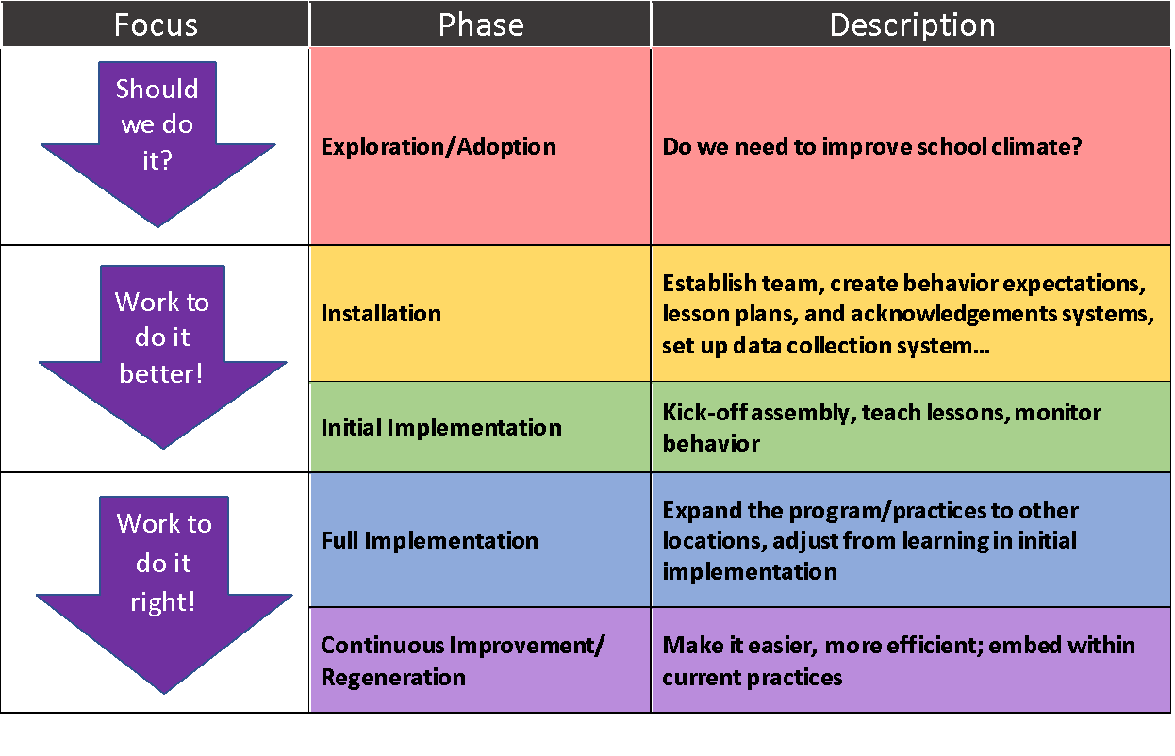
Phases Of Implementation
Based on the PBIS Implementation Blueprint; retrieved from https://www.pbis.org/resource/pbis-implementation-blueprint
Notes:
Trainer Notes:
From the Positive Behavioral Interventions and Supports Implementation Blueprint: Part 1 – Foundations and Supporting Information Technical Assistance Center on Positive Behavioral Interventions and Supports U. S. Department of Education, Office of Special Education Programs Version 18 October 2015:
“Because implementation of any practice or system is dynamic and influenced by a range of organizational, political, procedural, and regulatory factors, TA for PBIS is guided by implementation status or phase. Although number and differentiation between phases may vary, the following represents how the PBIS Center operationalizes implementation phase (adapted from Fixsen & Blase, 2006; Goodman 2013).”

Slide 30
Exploration
What do you already have in place?
  Initiatives
  Committees, groups
  Resources available
Do you have the capacity to begin?
  e.g., use the District Capacity Assessment
Are you ready to begin?
  Sample readiness questions on next page
https://implementation.fpg.unc.edu/resources/district-capacity-assessment-dca
Notes:
Trainer Notes:
The District Capacity Assessment (DCA) is a tool to determine whether a district can start something new. “The DCA is an action assessment designed to help educational district leaders and staff better align resources with intended outcomes and develop action plans to support the use of effective innovations. Both the training and tool are available online.” This assessment can be found at AI Hub (The National Implementation Research Network’s Active Implementation Hub): https://implementation.fpg.unc.edu/resources/district-capacity-assessment-dca

Slide 31
Sample Readiness Form
Documents / Evidence Complete? | Items to Complete Prior to PBIS Training | Notes
YES NO | 1. A school improvement plan exists that includes improving behavior support systems (i.e., behavior, school safety, school climate) as one of the top school goals. | Attach copy of goal(s). The entire plan is not needed, just the page indicating the goal(s) linked to improving school-wide behavior.
YES NO | 2. A school-wide Positive Behavior Support (PBIS) Team is formed with broad representation (e.g., administrator, general and special education teachers, professional staff). | Prior to your first training, your PBIS Consultant at A-State will request a list of your team members and contact information.
YES NO | 3. Administrator(s) who is responsible for making discipline decisions is an active participant on PBIS Team and agrees to attend all days of PBIS Trainings. | List primary Administrator: Phone number: Email:
YES NO | 4. Principal commits to PBIS and is aware that PBIS is a 3 to 5 year process that may require ongoing training and/or revisions of school’s PBIS Plan. | Please provide Principal signature(s) on School Commitment Sheet (Form D) and attach.
YES NO | 5. PBIS Team commits to meet at least once a month to analyze and problem-solve school-wide data. | During your first training, your PBIS Consultant at A-State will request the dates/times of your PBIS Team meetings.
YES NO | 6. At least 80% of your faculty, staff, and administration are interested in implementing PBIS. | Attach recent procedure/assessment/survey disseminated and results (i.e., percentage or range of faculty committed).
YES NO | 7. School has allocated or secured funding from their district to support their school-wide initiatives. | Identify funding source:
YES NO | 8. A PBIS Internal Coach has been identified to receive additional training and participate in the school-wide initiatives.
YES NO | 9. The school is committed to use of a behavior data collection system. | A final copy of a discipline referral developed during training (if none currently exists) is submitted to your PBIS Consultant.
Adapted from: http://pbismissouri.org/tier-1-readiness/
Notes:
Trainer Notes:
This was adapted from Missouri SW-PBS Tier I Readiness Indicators – http://pbismissouri.org/tier-1-readiness/

Slide 32
Make A Commitment To…
A positive, inclusive, collaborative environment
  Focus on expected outcomes.
Preventive, proactive discipline
  Children respond to their environment—make it a predictable and positive one.
Consistency in procedures and practices
  Teacher morale is improved by consistency in responses to children’s behavior.
Notes:
Trainer Notes:
For any organization to be successful, the stakeholders have to be on board with the same goals. Schools need to have these conversations among all staff; decide what staff will be committed to achieving. This is the first step in beginning to develop the PBIS action plan. Work as hard on what you want to see as on what you don’t want to see.

Slide 33
What Is Needed?
District approval and support
Administrative support in the school
A representative team to drive implementation
Majority of staff (80% recommended) agree/commit to implement PBIS.
With everything in place, training is needed.
Notes:
Trainer Notes:
The last few slides highlighted the process and elements that are involved in implementing PBIS. Teams will need administrative support for the time and resources necessary to develop the core components of PBIS and provide training and communication to staff, students, parents, and the community. Most importantly, you will need broad support from staff to be successful in implementation. Staff are going to be highly involved in carrying out practices, and it will not work well if only a small percentage of staff are participating. Consistency is crucial to making an impactful change. Training is critical for consistency.

Slide 34
Summary
PBIS is a preventive, proactive process that starts with a change in the adults’ approach to behavior.
Schools need to commit to this philosophy before implementation.
Administrative support and an implementation team are necessary to drive the implementation process.
A safe, positive climate is widely recommended for better student achievement. TESS says an excellent teacher “creates the best environment for student learning”; The LEADS Principal Rubric says that to be a Highly Effective principal, “Regular two-way meaningful communication [with families] exists”.
http://www.esc4.net/Assets/rubric-overview.pdf
https://dese.ade.arkansas.gov/Files/20201123105718_LEADS_2.0_Principal_Rubric.docx-3.pdf
Notes:
Trainer Notes:
LEADS Principal Rubric – Family and Community Engagement – “Regular two-way meaningful communication exists. Families are productively involved in learning (for their student and themselves). Family and community engagement is constantly monitored and adjusted as needed. School-family-community partnerships (include parents, extended family members and caregivers) have collaborative goals and are helped with specific strategies.”
Links to resources: TESS: http://www.esc4.net/Assets/rubric-overview.pdf,
LEADS Principal Rubric: https://dese.ade.arkansas.gov/Files/20201123105718_LEADS_2.0_Principal_Rubric.docx-3.pdf
Brown University study: https://www.sciencedaily.com/releases/2016/10/161026170323.htm

Slide 35
Summary
To start:
  Assess what you already have.
  Create a representative implementation team.
  Get input and feedback from staff.
  Get support from staff (80% recommended) before beginning the PBIS implementation process.
  Develop outcomes, systems, and practices.

Slide 36
Essential Primer
Simonson, B., Sugai, G., & Negron, M. (2008). Schoolwide positive behavior supports. TEACHING Exceptional Children, Vol. 40, No. 6, 32-40.

Slide 37
Resources
Some general resources from A-State https://pbis.astate.edu/about/what-is-pbis/
PBIS Technical Assistance Center
https://www.pbis.org/pbis/what-is-pbis
Missouri PBIS Website – Common Philosophy http://pbismissouri.org/wp-content/uploads/2018/08/Tier-1-2018_Ch.-1.pdf?x30198

Slide 38
Resources: Videos
#BecauseITMatters
https://www.youtube.com/watch?v=-vVzpHOM55s
Sharing Your Heart Through PBIS
https://www.youtube.com/watch?v=AkgX4tzWobo
Improving school climate (Every Opportunity)
https://www.youtube.com/watch?v=VxyxywShewI&t=10s
Notes:
Trainer Notes:
https://www.youtube.com/watch?v=-vVzpHOM55s
https://www.youtube.com/watch?v=AkgX4tzWobo
https://www.youtube.com/watch?v=VxyxywShewI&t=10s

