Slide 1
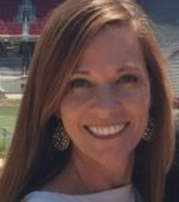

District Leadership in PBIS
Module 2
Anne Merten
Rebecca Hegger
amerten@astate.edu
rhegger@astate.edu
Notes:
Images in this module were obtained at google.com/images unless otherwise specified.
Trainer Notes:
In this module, we will take trainees through the roles and responsibilities of coaches, administrators, local school teams, and district teams.

Slide 2
Context
District plans & systems
Oversight of implementation
Shared responsibility
  Not a single person effort
  Leader
Notes:
Trainer Notes:
PBIS has to fit into district plans, initiatives, systems, and structures. There has to be district oversight for how PBIS is initiated, implemented, and sustained. Needs to be team, but led by champion with some authority and backing.

Slide 3
The PBIS District Team

Slide 4
District Leadership Team Focus
Drive district assessment & action planning process
  Decide on differentiation of expectations
  Decide on differentiation of implementation timeline
Increase capacity in four areas:
    Training
    Evaluation
    Coordination
    Coaching
Notes:
Trainer Notes:
Having leadership and support from the district provides the best chance at implementation with fidelity and getting buy-in from stakeholders. Coordinating regular evaluation ensures that schools get necessary resources and training. Districts can make decisions about what the expectations and implementation timelines are for schools in the district. Through regular evaluation, the district can report successes they’ve had and create action plans to address areas in need. Reporting successes to stakeholders will help secure sustained funding and political support, and these, in turn, along with visibility, will help create better buy-in at school and in the community.

Slide 5
Who Should Be On The District Team?
Personnel whose responsibilities are:
  Prevention of problem behavior
  Development and maintenance of positive behavior
  Management and evaluation of resources
Notes:
Trainer Notes:
The district team needs to have people with expertise in behavior and behavior management. It is also advantageous to have someone skilled at data management and evaluation.

Slide 6
Examples Of Team Members
District/school administration
District PBIS trainers
Instruction/curriculum
Special education
School psychology/school counseling
Title/other related initiatives
Character education
Data management
Cultural competency
Notes:
Trainer Notes:
The team doesn’t need to include all the examples listed here, but these are the types of individuals that make the team well rounded.

Slide 7
Example Of District Leadership Team
Director of student services
Director of special education
Assistant superintendent for curriculum
Director of secondary education
Director of elementary education
Professional development coordinator
Building principals from elementary and secondary schools
Classroom teacher
School psychologist coordinator
School counselor
University researcher
Notes:
Trainer Notes:
This is an example of a district team in Columbia Public Schools, Columbia, Missouri. Notice that this list includes people with expertise in behavior, but also people who can make things happen, and people who can provide good input for planning. (From presentation - Scaling Up: Lessons Learned in the Implementation of School-wide Positive Behavior Supports, by Tim Lewis.)

Slide 8
District Leadership Needs A Coordinator!
Funding
Visibility & Dissemination
Political Support
Policy & Systems Alignment
Personnel Readiness
LEADERSHIP TEAM
Active Coordination
Professional Development
Professional Development
Professional Development
Professional Development
Local Implementation Demonstrations
Notes:
Trainer Notes:
This graphic shows both the needs of the district leadership team (five bubbles at top) as well as its functions (four boxes below). Having a coordinator to liaise among district and building teams will better ensure that appropriate training, coaching, and evaluation are happening as needed. We will talk about district COACHES later, but for now we are talking about the importance of having a coordinator. In some districts, the coordinator may also be the coach, but in larger districts, the coaching job(s) would be too overwhelming for one person to be able to do both jobs well. The basis for this figure comes from the PBIS Implementation Blueprint, which can be downloaded here: https://www.pbis.org/resource/pbis-implementation-blueprint. In the original blueprint figure, the “Leadership Team” could be state, region, district, or any other situation, but the process works the same.

Slide 9
Functions Of The PBIS District Coordinator
Chair district PBIS team
  Utilize effective teaming meeting process
Coordinate
  Funding, political support, & visibility
  Data & evaluation
  District training & professional development
  With other initiatives
Communicate current research
Manage
  District implementation plan
  Budget
Provide TA
  Host district-wide meetings
  Visit implementing schools
  Work with coaches, trainers, teams
  Assist coaches/teams with data analysis
Notes:
Trainer Notes:
The district coordinator is the district leader and “expert” on PBIS. (The above functions are all in relation to PBIS.) Like we discussed in the last slide, there will also be a coach or multiple coaches on the district team, but these are the things that the coordinator will be doing. We will be discussing district coaches later in the presentation.

Slide 10
District Team Responsibilities
Make student behavior top priority
Conduct self-assessments
Develop three to five year action plan
Plan regular meetings
Lead data-based decision making
Secure stable funding
Establish visibility
Build training capacity
Develop coaching network
Evaluate PBIS efforts
Notes:
Trainer Notes:
This is a summary of the district team’s responsibilities.

Slide 11
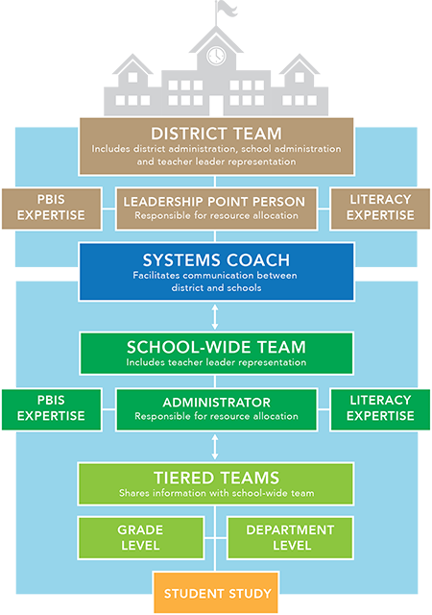
State of Oregon RTI District Leadership Model
Notes:
Trainer Notes:
This is a good illustration of how a district might streamline things with PBIS and RTI. Note that the “Leadership Point Person” could be the district coordinator that we talked about, and the systems coach could be one person, or many, depending on the size of the district. For very small districts, the coordinator could serve in both roles.

Slide 12
The PBIS District Coach
Notes:
Trainer Notes:
As we have discussed before, there will be a district coordinator role, as well as a district coaching role. In small districts, the district coordinator could serve two roles – both coordinator and district coach (e.g., Brookland School District), but with large districts, there will need to be coaches, and each will work with a designated number of schools in the district.

Slide 13
Basic Qualifications Of District Coaches
Fluency with data systems, tools and analysis, and data-based decision making
Knowledge of evidence-based classroom management & instruction
Skill with progress monitoring and communication
Experience training with…
  PBIS.
  school improvement.
  student diversity.
  developing and facilitating staff development activities.
Notes:
Trainer Notes:
District coaches will be helping building teams and coaches to gain fluency and expertise in all these areas.

Slide 14
Responsibilities Of District Coaches
Oversee district…
  Training
  Evaluation
  Coordination
  Coaching
Notes:
Trainer Notes:
These four will be broken down in the next several slides.

Slide 15
1. Training
Build capacity within the district
  Skills
  Knowledge
Develop training calendar
Notes:
Trainer Notes:
District coaches are tasked with meeting the training needs of the schools they are coaching. They must make sure school teams and coaches are building fluency with PBIS philosophy and practices.

Slide 16
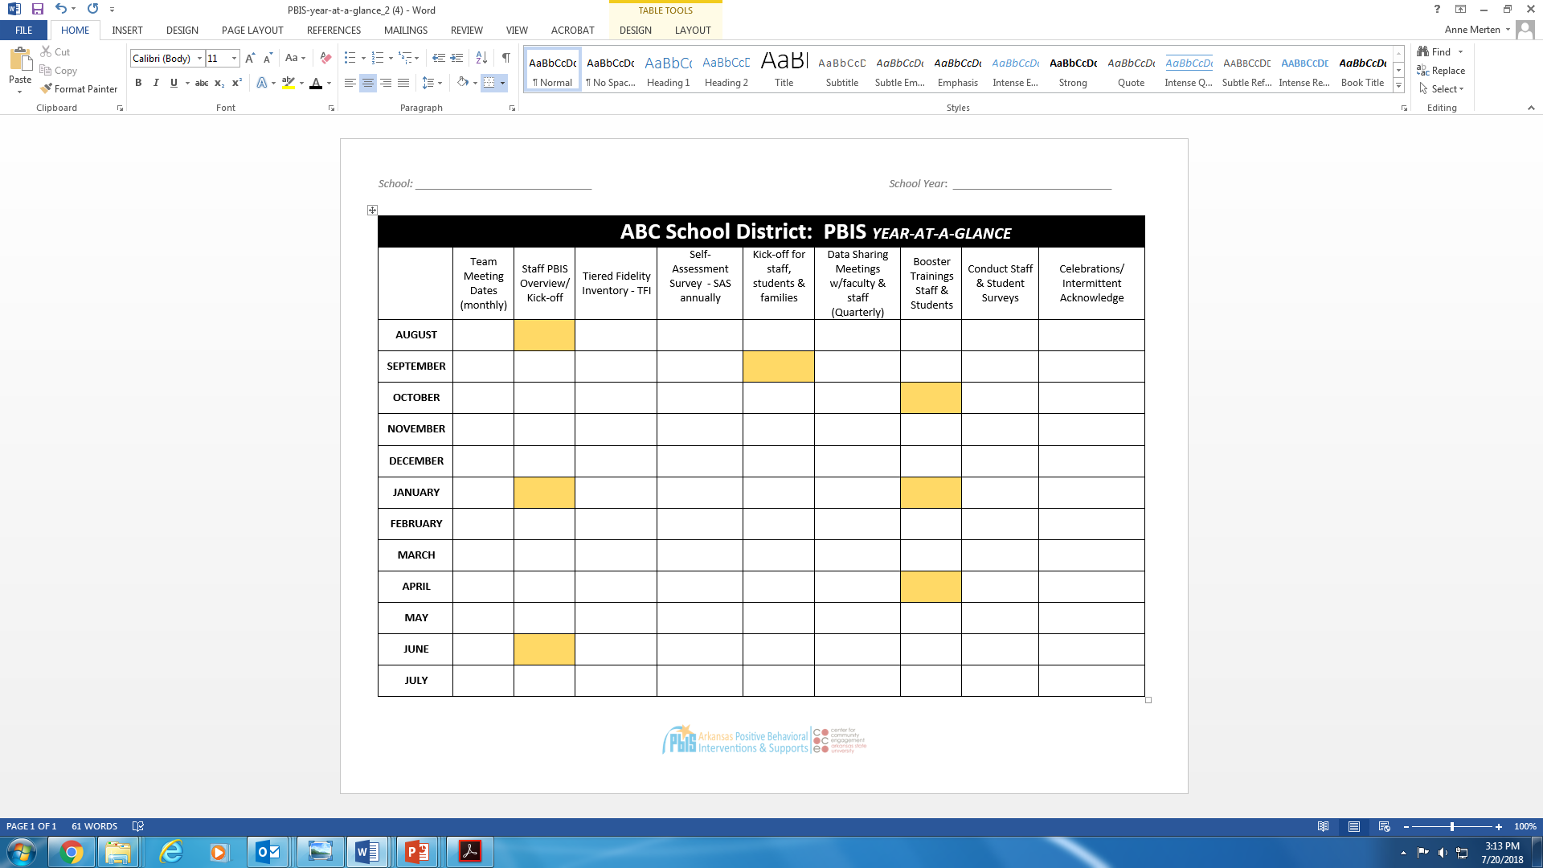
Notes:
Trainer Notes:
This is an example of a yearly schedule for PBIS. The boxes in yellow are suggestions for some items. This matrix will help district teams plan dates for schools in the district to give assessments and will help coaches plan to attend meetings and other important events. It will also serve as a prompt for district teams to follow up with schools after kick-offs and other trainings and review assessments so that they can plan to provide the appropriate support to schools in the district.

Slide 17
2. Evaluation
Conducts needs assessments of schools
Assists schools in completing fidelity assessments
  Examples might include the Self-Assessment Survey (SAS) and Tiered Fidelity Inventory (TFI).
Notes:
Trainer Notes:
In order to provide the appropriate support and training, district coaches depend on regular assessments to understand schools’ needs. District coaches will also be responsible for conducting fidelity assessments throughout the year such as the Self-Assessment Survey (SAS) annually and the Tiered Fidelity Inventory (TFI). The TFI has become the most complete tool for assessing how fully and well schools are implementing PBIS, so it is important that coaches ensure that schools know how to use, and are using, this tool.

Slide 18
3. Coordination
District leadership team meetings
Building team facilitator meetings
Quarterly team meetings
Develop communication systems in layers across district
Notes:
Trainer Notes:
The district coach coordinates meetings within the district (e.g. meetings with building coaches, meetings of the district team), and attends building team meetings. It is also the district coach’s responsibility to ensure that information about PBIS is communicated across the district and in the community.

Slide 19
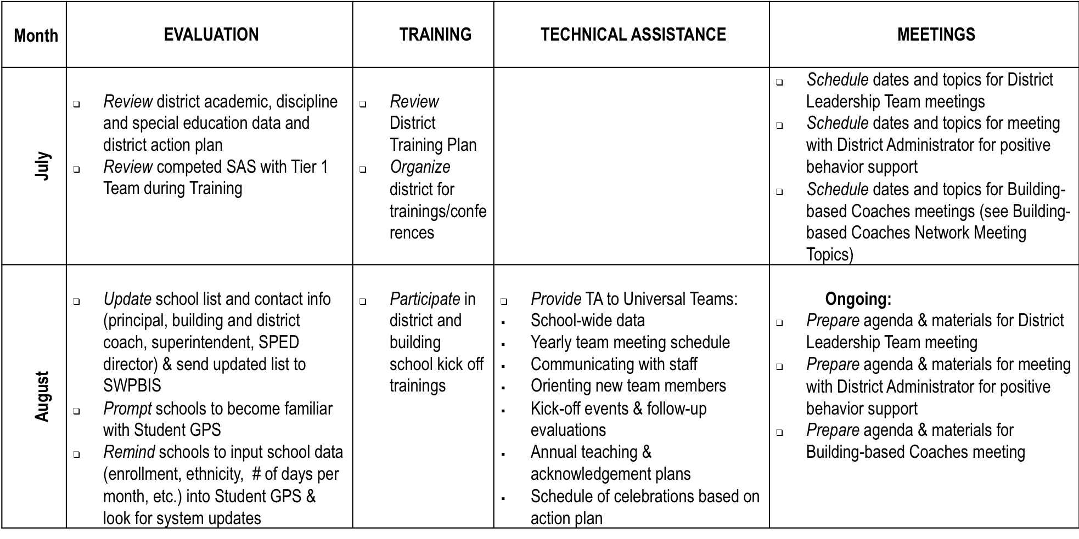
Sample District PBIS
Year-at-a-Glance Guide
Notes:
Trainer Notes:
This is a snapshot of a Year-at-a-Glance example for district coordinators and coaches. Point out a few items that coaches and coordinators may want to do before the school year begins. A full example of an entire year’s worth of plans is in the accompanying handbook.

Slide 20
4. Coaching
Technical assistance at team meetings
  Assists PBIS teams in developing training and coaching plans
  Monitors implementation of plans
Develops coaching service delivery plans
Notes:
Trainer Notes:
We will talk in more depth about coaching in a module dedicated to coaching, but the main points here are that coaches assist teams in learning and honing their skills at conducting team meetings and using data for decision making and progress monitoring. Coaches won’t be conducting the meetings, but rather are there to guide the team in the right direction and help them build fluency with skills.

Slide 21
Summary
Focus of district team: drive district assessment & action planning process; increase capacity in training, evaluation, coordination, & coaching
Team should include members skilled in prevention of problem behavior, development & maintenance of positive behavior, and management & evaluation of resources.
Team needs adequate, sustained funding; ongoing meaningful visibility; political support; coordinator

