Slide 1


Collecting and Using Data for PBIS Tier I Decision Making
Module 9
Anne Merten
Rebecca Hegger
amerten@astate.edu
rhegger@astate.edu
Notes:
Images in this module were obtained at google.com/images unless otherwise specified.
Trainer Notes:
In this module we will discuss the collection and use of data for problem solving and decision making, as well as progress monitoring.

Slide 2
Context
Why use data?
Data for minor behaviors
Data for major behaviors
Consistent procedures for managing problem behaviors
Team problem solving

Slide 3
What Are Data?
Data refer to objective (specific, observable, measurable) information about students, educators, or schools.
Notes:
Trainer Notes:
Data are not mystical or mysterious. They are pieces of information that tell you something. For example, counts of positive or negative behavior are data. Office referrals are data. Grades are data.

Slide 4
Why Use Data for Decision Making?
Notes:
Trainer Notes:
Let’s make a strong case for the use of data when making decisions about behavior.

Slide 5
Uses Of Data In Schools
Guide instruction and intervention
  Fidelity
  Outcomes
  Problem-solving process
  Action plan
  Equity
https://www.pbis.org/topics/data-based-decision-making
Notes:
Trainer Notes:
Data guide instruction and intervention by: assessing how well core features of a practice or systems are being implemented (fidelity), evaluating progress toward desired goals (outcomes), guiding a problem-solving process if adequate fidelity or outcomes are not observed, informing an action plan for improvement, and considering local norms and values in selecting and measuring strategies and ensuring selected strategies support all individuals (equity).

Slide 6
Benefits Of Collecting Data
Measures lost instruction time
Measures lost administrative time
Measures number of students making same mistakes
Helps to make informed decisions
  Identify precise problems
  Place problems into context
Helps to make efficient & effective action plans
Notes:
Trainer Notes:
By collecting data, we can keep an accurate measure of how long students are out of instruction and how much teaching and administrative time are lost. By looking at how many students are making the same mistake, you can evaluate how well your systems are working. Office referral data can be used to help you make informed decisions about supporting students. You can dig into these data to determine more precise problems, which in turn helps you focus your efforts better, making your action plans more efficient and effective.

Slide 7
A Snapshot Of Behavior
Look at discipline referrals and student performance data.
Develop a complete, accurate record of student behavior.
Notes:
Trainer Notes:
By looking at the data we have available, we are able to get a more accurate description of what is going on in the school. We not only take the guess work out of the equation, but we don’t base decisions on input from incomplete sources, such as staff observations, which are often biased, based on their own subjective experience of what happens at school. Having an accurate record of student behavior provides a way to determine what is actually happening school-wide.

Slide 8
Minor Behaviors
Notes:
Trainer Notes:
First, let’s take a look at why and how you can collect and use minor behavior data.

Slide 9
Monitoring Minor Behavior
A systematic way to…
Action plan (classroom & school-wide)
Access services
Self-evaluate effectiveness of strategies
Notes:
Trainer Notes:
By monitoring minor behaviors in the classroom and other school areas, you will have a systematic way to action plan and access staff and specialized services available. This also gives teachers a way to self-evaluate the effectiveness of the strategies they are using. By systematically looking at minor behaviors, you can identify where you will require more teaching, supervision, encouragement, skill development, environmental changes, or even some professional development.

Slide 10
Considerations Beyond Tier 1
Examples: Monitor minor behavior when…
  Student is losing instructional time
  Behavior is occurring frequently
  Intensity of the behavior draws attention
Staff need to maintain documentation.
Notes:
Trainer Notes:
The focus at Tier 1 is the whole school or classroom; however, the data work for Tiers 2 and 3 as well. Define when the decision to monitor minor behavior should occur. Some typical considerations include: 1) the student is losing instructional time because of their behavior, 2) the behavior is occurring frequently, requiring substantial teacher time, or 3) the intensity of the behavior draws attention, causing disruption to activities. Staff will want to maintain documentation to help make decisions on when to engage other supports to address the problem.

Slide 11
Collecting Data For Minors
Keep it simple!
  Use a teacher log
  Use tally forms
  Electronic monitoring software
Data analysis system
  Collect data regularly
  Analyze data
  Share results with stakeholders
Notes:
Trainer Notes:
Collecting minor data does not need to be inconvenient or time consuming. Some easy ways to collect data are using a teacher log, using forms specifically designed to tally minor behaviors as they occur, or employing simple electronic monitoring software. To create a system for analyzing the data, you will need someone who will be responsible for collecting data from all staff regularly and a process for analyzing and sharing the data-based results with stakeholders.

Slide 12
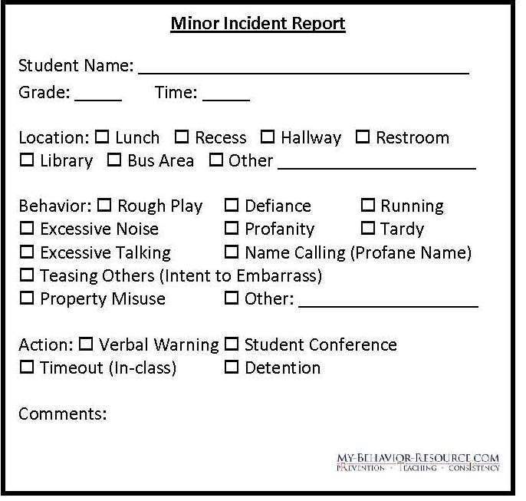
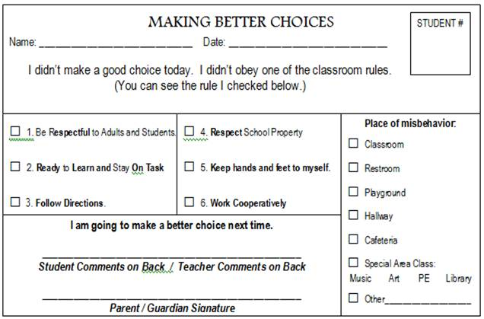
Minor Behavior Report Examples
Notes:
Trainer Notes:
Some schools collect minor incident reports. The form at left is for minors in non-classroom settings, while the form at right is for both non-classroom and classroom use. These could be used as reference for parent teacher conferences, and also down the road if staff want to consider referring students for additional supports (Tier 2 or Tier 3 interventions).

Slide 13
Major Behaviors
Notes:
Trainer Notes:
Now, let’s take a look at office-managed behaviors.

Slide 14
Staff Roles In Referrals (Examples)
Refer only office-managed behaviors
Complete all fields on Office Discipline Referral (ODR) form.
Send student to the office
Notify office
Be prepared to visit with administrator
Accept the student back into class
Notes:
Trainer Notes:
Refer students according to definitions for office-managed behaviors. Thoroughly complete the ODR form and be prepared to visit with an administrator if necessary. Send the student to the office; use an escort or call for help if safety is an issue. Notify the office when a student has been sent. Be prepared to visit with an administrator to determine restitution, make up work, additional interventions, etc. Then, be ready to accept the student back into the class when the administrator determines readiness and ensure a smooth transition for the student.

Slide 15
Prepare Staff For Using ODR Form
Ensure thorough understanding of…
  Referral form(s)
  Role in making referral
  What will happen in the office during and after referral
Notes:
Trainer Notes:
Make sure staff have a thorough understanding of the form or forms used when referring students to the office for behavior. Be sure staff understand their role in making a referral, as well as what will happen in the office during and after the referral, such as problem resolution, possible consequences, data entry, visits to referring staff, etc.

Slide 16
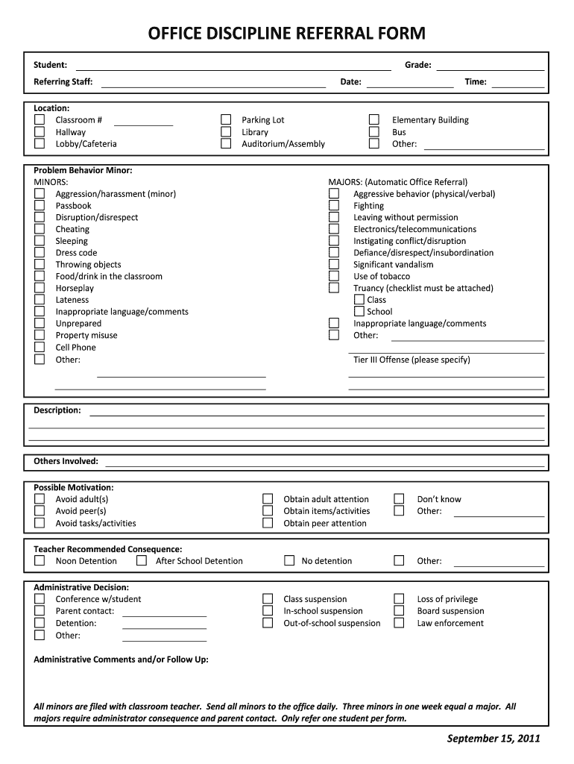
Office Discipline Referral Form Example
Notes:
Trainer Notes:
This particular form can be used to track both minors and majors. The first section of the form lets you record information on who was involved, as well as when and where the behavior happened. The next section of the form lets you easily identify the problem behavior. The third section gives you space to describe the event in more detail, while also giving a best guess as to the student’s motivation for the behavior. The last section is used to document the consequences used and any comments that might help in the problem solving process.

Slide 17
Procedural Chart
What do I do if the behavior was minor?
Sample answers:
  Confer with student
  Re-teach behavior
  Impose classroom consequence
  Inform parents
  Record data
Notes:
Trainer Notes:
Develop a procedural chart so that all staff are consistent in the referral process. This is an example of a question that a procedural chart should answer. Continued on next slide.

Slide 18
Procedural Chart
What do I do if the behavior is major, or a minor behavior has been repeated several times?
Sample answers:
  Refer student to office
  Contact parents
  Assign appropriate consequence
  Possible referral for interventions
  Record data
Notes:
Trainer Notes:
This is another example of a question that needs to be answered through a procedural chart.

Slide 19
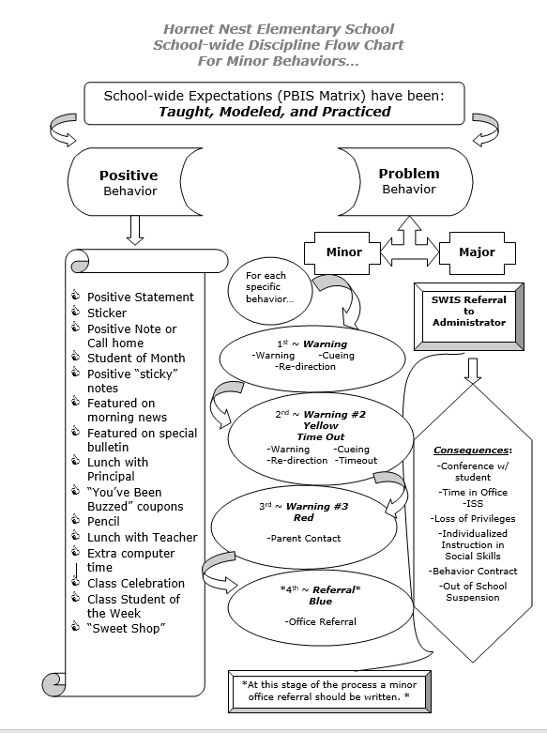
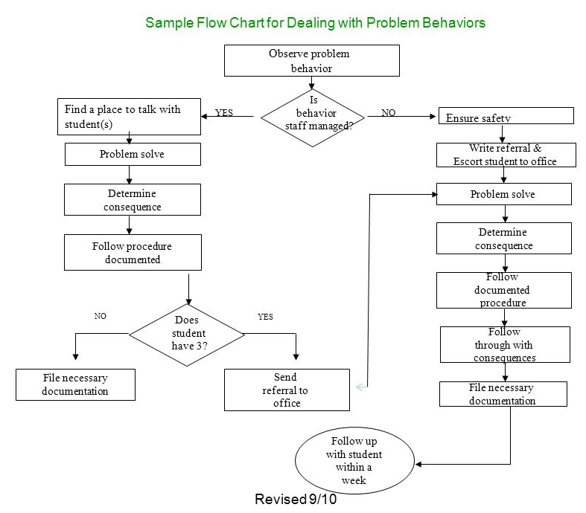
Example
Notes:
Trainer Notes:
These are examples of procedural charts. Notice how the charts begin by asking if the student has had access to Tier I (learning and being reinforced for expected behaviors). From there, depending on whether it’s minor or major, the staff member has a reference for taking the appropriate steps in response. In the second example, there is also a positive behavior flow that may be used to help remind teachers the importance of responding to positive behaviors as well. Note that SWIS is the online School-wide Information System used to help make data decisions.

Slide 20
Team Problem Solving
The heart of the PBIS team meeting
Notes:
Trainer Notes:
We will go into more detail about team meetings in another module. This section highlights the data-based decision making at the heart of the team meeting.

Slide 21
Meeting Goals
Identify, address, and resolve students' social and academic behavior problems.
  At Tier 1, not for individual students
  Focus on big picture
  Only at Tier 2 or 3 is it about individual children
Use data to inform decision making.
Notes:
Trainer Notes:
The main focus of a PBIS team meeting is to problem solve around current behavior data.

Slide 22
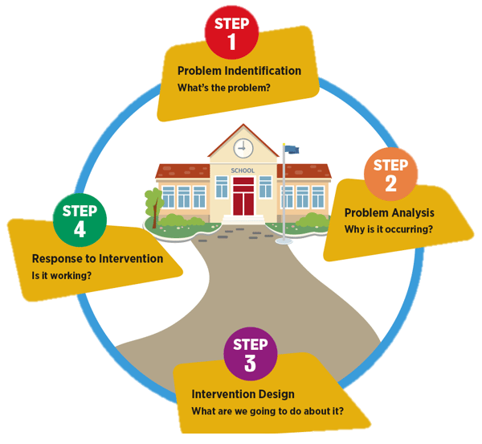
Judy Elliott’s Problem-Solving Process
The Arkansas Division of Elementary and
Secondary Education is using Judy Elliott’s
four-stage problem solving process for all RTI:
Define the problem and set goals
Analyze the problem and hypothesize
Develop and implement the plan
Evaluate the plan
Notes:
Trainer Notes:
DESE promotes the use of Judy Elliott’s problem-solving model to increase consistency and communication within and across schools. Please note that in PBIS, Tier 1 focuses on school-wide issues (all children in the aggregate) and uses aggregate data to identify “hot-spots” in the school—it does not focus on individual children. At Tier 2, the focus can be on individual children.

Slide 23
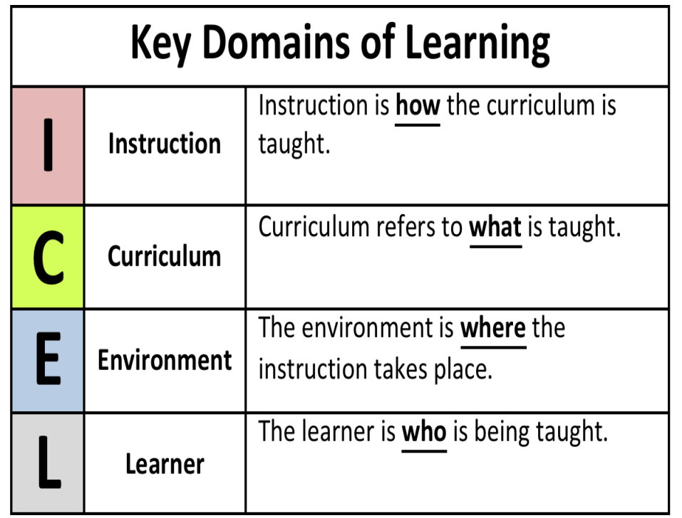
Judy Elliott’s Model (ICEL/RIOT)
http://sscc.dmschools.org/wp-content/uploads/2016/07/Judy-Elliott-Session4-MTSS.DIP_.SIP_.-HOs.pdf
Notes:
Trainer Notes:
Image obtained from http://sscc.dmschools.org/wp-content/uploads/2016/07/Judy-Elliott-Session4-MTSS.DIP_.SIP_.-HOs.pdf. The ICEL/RIOT matrix itself is not a data collection instrument. Instead, it is an organizing framework that increases schools’ confidence both in the quality of the data that they collect and the findings that emerge from the data (Hosp, 2006, May). The leftmost vertical column of the ICEL/RIOT matrix includes four key domains of learning to be assessed: instruction, curriculum, environment, and learner (ICEL). ICEL gives you the types of things to look at, but is flexible. This is a framework for guiding your investigation, not a rigid process. In the PBIS context, there is no curriculum in a strict sense, and the philosophy of PBIS is that the learner is never considered a cause. Rather, you must understand the learner(s) to identify what changes to make to the learner’s environment or how behavior is taught in order to change conditions and contingencies.

Slide 24
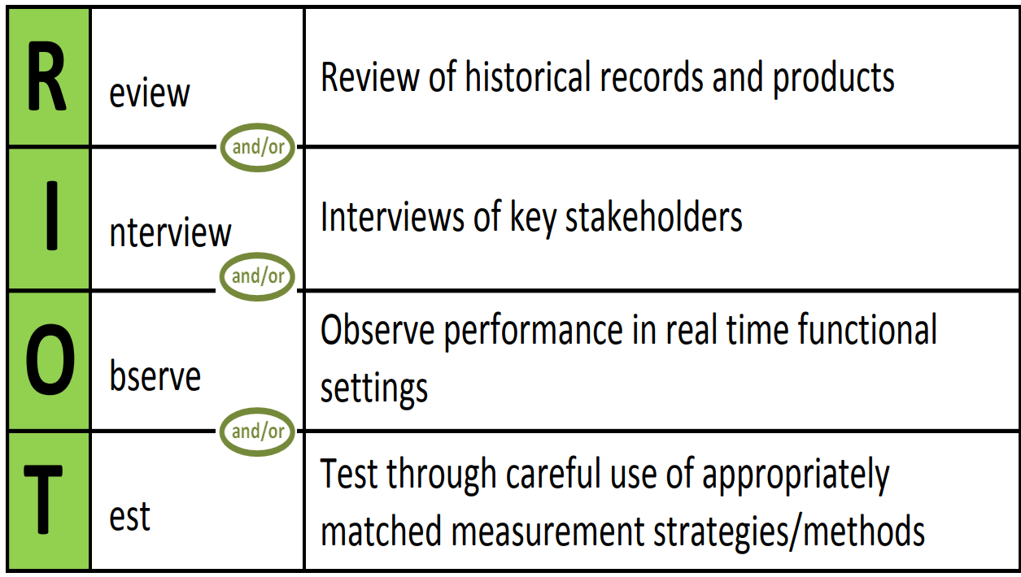
http://sscc.dmschools.org/wp-content/uploads/2016/07/Judy-Elliott-Session4-MTSS.DIP_.SIP_.-HOs.pdf
Notes:
Trainer Notes:
This table includes four potential sources of student information to examine what is not going well: review, interview, observation, and test (RIOT). Schools should attempt to collect information from a range of sources to control for potential bias from any one source. The RIOT sources help validate the hypothesis that is developed in step two of Judy Elliott’s Problem-Solving Process, but other sources of information can and should be used as well.

Slide 25
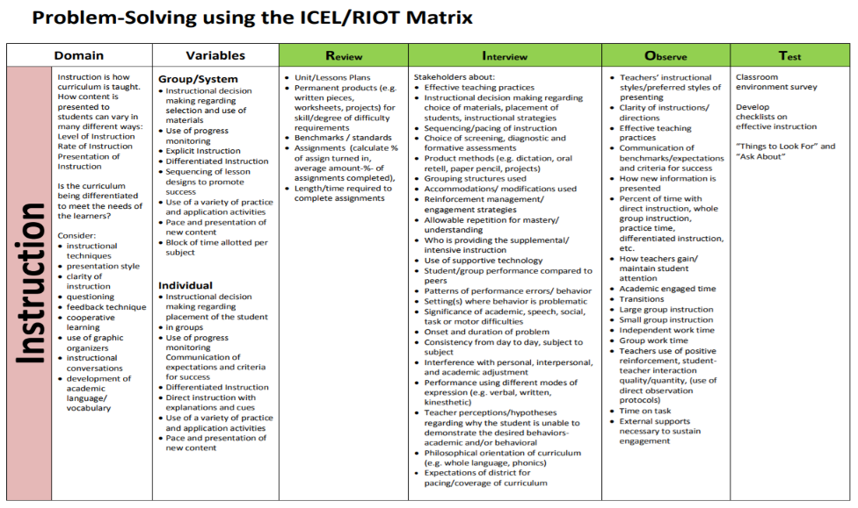
http://sscc.dmschools.org/wp-content/uploads/2016/07/Judy-Elliott-Session4-MTSS.DIP_.SIP_.-HOs.pdf
Notes:
Trainer Notes:
DESE recommends the ICEL/RIOT framework to help educators verify that they have asked the right questions and sampled from a sufficiently broad range of data sources to increase the probability that they will correctly understand a student’s presenting concern(s). Viewed in this way, the matrix is not a rigid approach but rather serves as a flexible framework for exploratory problem solving. There is an additional resource called Team-Initiated Problem Solving (TIPS), developed by the PBIS Technical Assistance Center that helps organize meetings to facilitate discussion. There is special training for this available, but the major focus is on conducting an efficient, effective problem solving team meeting.

Slide 26
Define/Identify A Problem With Precision
What is the problem?
Where is it happening?
When is it happening?
Who is involved?
What is the motivation?
Notes:
Trainer Notes:
A precise problem is a focused problem that can be addressed that will make a big impact without requiring a lot of resources and time invested. Start with one of the above and dig down! Motivation is important in developing hypotheses and effective solutions. You want to make it more rewarding to use appropriate behavior.

Slide 27
Example Of A Precise Problem Statement
There are many referrals for fighting on the playground. Most of these referrals are happening between 9:15 and 10:15 am among 3rd and 4th graders. The motivation appears to be wanting to obtain sports equipment.
Notes:
Trainer Notes:
This problem statement was developed using referrals for fighting (which must have been sparked by data or hypotheses), then sequentially looking for where, when, and who; those on the playground, those between 9:15 and 10:15, and those from 3rd and 4th grade. A good thing to note here is that the motivation might spark additional observation to see if something can be done to the environment, such as adding more equipment or changing the schedule, in addition to re-teaching students the expectations. You want to find lasting solutions. Getting into the practice of looking at motivation will help teams build function-of-behavior assessment skills that will be increasingly used in Tiers 2 and 3.

Slide 28
Data System
You must have a data system that gives you data for problem statements.
Examples:
  Smart Data Dashboard
  School-wide Information System (SWIS)
  PBIS Rewards
Notes:
Trainer Notes:
Arkansas is trying to increase consistency among schools, so you can access their Smart Data Dashboard on from the ADE website at https://dese.ade.arkansas.gov/Offices/public-school-accountability/data-integration/smartdata-dashboard. If a school wants even greater precision (in ADDITION to GPS), another example is the School-wide Information System (SWIS) run by the PBIS group in Oregon (website: https://www.pbisapps.org/products/swis). This link will open an overview page. You can click the “Demos” tab at the top, then click “SWIS Suite” to view an example of the program, including data reports and the “Drill Down” tool.

Slide 29
Identify A Goal For Change
What change is desired? How can you define it?
A goal is a definition of success in the problem solving effort.
A goal will detail the change that is desired and include a timeline.
Guiding questions:
At what point is the identified problem no longer a concern?
At what point is the frequency and duration of the behavior at an acceptable level?
Notes:
Trainer Notes:
Now you need to think about where you WANT the data to be. What is an acceptable level? When will the behavior cease to be a concern? The goal needs to include a time period; how soon do you feel the goal should be achieved?

Slide 30
Example Of A Goal With Timeline
Have a SMART goal:
  Specific
  Measurable
  Achievable
  Relevant
  Timely
Using the precise problem statement from earlier:
  Goal: 75% reduction in referrals for playground fighting in one month.
Notes:
Trainer Notes:
Does it seem achievable to see a 75% reduction in playground fighting? If we look at all playground fighting, what percent fall into the category we defined in our precise problem statement? If we address those students only, is it reasonable to expect a reduction this large in a month’s time?

Slide 31
Identify A Solution, Create A Plan
Guiding questions:
What will you do to bring about the desired change?
How will you remove the barriers to success?
Notes:
Trainer Notes:
Use these guiding questions to start formulating a plan to reach your goal.

Slide 32
Solution Strategies
Prevent: Remove the “trigger”.
Define & teach: Provide instruction in expected behavior (alternative to problem behavior).
Reinforce the expected behavior when it occurs.
Extinction: Withhold reward for the problem behavior, if possible.
Use corrective consequences when problem behavior occurs.
Consider safety issues.
Notes:
Trainer Notes:
These are some generic solution strategies: Prevent – Remove or alter the “trigger” for problem behavior. Define & teach – Define behavioral expectations and provide demonstration/instruction in expected behavior (alternative to problem behavior). Reward/reinforce the expected/alternative behavior when it occurs; prompt for it as necessary. Withhold reward/reinforcement for the problem behavior, if possible (“Extinction”). Use non-rewarding/non-reinforcing corrective consequences when the problem behavior occurs. Consider safety issues.

Slide 33
Create A Plan
Use solution strategies
Include WHO will do WHAT by WHEN and a plan to EVALUATE progress.
Notes:
Trainer Notes:
The plan needs to include a prevention component, a teaching component, an acknowledgement component, and appropriate consequences. You must outline and assign roles, state a specific date and goal, and select a method for evaluating progress.

Slide 34
Example: Trevor Test Middle School
Precise problem statement:
Many instances of disruption are occurring in the cafeteria between 11:30 AM and 12:00 PM with a large majority involving 6th graders.
Hypothesis:
Cafeteria overcrowded
6th graders with insufficient instruction in cafeteria expectations
Attention from adults and peers rewarding disruption
Notes:
Trainer Notes:
This slide and the next two show an example of using a precise problem statement and hypothesis to create an action plan for reducing problem behavior. The hypothesis was developed through observation and data.

Slide 35
Prevent “Trigger” | Change lunch schedule so fewer students are eating between 11:30 AM and 12:00 PM.
Define & Teach | Focus on 6th graders- define cafeteria expectations, develop and post expectation signage in cafeteria, demonstrate and teach expectations.
Reward/Reinforce | Set up “Friday 5” (extra five minutes of lunch time on Friday, if no ODRs occur in cafeteria during lunch time).
Withhold Reward (Extinction) | Ensure staff don’t argue back and forth with student if instance of disruption occurs (may be an inadvertent reward); remind students that paying attention to a disruptive student can mess up “Friday 5”.
Corrective Consequence | Ensure active supervision during lunch (possibly add one supervisor between 11:30 AM and 12:00 PM); ensure quick corrective consequence, per our handbook.
Safety
Notes:
Trainer Notes:
Using the solution strategies from slide 32, the above plans were developed. The next slide shows an example of a full action plan, complete with a goal, timeline, persons responsible, etc.

Slide 36
Notes:
Trainer Notes:
This is an example of a problem-solving action plan that starts with the precise problem statement and hypothesis and includes all the components: prevention, teaching, recognition, extinction, corrective consequences, roles assigned, date set, and a method for measuring progress.

Slide 37
Implement The Solution With Integrity
Was the intervention implemented as planned?
The plan has to be implemented correctly before you can determine its effectiveness.
Use data from previously determined sources (e.g., checklists, observations).
Notes:
Trainer Notes:
When evaluating progress, it’s important to make sure everything was done with fidelity. Have a method for staff to report what they have done. For example, if you ask all classroom teachers to re-teach an expectation daily for two weeks, give them a simple way of reporting back to you that they did this – maybe a checklist that they will return to someone’s mailbox at the end of the two weeks.

Slide 38
Monitor The Impact Of The Solution
Did the plan work? Are we solving the problem?
Has the desired goal been achieved?
Use data to determine the impact the plan is having.
Notes:
Trainer Notes:
Go back to your data to see if you are seeing results. At the end of the determined timeline have a data report ready to discuss with team members. The team will then decide whether this problem has been solved, or if the plan needs revising.

Slide 39
Evaluate & Make A Decision
Look at the big picture!
What should you do next?
  Do you need to modify the strategy to make a stronger impact?
  How do you maintain the goal, once you reach it?
  Do you need to revise the goal?
  Was the solution as feasible as you thought?
  Do you need to redefine the precise problem?
Notes:
Trainer Notes:
When evaluating your plan at the determined deadline, using the determined method, you have to once again make a decision. Use the questions above. This is a continuous process: progress monitoring previous action plans, developing new action plans, and making decisions based on current data.

Slide 40
Do It With Fidelity!
Tiered Fidelity Inventory (TFI)
Efficient, valid index of extent to which PBIS core features are in place
Section 1.12 Discipline Data
Section 1.13 Data-Based Decision Making
Notes:
Trainer Notes:
The TFI is an important tool in the PBIS implementation process. It can be used in the development stage, and then used in an ongoing manner to ensure all core features are in place. The TFI highlights each critical component of PBIS.

Slide 41
1.12 Discipline Data
Subscale: Evaluation
Feature | Data Sources | Scoring Criteria
 |  | 0 = Not implemented 1 = Partially implemented 2 = Fully implemented
1.12 Discipline Data: Tier I team has instantaneous access to graphed reports summarizing discipline data organized by the frequency of problem behavior events by behavior, location, time of day, and by individual student. | School policy Team meeting minutes Student outcome data | 0 = No centralized data system with ongoing decision making exists. 1 = Data system exists but does not allow instantaneous access to full set of graphed reports. 2 = Discipline data system exists that allows instantaneous access to graphs of frequency of problem behavior events by behavior, location, time of day and student.
Main Idea: Teams need the right information in the right form at the right time to make effective decisions.

Slide 42
1.13 Data-Based Decision Making
Subscale: Evaluation
Feature | Data Sources | Scoring Criteria
 |  | 0 = Not implemented 1 = Partially implemented 2 = Fully implemented
1.13 Data-based Decision Making: Tier I team reviews and uses discipline data and academic outcome data (e.g., Curriculum-Based Measures, state tests) at least monthly for decision making. | Data decision making for non-responders Staff professional development calendar Staff handbook Team meeting minutes | 0 = No process/protocol exists or data are reviewed but not used 1 = Data reviewed and used for decision making, but less than monthly 2 = Team reviews discipline data and uses data for decision making at least monthly. If data indicate an academic or behavior problem, an action plan is developed to enhance or modify Tier I supports
Main Idea: Teams need the right information in the right form at the right time to make effective decisions.

Slide 43
Summary
Collect data regularly.
Analyze data regularly and develop precision statements.
Meet with the team regularly to discuss data and make decisions.
Develop specific action plans and progress monitor.

Slide 44
Resources
PBIS Apps
www.pbisapps.org
Supporting and Responding to Students’ Behavioral Needs http://www.pbis.org/common/cms/files/pbisresources/Supporting%20and%20Responding%20to%20Behavior.pdf
Supporting and Responding to Educators’ Implementation Needs https://www.pbis.org/resource/supporting-and-responding-to-educators-classroom-pbis-implementation-needs-guide-to-classroom-systems-and-data
Notes:
Trainer Notes:
Here are links to PBIS Apps, Supporting and Responding to Student Behavior: Evidence-Based Classroom Strategies for Educators, and PBIS Technical Guide on Systems to Support Educators' Implementation of Positive Classroom Support.

